Slide 1
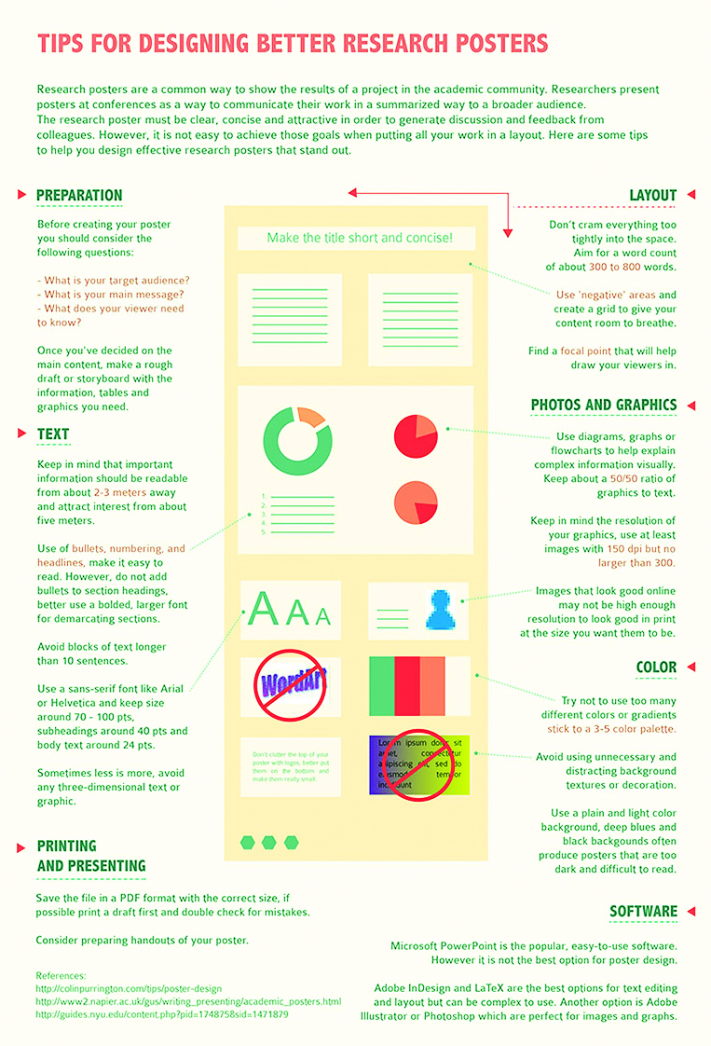
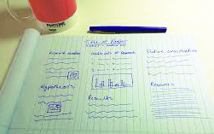
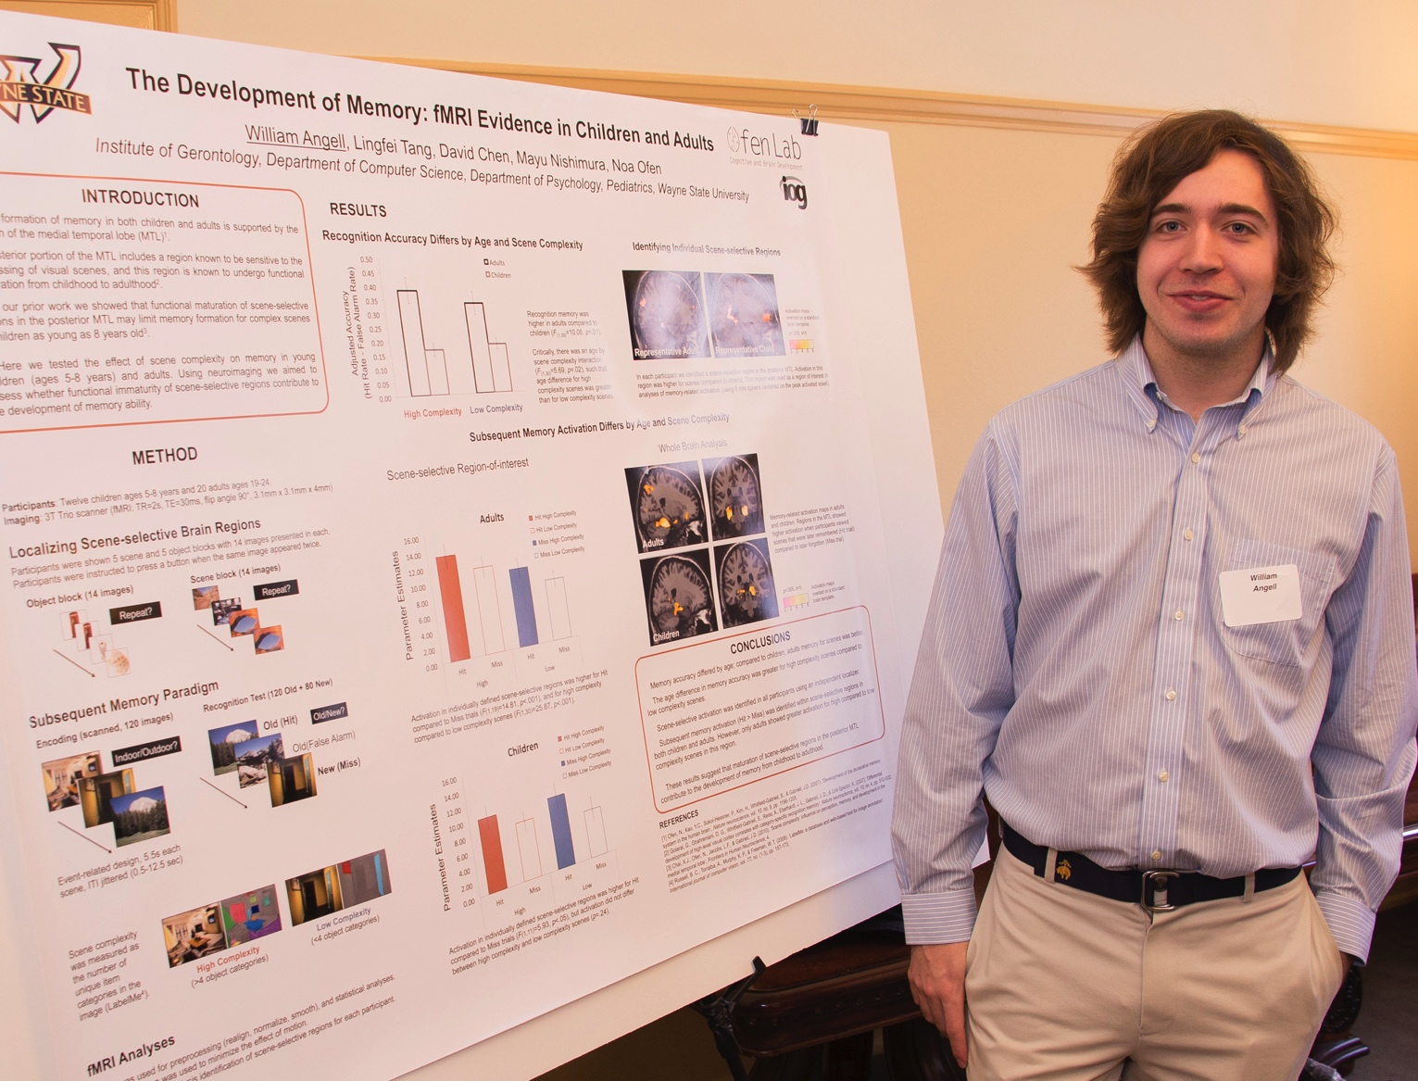
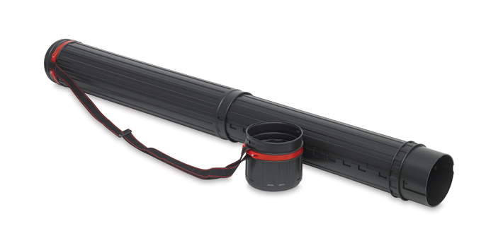
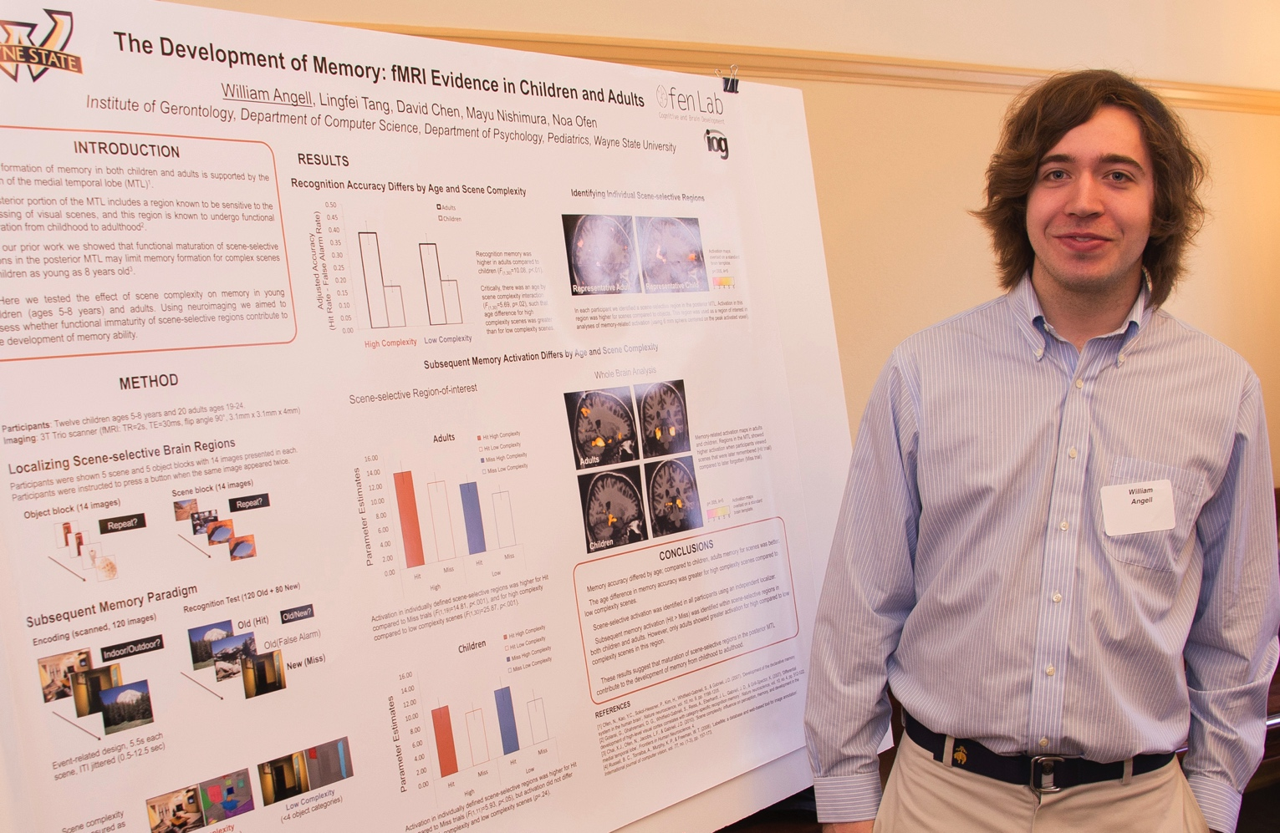



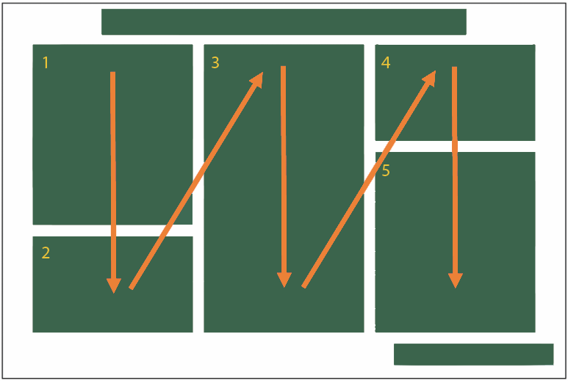
Research Title Should be Concise, With Size of 72-100pts
Presenter name, Associates and Collaborators
WAYNE STATE UNIVERSITY, INSTITUTE OF GERONTOLOGY | DEPARTMENT OF …....
INTRODUCTION
METHODS
OUTCOMED MEASURES
RESULTS
http://rgs.usu.edu/undergradresearch/posters/#iLightbox[gallery_image_1]/-1
http://cfaes.osu.edu/brand/research-poster-templates
https://www.asantcafe.ca/learn/program/5
http://justinlmatthews.com/posterhelp/posterguide/
This editable template is in the most common poster size (48” x 36”) and orientation (horizontal); check with the conference organizers for specific conference requirements regarding exact poster dimensions.
Once you decided on your content, Before you start working in the power point sketch out your poster on a piece of paper. If you are working with a mentor it is a good time to show them this.
Photos or Drawings
Images should be 100 to 200 dpi in their final size, or use a rule of thumb of 2 to 4 megabytes of uncompressed. For instance, a 3x5 photo that will be 6x10 in size on the final poster should be scanned at 200 dpi.
• For line art, text, illustration or cartoons, 225 dpi is a good resolution.
• Best image files to insert are JPEG or TIFF. JPEGS are best because
the files are much smaller>
• DO NOT enlarge images once they are in Powerpoint
• Do not use images from the web
• Very large images may show on your screen but PowerPoint cannot print them.
• If you are scanning images, be sure to save at 150 – 300 dpi
Preview
To see your in poster in actual size, go to view-zoom-100%. Posters to be printed at 200% need to be viewed at 200%.
This image helped determine using orange
as an accent color in charts.
And also the pale gold witch supports the WSU brand.
Plan Plan Plan
Printing
To place your order, contact _________________
Plan ahead; allow at least _____ business days for Printing Services to complete the order.
Information regarding cost ______________
Creating a poster is a multiple-step process:
    • Look at templates and
    • Create a messageREATE A MESSAGE
    • ReviewEVIEW
    • Print
    • Present
• What is your main messages?
• What does your viewer need to know?
• Allow at least _____ Days to create your poster
• ___ Days for printing
• Time for someone else to proof
Captions to be set in italic font, between 18 and 24 points. Right aligned if it refers to a figure on its right. Caption starts right at the top edge of the picture (graph or photo)..
Tips for Writing Copy & Determining Graphics
Graphic Guidelines for Font Use
Craft the Take-Away Message
2. Summarize Key Supporting Information
3. Make Your Poster Easy to Read
• Avoid wordiness, unnecessary jargon, and abbreviations
• Use the active tense.
• Keep text fewer than 10 lines long
• Use bullet points instead of using full paragraph
(not all…)
• Emphasize key words with boldface or italics, (avoid
underlining) but do so sparinly
• Spell check all text and have trusted and have a
colleague(s) proofread.
4, Create a Logical Visual Flow (Typically left to right)
• Main title 70-100 pts .
• Subheads around 40 pts.
• Copy Text 24 pts (min. 16)
• Establish your sizes for each and stay consistent
• Avoid all caps in long headlines and underlining text.
• Avoid any additional over stylized text. Your graphic
interest should come from charts & photos
CONCLUSIONS
We have created this template with scientific researchers in mind. We encourage any comments or suggestions so that we can continue to update and improve this template.
E-mail name@wayen.edu with suggestions.
Graphs and Charts
• For simple graphs use MS Excel, or do the graph directly in PowerPoint.
• Graphs done in a scientific graphing programs (eg. SPSS
should be saved as JPEG or TIFF if possible.
As a general rule, less is more.
And wordart Is too much
1:1
Image to Text Ratio
1 : 1
Image to Text Ratio
BIBLIOGRAPHY
Use of charts and imagery and color selection
References. lum exer adipsustrud doloree tuerat lorpera esenibh eu faccum eum iuscili quamcommy nit lorerillut ullam quat lore verostrud ming et, si tie faciliquisse modolortin volore
vel et vel dionsenit adit, consenim zzrillute el euguerostie faci bla conse minim zzriure tio dolore tet, volobor si.
Velit vendipit, quat iustrud eraeseniat do conummod ea alisci tie vel ea commodo lortis aliquamcommy niat aliquat niam ercillan eu feugue magnisl utpat autat.
Ut nostionsed molobore feugiam quiscing exeraese ting etue dit atetum ipsum inim ex exercin cincincinci et lut incinis er in
Color
Captions to be set in italic font, between 18 and 24 points. Alien text flush against image. Caption starts t at the top edge of the picture (graph or photo).
This template is four columns but can be altered according to your needs.
• You should have on dominent color
• Establish Your main color according to your branding
• Limit additional colors and take a que from photos and
graphics you have selected.
• Avoid long numerical tables
small copyIm ipit, quam aliquis nullan volobor am quat vulla faci bla feuisl ea facidunt luptatin ut prat. Henim do conse feum nim velessim nulla augiat, quat acil ulla acin henim irit alit praesto commod te doloborperos acilla facincin henit lan henim ilit atincil laortisl enit praestie molore feugiam ver in eummy nos dolortisi bla faci Rit dolesendus, tet endenis ea volupta eperere ssenem nam hictus.
ACKNOWLEDGEMENTS
Check to make sure you’ve acknowledged partner and funding agencies, either with text or with their logos.
Copyright Guidelines visit: Give a URL hot link
UNIT/PROGRAM/COUNTY NAME 1
UNIT/PROGRAM/COUNTY NAME 2
UNIT/PROGRAM/COUNTY NAME 3

