Slide 1
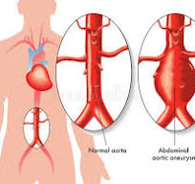
Abdominal Aortic Aneurysm(AAA) 2025
Written by Dana Rizzo RN, BSN, ACM-RN
Dana.Rizzo@singhmail.com

Slide 2
Objectives: Upon completion of this presentation the learner will be able to:
Describe the Histopathology of Abdominal Aortic Aneurysms (AAA).
Identify the location for most of the Abdominal Aortic Aneurysms (AAA) relative to the origin of the renal arteries.
List lifestyle changes patients diagnosed with AAA can take to lessen the risk of rupture.
Discuss Acute Aortic Dissection (AAD) and what pathology occurs.
Describe the difference between an Open Surgical Repair for AAA and the EVAR procedure.
Summarize how interdisciplinary team management can improve the diagnosis, management, and outcomes for patients with AAA.

Slide 3
Abdominal Aortic Aneurysm (AAA) Defined
Abdominal Aortic Aneurysm(AAA) is an abnormal focal dilation of the abdominal aorta, it is a life-threatening condition that requires monitoring and treatment depending on its size and/or symptomatology.
An aortic aneurysm occurs when the walls of the main blood vessel(aorta) that carries blood away from the heart bulge or dilate. Aneurysms can occur in any area of the aorta, but the abdomen is the most common site.
According to JAMA an abdominal aortic aneurysm is defined as” aortic enlargement with a diameter of 3.0 cm or larger.”
The normal size of the abdominal aorta is 1.5 cm to 2 cm in diameter.
The prevalence of AAA has declined over the past 2 decades among screened men 65 years or older in various European countries.
The US Preventive Services Task Force(USPSTF) has been meeting to determine the criteria needed for the screening of people in the Unites States.
Most AAAs are asymptomatic until they rupture.
The risk of rupture varies depending on aneurysm size, and the associated risk for death is as high as 81 % if they do rupture. (USPSTF 2019).
An abdominal aneurysm normally grows slowly about 1 to 2 mm per year.

Slide 4
The US Preventive Services Task Force (USPSTF) Study
Objective: The USPSTF must update their 2014 recommendation and commissioned a review of the effectiveness of a 1-time and repeated screening for AAA, the associated harms of screening, and the benefits and harms of available treatments for small AAAs (3.0-5.4 cm in diameter)identified through screening.
The recommendation applies to asymptomatic adults 50 years or older. However, most of the studies focused on men aged 65-75 years.
The evidence assessment, based on review of the evidence, the USPSTF concludes with moderate certainty, that screening for men 65-75 years who have “ever” smoked (100 cigarettes or more) is of moderate net benefits.
The USPSTF concludes with moderate certainty that screening for AAA in men aged 65-75 years who have never smoked is of small net benefit.
The USPSTF concludes that the evidence is insufficient to determine the net benefit of screening women ages 65-75 years who have “ever” smoked (100 cigarettes or more) or have a family history of AAA.
The USPSTF concludes with moderate certainty that the harms of screening for AAA in women aged 65-75 years who have never smoked and have no family history of AAA outweigh the benefits.

Slide 5
Cardiovascular Review

Slide 6
Anatomy of the Aorta

Slide 7
Aortic Anatomy Review

Slide 8
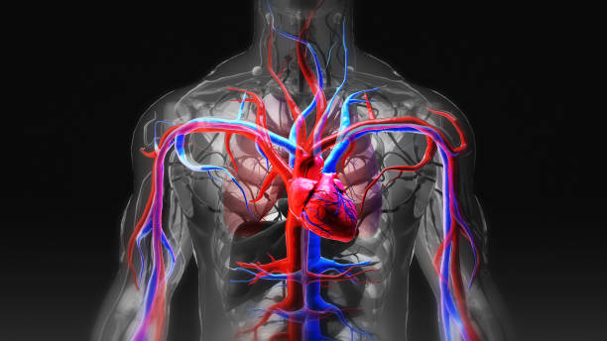

Slide 10
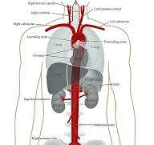

Slide 11
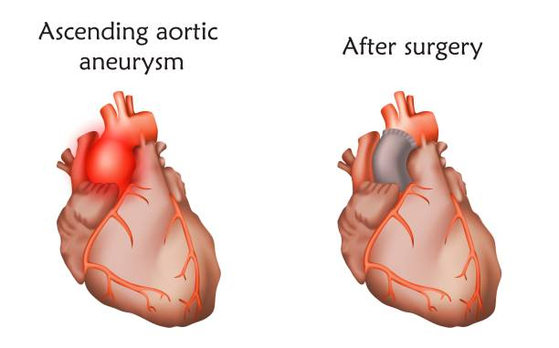

Slide 13
Abdominal Aortic Aneurysm

Slide 14
Etiology for AAA
Risk Factors for AAA include:
Family History: can be as high as an 18% risk for males in the family.
Atherosclerosis: (most common)
Smoking : Risk is directly related to years smoked and decreases in the years following smoking cessation.
Advanced Age: (over 60 years old, Peaks in the 70- and 80-year range) 1 person in 1000 develops AAA between 60-65 . This number rises with age.
Male Gender: 4-5 times more likely than women.
White Race: Develop AAA more commonly than people of other ethnicities.
Hypertension: related to Atherosclerosis.
Hypercholesterolemia: Leads to CAD and PVD, leading to AAA.
Prior history of Acute Aortic Dissection (AAD)

Slide 15
Other Etiologies/Causes of Aortic Abdominal Aneurysm
Cystic Medical Necrosis : (CMN) disorder of large arteries, accumulation of cyst like lesions in the aorta.
Syphilis: (causes vasculitis)
Cocaine use: (causes vasculitis)
HIV: (causes vasculitis)
Connective tissue diseases: (Ehlers-Danols, Marfan, Loeys-Dietz Syndromes)
Diabetes : increased risk of atherosclerosis
An abrupt, transient, severe increase of blood pressure: ( ie. Strenuous weight lifting, use of cocaine, ecstasy, energy drinks, stimulates the sympathomimetic nervous system).

Slide 16
Classification of Aortic Aneurysm: Based on location

Slide 17
Types of Aneurysm

Slide 18
Types of Aneurysm

Slide 19
Abdominal Aortic Aneurysms may be detected incidentally or at time of rupture. An arterial aneurysm is defined as a permanent localized dilatation of the artery (vessel) by at least 150% compared to a relatively normal adjacent diameter of that artery.

Slide 20
Infrarenal Aneurysm

Slide 21
What is Acute Aortic Dissection (AAD)?
Acute Aortic Dissection (AAD) is uncommon, but when it does occur it is catastrophic.
AAD is due to the separation of layers of the aortic wall. A tear in the intimal layer results in the progression of the dissection (either proximal or retrograde) chiefly due to the entry of blood between the intima layer and the media layer of the aortic wall. Occurs more in women (Mayo 2023)
AAD is associated with a high mortality rate . The majority of the patients die before reaching the hospital.
Patients with a chronic aortic dissection(more than two weeks) have a slightly better prognosis .
Symptoms of AAD:
Abrupt onset of severe “tearing” chest pain. Physicians correctly suspect the diagnosis in as few as 15% to 43% of cases of verified AAD. If left untreated, mortality approaches 50% in the first 48 hours of onset.
Two Classification Systems are used for AAD:
1. The Stanford System: Type A (Involves ascending Aorta, dissection proximal to brachiocephalic artery)or Type B ( aortic dissection originating distal to the left subclavian artery involving only the descending aorta).
2. The DeBakey Classification is based on the site of origin of the dissection.
(National Library of Medicine , NIH, NCBI Jan. 2023)

Slide 22
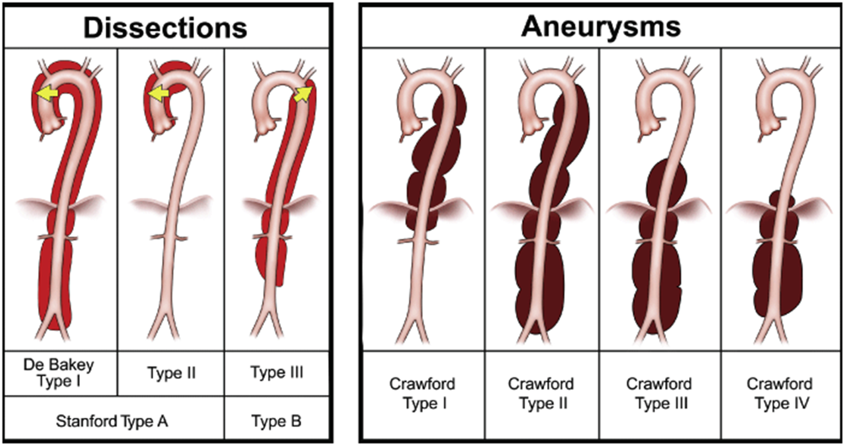
Aortic Anatomy Review

Slide 23
Aortic Anatomy Review

Slide 24
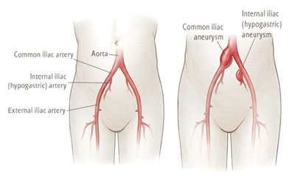
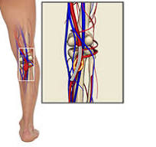
History and Physical continued
Doctors should look for other associated aneurysms.
Iliac Artery Aneurysm (Most common associated to the AAA).
Peripheral Aneurysms are also associated with approximately 5% of patients, of which popliteal artery aneurysms are also common.

Slide 25
Abdominal aortic infrarenal iliac artery aneurysm (Infrarenal-below the kidneys)

Slide 26
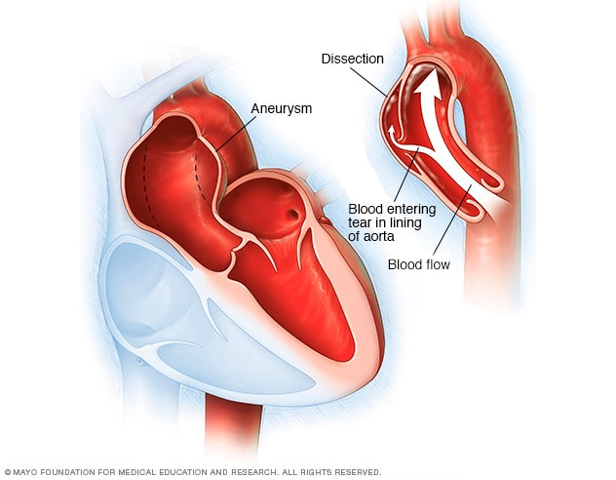
Acute Aortic Dissection (AAD) Aneurysms

Slide 27
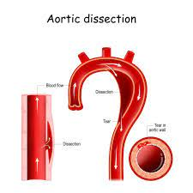
Acute Aortic Dissection (AAD)

Slide 28
Aneurysm enlargement
Aneurysm enlargement follows a pattern of progression with the stability of the size for some time and then a more rapid enlargement.
A Small AAA (3-5 cm in diameter) enlarges between 0.2 to 0.3 cm/year.
Aneurysms of greater than 5 cm in diameter grow 0.3 to 0.5 cm/year.
Law of Laplace: The pressure on the aortic wall follows the Law of Laplace, wall stress is proportional to the radius of the aneurysm.
Accordingly, the larger aneurysms are at higher risk of rupture, and the presence of hypertension also increases the risk.

Slide 29
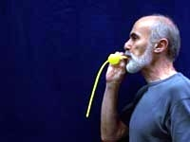
Aneurysm enlargement: Law of Laplace
How it works:
Laplace's law for the gauge pressure inside a cylindrical membrane is given by ΔP = γ/r, where γ is the surface tension and r the radius of the cylinder. Note the inverse relation between pressure and radius.

Slide 30
Aneurysm Size, strongest predictor of the risk for rupture
A statement from the Joint Council of the American Association for Vascular Surgery and Society for Vascular Surgery estimated the annual rupture risk according to the AAA diameter to be the following: Follows Law of Laplace.
Less than 4.0 cm in diameter – 0% risk of rupture
4.0 cm to 4.9 cm in diameter – 0.5% to 5% risk of rupture
5.0 cm to 5.9 cm in diameter- 3% to 15 % risk of rupture
6.0 cm to 6.9 cm in diameter – 10% to 20% risk of rupture
7.0 cm to 7.9 cm in diameter- 20% to 40 % risk of rupture
8.0 cm in diameter or greater – 30% to 50% risk of rupture

Slide 32
Pathophysiology of AAA
AAA tend to occur when there is a failure of the structural proteins of the aorta. What causes these proteins to fail is unknown, but it results in the gradual weakening of the aortic wall. The decrease in structural proteins of the aortic wall, such as elastin and collagen, has been identified in several studies.
The composition of the aortic wall is made of collagen and elastin lamellar units.
The number of lamellar units is lower in the infrarenal aorta than in the thoracic aorta.
This is felt to contribute to the higher incidence of aneurysmal formation in the infrarenal aorta. Infrarenal means just below the kidneys.
A chronic inflammatory process in the wall of the aorta has been identified, but is of unclear etiology.
(Parry DJ, Al-Barjas HS, Chappell L, Rashid ST, Ariens RA, Scott DJ, Markers of Inflammation in men with small AAA. J Vasc Surg. 2010)

Slide 33
Histopathology of AAA
Histopathology refers to the study and diagnosis of diseases of the tissues.
Autopsy studies show a marked degeneration of the media of the aorta.
Resected AAA usually show a marked increase of chronic inflammation with an infiltrate of neutrophils, macrophages, and lymphocytes.
The media wall of the aorta is often thin, and there is evidence of degeneration of the connective tissue.

Slide 34
Aortic Anatomy Review

Slide 35
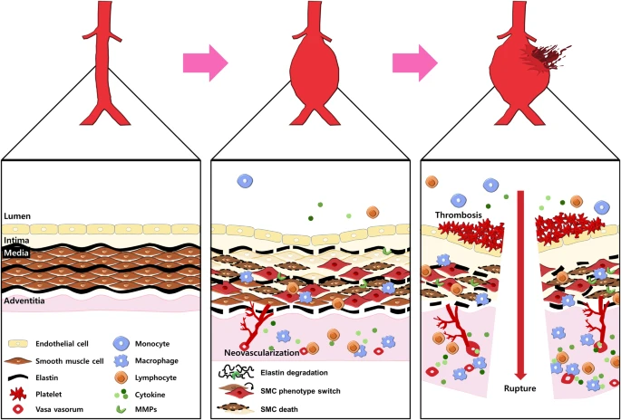
Collagen and Elastin Lamellar Units

Slide 36
Evaluation of AAA
Diagnosis of AAA is usually made with ultrasound (US) , often used for screening.
Ultrasound is less accurate for finding aneurysms above the renal arteries, because of the overlying air-containing lungs and viscera.
CT scan is still needed to determine exact size, location, and involvement of other vessels and the imaging of asymptomatic patients.
CTA (computerized tomography angiography)requires use of ionizing radiation and IV contrast.
Magnetic resonance angiography can be used to delineate the anatomy and does NOT require ionizing radiation.
Most of these Aneurysms are located below the origin of the renal arteries (Infrarenal).
They may be classified as saccular (localized) or fusiform(circumferential).
More than 90% of AAA are fusiform.
Inflammatory Abdominal Aneurysms are characterized by intense inflammation, a thickened peel, and adhesions to adjacent structures. CT scans can find these better than angiography.
MRA can be used for patients allergic to contrast media.
An echocardiogram is recommended as many patients have associated heart disease.
(NCBI Bookshelf, AAA, 2023)

Slide 37
Evaluation of AAA continued:
Routine lab work
Type and Cross match for blood, if surgery is indicated
Comorbidities like COPD, Diabetes, Heart Disease, require that patients be cleared for surgery by their specialists.

Slide 38
History and Physical
Most AAA are found incidentally during an examination for another medical issue.
Most patients are asymptomatic.
Palpation of the abdomen usually reveals a non-tender, pulsatile abdominal mass. Enlarging aneurysms can cause symptoms of abdominal, flank, or back pain.
Compression of adjacent viscera (organs) can cause gastrointestinal (GI) or renal manifestations.
Rupture of an AAA is life threatening.
Many patients present in shock, often with diffuse abdominal pain and distention of abdomen.
On physical exam the patient may have tenderness over the aneurysm or demonstrate signs of embolization.
They may present with a GI bleed due to the aneurysm bleeding into adjacent viscera or vessels.
They may present in Heart Failure due to the aorta caval fistula (bursting heart syndrome) where the
AAA erodes into the inferior vena cava .

Slide 39
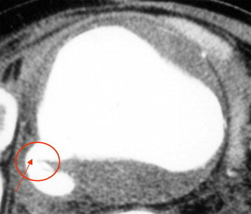
Large aortic aneurysm and aorto-caval fistula.

Slide 41
Plain film of a lumbar spine in a patient with lower back pain (A) demonstrates a large calcified aortic aneurysm (arrow). Follow up CTA and 3D images (B,C,D) demonstrate a large partially thrombosed infrarenal aortic aneurysm (arrow). CTA, computed tomography angiography.

Slide 42
Treatment and Management
Treatment is recommended when the diameter of the aneurysm reaches 5 to 5.5 cm, has demonstrated as rapidly enlarging for greater than 0.5 cm over 6 months, or becomes symptomatic. (Law of Laplace).
Open surgical repair via transabdominal or retroperitoneal approach has been the gold standard.
Endovascular repair from a femoral artery approach is now applied for most repairs, especially in older and higher risk patients.
Endovascular therapy is recommended in patients who are not candidates for open surgery.
This includes patients who have severe heart disease and other comorbidities that preclude open repair.
A ruptured AAA warrants emergency repair. Endovascular approach is used if suited.
Mortality rates remain high, but depends on patient’s age, presence of renal failure and status of Cardiopulmonary system.
( Outcome of Currently Available Endographs for the Treatment of Infrarenal AAA 2018)

Slide 43
Open surgical correction of AAA
Open surgical correction of AAA involves opening the aortic aneurysm, sewing a graft into the aneurysmal section , and then closing the aneurysm with a graft. The aneurysm is NOT removed, rather the aneurysmal segment is “grafted” replacing it with a prothesis made of synthetic material( graft) that is sutured into place. This will allow blood to flow normally, and the artery wall is used to cover the graft.
Planned or elective surgery reduces the risk of rupture of large AAA, and graft failure in uncommon.
Takes 2-4 hours for surgery
Post-op patients are taken to intensive care unit for monitoring.
Catheters in place are;
Urinary catheter to drain urine
Arterial catheter to monitor b/p
Central venous catheter to monitor pressures in the heart
Epidural catheter for pain management
Nasogastric tube (NG) to keep the stomach empty
Discharged home after 4-7 days and can return to normal ADL in about 4 weeks.
(Ronald, Dalman MD, Matthew Mell MD, Patient Education: AAA Beyond the Basics, 2023)

Slide 44
Pre-operative measurements include: the diameter and length of the aneurysm, the center line of the aneurysm with respect to any curvature of the aorta, the diameter of the aneurysm neck, the neck length (distance from the lowest level of the renal arteries to the proximal segment of the aneurysm), and the diameter and length of the common iliac arteries (Figure 3).^{[27],[28]}
Diagram shows preoperative planning of endovascular aneurysm repair with detailed measurements of the relevant parameters and design of the stent-graft to be implanted in a patient with an infrarenal aortic aneurysm. (A). Viewing from the top to the bottom, scallop fenestration, large fenestration and small fenestrations are recommended for the celiac axis, superior mesenteric artery and bilateral renal arteries, respectively (B).

Slide 45
3D volume rendering (A) in a patient treated with fenestrated stent-graft shows different colors, such as red and white, are coded to blood vessels and bones and stent wires, respectively. Coronal maximum-intensity projection (MIP) (B) shows that fenestrated renal stents are placed inside the renal arteries with successful exclusion of the aneurysm, while thin-slab MIP image (C) clearly demonstrates the intra-aortic fenestrated stents.

Slide 46
Mayo Clinic Complicated AAA repair

Slide 47
Endovascular Stent Graft (EVAR) for AAA
A less invasive surgical procedure called Endovascular Aneurysm Repair (EVAR) has shown success in repairing AAA.
Usually, an incision is made in the groin to expose the femoral artery, placing a wire in the vessel over which a variety of specialized catheters are used to pass a folded stent-graft to the area of the AAA.
Under selected circumstances, the surgeon may instead be able to access the common femoral artery without making an incision (percutaneously).
Either way, once the femoral artery is accessed, dye is injected to guide the placement of a stent-graft device into the area of the aneurysm. Once the device is correctly positioned, the stent-graft is unfolded and expanded with a balloon that pushes it up against the normal aortic wall. This type of graft is sewn into place. Blood flows through the graft instead of the abnormally dilated aorta, which decreases the pulsations on the aortic wall.
80% of AAA can be repaired with an EVAR approach.
EVAR patients must be followed carefully because the Stent-grafts can slip out of place
Causing an endo-leak or kinking of the graft. Surgeon can correct this with another EVAR.
(Ronald Dalman MD, Matthew Mell MD, Patient education: AAA Beyond the Basics, 2023)

Slide 49
EVAR Stent-Graft Devices

Slide 51
Management Options for Patients with an asymptomatic AAA include observation with follow-up, medical therapy, surgery and endovascular stenting. Interdisciplinary Interventions:
Medical therapy may be helpful in patients with small to medium sized aneurysms that are not surgically treated.
Cessation of smoking: Major risk factor for Aneurysms formation, growth, and rupture. Continued smoking increases the risk by 20-25%. Offer Cessation interventions to all patients with a AAA.
Beta-blockers: Thes medications have significantly reduced the expansion rate of AAA with care taken when monitored by serial USG examination. Preferred drug for patient with hypertension or angina with care taken in patients with atrioventricular blocks, bradycardia, COPD and PVD.
Antibiotic therapy: Based on evidence of chronic inflammation in AAA, inhibition of proteases and inflammation when using antibiotics, and possible involvement of chlamydia pneumoniae in the pathogenesis of AAA. (inflammatory aneurysm 5%)
Research found a reduction in expansion rate of the aneurysms using antibiotic therapy. Still under research.
Risk factor reduction: Treat cardiovascular risk factors. Control b/p, dyslipidemia. Use of long-term statins,
Beneficial in reducing mortality.
Surgery or waiting: the decision to perform elective surgery to prevent aneurysm rupture is tricky.
Doctors must identify appropriate patients who are at risk for rupture.

Slide 52
Summary of todays talk on AAA
Today we discussed the histopathology of AAA
We talked about the location of most AAA relative to the origin of the renal arteries and why they occur there.
Discussed actions patients can take to lower their risk of rupture of their AAA.
Discussed the Open Surgical Repair of the AAA, and how it differs from the EVAR procedure.
Listed the Management focuses of the Interdisciplinary Team in educating patients about their management of their AAA.
Thank you for attending today!
Dana.Rizzo@singhmail.com

Slide 53
Resources for Patients and Healthcare Professionals
Society for Vascular Surgery www.vascualarweb.org/vascularhealth/Pages/abdominal-aortic-aneurysm.aspx)
Vascular Disease Foundation (vasculardisease.org)
National Library of Medicine
(www.nim.nih.gov/medicineplus/healthtopics.html)
National Heart, Lung, and Blood Institute (www.nhlbi.nih.gov)
American Heart Association (www.americanheart.org)

Slide 54
Resources
1. Schermerhorn, ML, Bensley RP, Giles, KA, et al. Changes in abdominal aortic aneurysms rupture and short term mortality, 1995-2008: a retrospective observational study. Ann surg 2012; 256-651.
2. Lederle, FA. The Rise and Fall of Abdominal aortic aneurysm. Circulation 2011; 124: 1097.
3. Baxter, BT, Matsumura J, Curci JA, et al. Effect of Doxycycline on Aneurysm Growth among patients with small Infrarenal AAA: A Randomized Clinical Trial. JAMA 2020; 323-: 2029.
4. Palma M. Shaw; John Loree; Ryan Gibbons, National Library of Medicine, NIH, Jan. 2023.
5. David Levy, Amandeep Goyal, Yulia Grigorova, Fabiola Farci, Jacqueline Le, Aortic Dissection, National Library of Medicine, NIH April 23, 2023.
6. Ronald Dalman, MD, Matthew Mell MD, Patient Education: AAA Beyond the Basics. Up To Date, October 26, 2023.
7. J. College, Pathogenesis and Management of Abdominal Aortic Aneurysms, NIH 2023.
8. Understand your Abdominal Aortic Aneurysm Treatment Options. Cleveland Clinic 2024.
9. PJ Bruhn, “Hypoxia Inducible Factor 1-Alpha in Pathogenesis of Abdominal aortic Aneurysm”, Science direct 2024.
10. LM Weaver, “A Highly Selective mPGES-1 inhibitor to block Aortic Abdominal Aneurysm. 2024 WWWNature.com.

