Slide 1
Building Cultural Fluency Within Diverse Communities
By: Hawra Khraizat LMSW, MA

Slide 2
What is Cultural Fluency?
Cultural fluency is the ability to effectively navigate and communicate across diverse cultural contexts.
Cultural fluency involves:
Recognizing and respecting cultural differences
Adapting communication styles to fit cultural norms
Building trust through cultural understanding
Similar to cultural competence, which involves gaining knowledge and awareness of other cultures, cultural fluency builds on that foundation by emphasizing ongoing learning and adaptability in real-world interactions.

Slide 3
Aspect | Cultural Competence | Cultural Fluency
Emphasis | Awareness, knowledge, and skills | Intuition, adaptability, and communication
Depth | Foundational and learned | Advanced and often experiential
Analogy | Knowing the rules of a culture | "Speaking" the culture naturally
Goal | Avoid offense, promote inclusivity | Build deep trust and rapport across cultures

Slide 4
Cultural Fluency Examples:
Patient Communication
Cultural Competence: A doctor uses a trained interpreter to ensure clear communication with a non-English-speaking patient.
Cultural Fluency: The doctor adjusts tone, body language, and phrasing to build trust—understanding how indirect communication may be more respectful in that culture.
Pain Expression
Cultural Competence: A nurse knows that some cultures may underreport pain and uses alternative ways to assess discomfort.
Cultural Fluency: The nurse picks up on subtle facial cues and cultural norms around stoicism, adjusting care accordingly without needing explicit reports.
Treatment Decisions
Cultural Competence: A provider recognizes that some cultures prefer family-centered decision-making and invites family members into the conversation.
Cultural Fluency: The provider senses when a patient defers to elders or avoids eye contact out of respect and tailors the approach to make the patient comfortable.
Dietary Restrictions
Cultural Competence: A dietitian knows which religious or cultural groups avoid certain foods and offers alternative meal plans.
Cultural Fluency: The dietitian anticipates upcoming holidays or fasting periods and proactively adjusts nutritional guidance to support the patient’s needs.

Slide 5
Importance of Cultural Fluency:
Developing cultural fluency is crucial for:
Enhancing patient-provider relationships
Improving health outcomes in diverse populations
Reducing health disparities
Fostering inclusive community environments
Research indicates that culturally fluent healthcare providers are better equipped to engage patients, leading to improved satisfaction and adherence to treatment plans.

Slide 6
Core Components of Cultural Fluency:
Self-Awareness Understanding one's own cultural background and biases.
Cultural Knowledge Learning about different cultural practices and worldviews.
Cultural Skills Developing effective communication and interaction techniques.
Cultural Encounters Engaging directly with diverse groups to gain practical experience.
Cultural Desire Having a genuine motivation to engage with and understand other cultures.

Slide 8
VIDEO: What is Cultural Humility?
https://www.youtube.com/watch?v=XNaXUkdvWzI
Requires continuous effort
Fosters respectful and open interactions

Slide 9
Cultural Differences Impacting Interactions:
Communication Styles
Direct vs. Indirect Communication can significantly affect how messages are received. In some cultures, direct communication is valued, while others prefer a more indirect approach to avoid confrontation.
Research: Studies show that nearly 70% of misunderstandings in healthcare settings are attributed to differences in communication styles, with cultural differences playing a significant role (Source: Journal of General Internal Medicine).
Time Orientation
Some cultures place high value on punctuality, while others have a more flexible approach to time, potentially affecting appointment adherence and perceptions of professionalism.
Decision-Making Processes
Individual vs. Collective Decision-Making affects how patients engage with healthcare decisions. Some cultures emphasize family or group input in decision-making, while others focus on individual autonomy.
Research: A survey of 500 patients in the U.S. found that 65% of Asian patients prefer family involvement in healthcare decisions, compared to 20% of White patients (Source: American Journal of Public Health).
Health Beliefs and Practices
Traditional healing methods may coexist with or differ from Western medical practices, influencing how patients approach treatment and care.
Research: 70% of African American and Hispanic patients report using alternative medicine in addition to conventional treatments (Source: National Center for Complementary and Integrative Health).

Slide 10
Communication Styles: Direct vs. Indirect:
Direct communication: Values clarity, assertiveness, and getting straight to the point. → Example: A patient might openly question a doctor’s decision or diagnosis.
Indirect communication: Prioritizes harmony and respect; criticism or disagreement is often implied rather than stated. → Example: A patient may nod or say “yes” out of politeness, even if they don’t understand or agree.
Impact: Misunderstandings can occur when providers misread politeness as comprehension or consent.

Slide 11
Approaches to Illness and Healing:
Western biomedical model: Views illness as a physical condition to be treated with science and technology. → Example: Immediate reliance on medications, surgeries, or diagnostic testing.
Traditional or spiritual models: May attribute illness to spiritual imbalance, fate, or ancestral causes. Healing can include rituals, herbs, or prayer. → Example: A patient might use traditional healers in conjunction with medical treatment—or instead of it.
Impact: If not acknowledged, patients may withhold their full treatment practices, impacting outcomes.

Slide 12
Decision-Making: Individual vs. Family-Centered:
Individual autonomy (common in U.S. and Western Europe): Emphasizes personal choice; the patient makes their own health decisions.
Family or collective decision-making (common in Hispanic, Asian, and Middle Eastern cultures): Major decisions are made in consultation with family elders or group consensus. → Example: A patient may defer entirely to their spouse, children, or elder relatives.
Impact: Providers who press for immediate individual decisions may cause stress or appear disrespectful.

Slide 14
Intention vs. Impact:
1. Commenting on a Patient's English Fluency
Intent: A provider says, "Wow, your English is so good!" to compliment a non-native speaker.
Impact: The patient may feel singled out as “other” or unwelcome, reinforcing that they’re seen as an outsider despite their competence.
2. Assuming Cultural Beliefs
Intent: A nurse says, "I know your culture doesn’t believe in vaccines, right?" in an effort to be culturally aware.
Impact: The patient may feel stereotyped or misunderstood. This can shut down trust or lead to resistance, even if they were open to vaccination.
3. Overemphasizing Dietary Restrictions
Intent: A dietitian carefully avoids offering pork to a patient with a Muslim-sounding name.
Impact:
4. Using Simplified Language or Tone
Intent: A doctor uses basic terms and slow speech with a patient from another country to be helpful.
Impact:
5. Not Asking About Pronouns or Gender Identity
Intent: A clinician avoids the topic to "stay neutral" or "not offend."
Impact:

Slide 15
Key Factors Contributing to Cultural Fluency:
Cultural Health Literacy
Patients may know healthy behaviors but struggle to apply them due to cultural differences or language barriers.
Example: Instructions that are not culturally relevant may lead to misunderstandings in following medical advice.
(Nearly 9 out of 10 adults in the U.S. have limited health literacy, CDC 2024).
Behavioral and Psychological Barriers
Psychological and cultural factors like fear or denial can prevent action despite knowledge.
Example: A patient may know exercise is vital for diabetes but feels culturally pressured or lacks motivation.
Cultural and Social Determinants of Health (SDOH)
Social, economic, and cultural factors affect the ability to act on health knowledge.
Example: Limited access to culturally appropriate food or healthcare in low-income areas can hinder healthy choices.

Slide 16
Key Factors Contributing to Cultural Fluency (Continued):
Healthcare System Barriers
Fragmented healthcare systems create confusion, making it hard to follow advice.
Example: Conflicting advice from multiple providers can leave patients uncertain about what to prioritize.
Complexity of Health Behaviors
Healthcare recommendations often require significant lifestyle changes, leading to overwhelm.
Example: A patient with hypertension may struggle to manage multiple changes in medication, diet, and exercise.
Motivation and Intentionality (Intrinsic and Extrinsic)
Lack of motivation can prevent action despite knowing necessary behaviors.
Example: A person with chronic pain may know exercise is beneficial but lacks the motivation due to pain or past failures.

Slide 17
Assessing Personal Biases and Stereotypes:
Self-reflection is essential for cultural fluency Example: A provider regularly journals about difficult patient interactions to identify emotional triggers and patterns in cross-cultural misunderstandings.
Identify personal biases and stereotypes Example: A clinician notices they assume patients with limited English proficiency have low health literacy—and actively questions this assumption during each encounter.
Understand their impact on interactions Example: A nurse realizes their discomfort with certain religious practices causes them to rush through those patients’ care, potentially compromising patient trust and safety.
Implement strategies to mitigate their effects Example: A medical team uses structured checklists and shared decision-making tools to ensure equitable care regardless of the patient’s background or perceived education level.

Slide 18
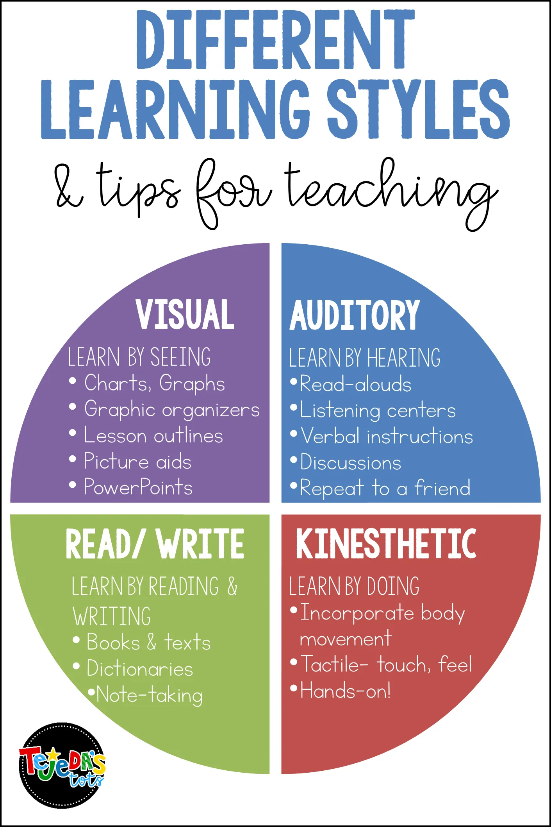

Slide 19
Effective Communication Strategies:
Active Listening
A provider pauses after a patient speaks, paraphrases what was said (“So you’re saying the medication makes you feel dizzy after lunch?”), and checks for confirmation, ensuring mutual understanding.
Empathy
When a patient expresses fear about a diagnosis, the provider responds, “I can imagine this feels overwhelming—let’s take it one step at a time together,” creating emotional safety before discussing next steps.
Use of Plain Language
Instead of saying, “You need to monitor your glucose to avoid hypoglycemia,” a provider says, “Check your blood sugar often so it doesn’t get too low and make you feel shaky or weak.”
Non-Verbal Communication
A provider notices a patient avoiding eye contact and sitting stiffly, signaling discomfort. They adjust their posture, soften their tone, and reduce physical distance to create a more relaxed space.
Cultural Adaptation
A provider working with a Southeast Asian family avoids pressuring the patient to speak first, instead addressing the eldest family member present to align with cultural norms around respect and decision-making.

Slide 20
What matters the most?

Slide 21
Strategies to Enhance Cultural Fluency:
Practice active cultural humility Example: A provider recognizes that they may not fully understand a patient’s cultural practices and asks, “Can you share more about your health beliefs so I can ensure we respect them during your treatment?”
Engage in ongoing education and exposure Example: A provider participates in cultural competency training specific to treating diverse populations, learning about barriers to care and ways to foster trust with various cultural groups.
Adapt communication styles across cultural contexts Example: A provider working with a patient from a culture that values family input in medical decisions asks, “Would you like to involve a family member in today’s treatment session?” before proceeding with care.

Slide 22
Strategies to Enhance Cultural Fluency (Continued):
Collaborate with interpreters and cultural liaisons Example: A provider involves a cultural liaison when meeting with a patient who speaks a different language, ensuring that not only is the information communicated clearly but also that the patient's values and preferences are respected.
Use inclusive, patient-centered language Example: A provider asks, “How do you prefer to make decisions about your treatment?” acknowledging that some patients may want more control while others prefer guidance from a trusted family member or religious leader.
Build relationships over time Example: A provider makes a consistent effort to connect with a patient who is hesitant to trust healthcare providers, taking time to learn about their cultural background and building rapport over multiple visits to enhance their comfort level with treatment.

Slide 23
Prevent compassion fatigue by encouraging self-care and well-being!
Set aside quality time for yourself and those you care about.
Engage in activities you enjoy, no matter how big or small they might be.
Participate in calming practices like meditation, yoga, reading, or listening to music.
Focus on nurturing your physical, mental, and spiritual health.
Manage your work hours and caseload to avoid overload.
Stay in touch with your loved ones.
Practice what you preach and lead by example.
Remember, self-care is incredibly important! 😊

Slide 24
Interested in a presentation? Lets connect! My Contact Information: Hawra Khraizat, LMSW, MA Hawrakhraizatpresents@gmail.com

