Slide 1
Clinical Ethics in Health Care: How they Improve Patient Outcomes Created by Dana Rizzo RN, BSN, ACM-RN

Slide 2
Upon completion of this presentation the learner will be able to:
Define Ethics in Health Care?
Define the Core Ethical Principles: Beneficence, Nonmaleficence, Autonomy and Justice.
Discuss Principles of Clinical Ethics and their Application to Practice.
Describe how Healthcare Administrators uphold Ethics.
Define Turfing and Dumping and how it impacts the quality metrics.
Discuss Artificial Intelligence (AI) and Machine Learning (ML) in Diagnosis and Treatment.
List 5 Best Practices Hospitals can follow to uphold Ethics and improve outcomes for patients and health care professionals.

Slide 3
What is Ethics in Health Care?
Healthcare professionals face ethical dilemmas daily. We need clear ethical guidelines:
Advanced medical technologies
Diverse patient populations
The use of Artificial Intelligence(AI) and Machine Intelligence (MI)
Ethical competencies for the healthcare professionals involve sensitivity, compassion, knowledge, reflection, decision making, action and behavior.
Health care technology advances bring with them countless benefits and expanded capabilities, but they also bring with them increased obligations when it comes to ethical issues.
As healthcare professionals we prioritize patient well-being, which can sometimes mean respecting patient’s wishes that they themselves disagree with. (Managing different perspectives in the situation).
Ethics are moral principles that govern a person’s behavior or the conducting of an activity.
In plain language, ethics refers to well-founded standards of right and wrong that prescribe what humans ought to do, usually in terms of rights, obligations, benefits to society, fairness, or specific virtues.

Slide 4
Key areas of focus in recent healthcare ethics articles in 2024:
Artificial Intelligence (AI) and Machine Learning (ML):
Ethical implications of using Artificial Intelligence (AI) for diagnosis and treatment, including potential biases in algorithms and ensuring transparency in decision-making processes.
Health Equity:
Addressing disparities in healthcare access and quality, based on factors like race, socioeconomic status, and geographic location.
Patient Privacy and Data Security:
Balancing the need for patient data for research and treatment with the right to privacy and protection against data breaches.
Informed Consent:
Ensuring patients fully understand the risks and benefits of treatment options before making decisions.

Slide 5
Key areas of focus in recent healthcare ethics articles in 2024:
End-of-Life Care:
Ethical considerations around withdrawing life-sustaining treatment, physician-assisted suicide, and advance care planning. National POLST Form (Physicians Orders for Life Sustaining Treatment)
Resource Allocation:
How to ethically distribute scarce healthcare resources, especially during crises, like pandemics.
Physician Conflicts of Interest:
Managing financial incentives that could influence medical decision-making.

Slide 6
Let’s talk AI in 2024
Artificial intelligence (AI) as a functioning tool is growing in popularity in the healthcare sector.
In fact, it’s proving vital in bridging the service gap between patients and healthcare providers.
The need for more efficient and effective AI-based healthcare solutions is causing the healthcare industry to see some of the biggest investments in recent times.
To help you understand the state of AI in healthcare in 2023, we’ve put together some major statistics and trends you should know.
Let’s get right into it.
The AI in healthcare market is projected to grow to $20.65 billion in 2023
ML: Machine Learning
AI: Artificial Intelligence

Slide 7
Artificial Intelligence can be used to diagnosis diseases, develop personalized treatment plans, and assist clinicians with decision-making. AI Challenges related to:
Data Privacy
Need for human expertise
Must develop AI Principles
Make sure Physicians have leading voice in shaping AI in Healthcare
Artificial Intelligence must be ethical, equitable, responsible, and transparently designed, as it is applied to the Healthcare field.
Augmented Intelligence (AI): Assists Doctors and Healthcare Professionals with decision making. Augmented Intelligence tools can support rather than replace healthcare decision making.
Artificial Intelligence (AI): can replace human jobs that are repetitive and task oriented.

Slide 8
Artificial Intelligence (AI) is a rapidly evolving field of Computer Science that aims to create machines that can perform tasks that typically require human intelligence. AI includes the various techniques such as:
1. Machine Learning (ML): Can assist in decision-making, manage work-flow, automate tasks, timely, cost- effective.
2. Deep Learning (DL): subset of ML uses models built on deep neural networks detects data patterns with minimal human involvement. Convolutional Neural networks (CNN) Diagnosing, predicting, classification of diseases.
3. Natural Language Processing(NLP): Branch of AI focused on teaching machines to understand, interpret, and generate human language. Ie. Siri and Alexa
Large Language Models (LLMs): are a type of AI algorithm that uses deep learning techniques and massively large data sets to understand, summarize, generate, and predict new text-based content. LLMs have been designed to generate text-based content and possess broad applicability for various natural language Processing (NLP) tasks. Including:
A. Text generation
B. Translation
C. Content summary
D. Rewriting
E. Classification
F. Categorization
G. Sentiment Analysis (BMC Medical Education, September 2023 Article Number: 689, 23)

Slide 9
In summary, DL is a subset of ML, and both are subsets of AI. ASR & NLP fall under AI and overlap with ML & DL. It's amazing how they are all intertwined. (ASR: automated speech recognition, speech to text) (NLP: Natural Language Processing, Processing of text to understand the meaning).

Slide 10
Artificial Intelligence Timeline in History:
1951 First AI Program designed by Christopher Strachey
1956 John McCarthy, Dartmouth conference coined Term “Artificial Intelligence”.
1960-1970s AI research focused on rule-based and expert systems, needed more computing power and data.
1980-1990s AI research shifted to Machine Learning (ML) and neural networks, which allow machines to learn from data and improve performance. IBMs “Deep Blue” defeated World Chess Player Champion Garry Kasparov in 1997.
2000s AI Improved focusing on Natural Language Processing (NLP) and computer vision. Lead to virtual assistants, Apple’s- Siri and Amazon’s -Alexa, which could understand natural language and respond to user requests.

Slide 11
Pros of Artificial Intelligence(AI):
1. Diminishes Human Error: because AI decisions come from compiled data, with designed algorithms, errors are reduced, accuracy increased, and precision is possible.
2. Facilitates Faster Decision-Making: Emergency room
3. Offers Continual 24/7 Availability: humans need sleep. AI computers still require maintenance, updates, occasional downtime. Huge impact on company’s productivity.
4. Lessens Risk: Can take on risky tasks, would be hazardous for humans. Minimizes risks for humans.
5. Automates Repetition: Repetitive work and tasks part of our jobs, often not utilizing highest potential of human workers.
6. Provides Digital Assistants: Helps with customer interactions. Triage of patients based on their signs and symptoms.
7. Identifies patterns: In words, numbers, images. AI allows you to see the bigger picture faster.
8. Identifies Better Human Workflows: Increased productivity, revenue, efficiency. Ie. Staffing patterns.
9. Excels at Working Large Sets of Data: The more data available, AI makes sense of it all in less time.
AI can then interpret the data and transform the data.
(Rockcontent.com Barbara von der Osten May 21, 2023, Updated June 2024, Artificial Intelligence Pros and Cons)

Slide 12
Cons of Artificial Intelligence
1. Reduces employment: replace repetitive jobs, phase away traditional jobs.
2. Lacks creative ability: AI cannot think outside of box. Human wisdom and creative thinking by humans still valued.
3. Absence of emotional range: AI has no emotions into decisions.
4. Ethical Dilemmas: cannot incorporate ethics and morality.
5. Increases potential for Human Laziness: automating tasks and digital assistants can increase machine dependence and promote human laziness.
6. Privacy and Data Security Concerns: AI systems rely on data to function. Raises concerns.
7. Lack of Transparency and Explainability: AI algorithms complex and difficult to understand, especially in deep learning (SL) and Neural network Models (NNM). Hard to determine how AI arrive at certain decisions and predictions. Black Box Nature of AI.
8. Dependency and Reliability: If AI experiences failures and malfunctions issues occur.
Mitigate risks associated with AI.
( Artificial Intelligence, Barbara vonder Osten, May 21, 23, Rockcontent.com)

Slide 14
Artificial Intelligence if Used, Patients said they would?

Slide 15
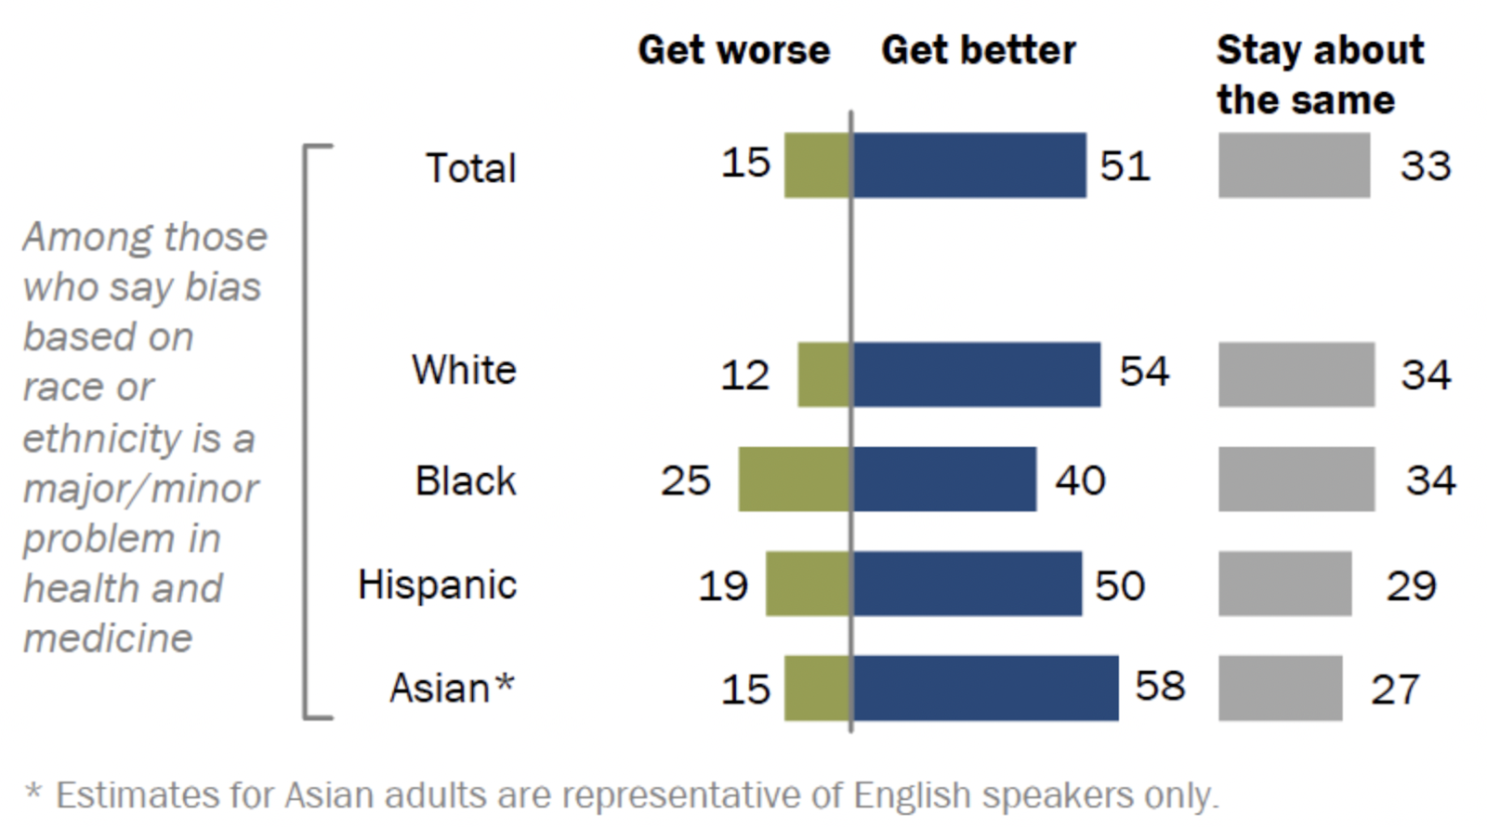
If AI or ML were used people felt Bias would get?

Slide 16
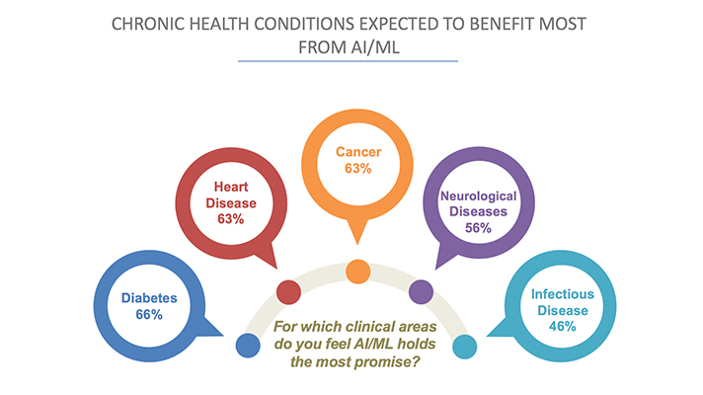
ML: Machine Learning AI: Artificial Intelligence

Slide 17
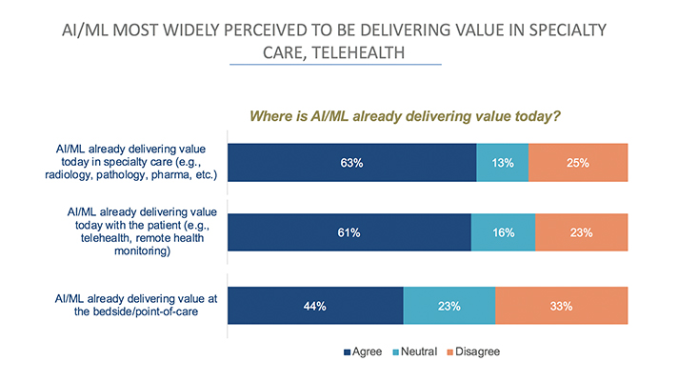

Slide 18
Ethics is an inherent and inseparable part of clinical medicine
The physician has an ethical obligation :
To benefit the patient.
To avoid or minimize harm to the patient.
To respect the values and preferences of the patient.
Physicians and Healthcare Professionals must have competence in core ethical behavioral skills in the following areas:
Obtaining informed consent, assessing decision-making capacity, discussing resuscitation status and use of life-sustaining treatments, advanced care planning, breaking bad news and effective communication.
Physicians and Healthcare Professionals must have competence in analyzing and resolving ethical problems.
Physicians and Healthcare Professionals must appreciate cultural diversity and its impact on ethics.
(Principles of Clinical Ethics and Their Application to Practice, PMC, Feb. 2021 17-28)

Slide 19
History of Ethics in Health Care
Ancient Greece created the Hippocratic Oath, to keep physicians accountable for taking care of their patients, and bringing no harm to them.
Hippocrates stated” to help and do no harm”. (Beneficence and nonmaleficence)
Late in the 1800’s Percival’s book on ethics expanded and added the concepts of Autonomy and Justice.
Ethics in health care is what guides the work of professionals in the healthcare industry.
Ethics is an essential component of providing health care, ensures practitioners treat their patients with dignity and respect, and that the decisions made by healthcare professionals are fair and just.
Ethics helps promote trust and confidence in the healthcare system, and it ensures healthcare professionals act in their patient’s best interests.
The Code of Ethics concept, lays out guidelines for physician’s professional conduct, and their ethical obligations, have remained relevant to the healthcare field ever since ancient Greece.
Since World War II we have had rapid development of medical treatments,
and techniques which culminated in several core ethical principles.
(Beauchamp and Childress’ book Biomedical Ethics is a classic)

Slide 20
Core Ethical Principles
These core ethical principles guide healthcare professionals today in resolving an ethical dilemma.
Beneficence: Refers to healthcare practitioner’s responsibility to act in their patient’s best interests. This principle entails improving the patient’s well-being and health, including giving treatments to relieve pain, avoid injury, and promote their health.
Beneficence is central to ethics in health care, and while making choices regarding patient care, healthcare practitioners must assess each course of action, possible advantages, and potential harms, and recommend the actions they believe will best serve the patient.
Each partitioner must ask themselves what is beneficial to this patient?
Partitioners must consider patient’s individual goals, needs, past experiences, their background, religious beliefs, and life experiences. Our initial assessments of our patients help us to gather this information.
Beneficence is a framework from which we work. It ensures that the healthcare provider presents the best course of action for the patient, taking into account their concerns and wishes.
To promote their welfare.

Slide 21
Core Ethical Principles
Nonmaleficence: Do no harm, this is the opposite of beneficence, as it dictates that healthcare practitioners should “Do no harm”, meaning they should not allow harm to a patient due to their own neglect.
Consider our actions and how they impact others, as our actions may intentionally or not, cause harm to patients or even other healthcare workers.
Practitioners must be mindful of our actions’ consequences, and refrain from decisions that could harm others.
Nonmaleficence supports several moral rules-do not kill, do not cause pain or suffering, do not incapacitate, do not cause offense, and do not deprive others of the goods of life.
Example: A doctor could order a medication for a patient to help with a health issue, but due to the medication’s side effects, stemming from another unrelated chronic condition, the doctor’s decision to prescribe the medication unintentionally causes harm.
Nonmaleficence is a guiding principle, and actions can be taken if the likely good for the patient outweighs the pain or discomfort they may experience with the medial treatment. (ie. Pain is expected after surgery or some treatments).
A physician’s obligation and intention to relieve suffering( IE, refractory pain or dyspnea) of a patient by the use of appropriate opioids override the foreseen but unintended harmful effects or outcomes (Doctrine of Double Effect).
This is one reason why Ethics in Healthcare can be complex and require administrative guidance.

Slide 22
Core Ethical Principles
Autonomy: Autonomy is a practice that acknowledges patients have the right to exercise control over what happens to them regarding treatment. Truth-Telling, informed consent, and confidentiality spring from the principle of Autonomy. Each person has the right for Self –Determination (Ability to make sound decisions).
Health care workers assess for capacity/incapacity to make health-care decisions.
Court of Law determines incompetence.
Patient autonomy allows the healthcare providers to educate the patient, but does not enable them to make decisions for the patient. Even when the healthcare provider feels the treatment is in the best interest of the patient.
Autonomy allows the patient to have the final say in the decision-making process. Moving away from Paternalism found in ancient civilizations, in the advanced western countries like the United States, we are moving away from Paternalism.
Autonomy also requires the Informed Consent, which involves clear communication between the patient and their healthcare provider, that leads to authorization for care, treatment, or services.
Patient must be given all information about their medical concerns, testing, and treatment alternatives.
The patient must have capacity to make their informed decision about their care, so that informed permission can be given by them.
Patients and professionals may have different beliefs and experiences that may inform their feelings on the best treatment in a given scenario.
Example: A medical professional can restart someone’s heart in order to save their life, but the patient consents to a DNR order and declines CPR etc.

Slide 23
More on Autonomy
Respect for Autonomy is a norm in medical ethics that requires the respect for the decisions of adults who have the ability to make sound decisions (self-determination).
A Determination of someone’s decision-making ability can be gauged by their:
Intentionality (Is it believable he or she will follow-through with a decision?)
Understanding (Does he or she understand the situation and the consequences and implications of different options?).
Absence of controlling influences that determine their action (Is he or she being influenced somehow against choosing reasonably?).
(Healthcare Ethics in Modern Medicine, August 20, 2019)

Slide 24
Core Ethical Principles
Justice: means treating all people fairly. The principle of Justice does not necessarily mean Equal Care but rather Equitable Care.
Healthcare Equity means patients should not be denied care, have restricted access to care, or be provided with lower-quality of care, based on their socioeconomic class, ethnicity, gender identity, and expression, or any other characteristic.
Justice can also be ascribed to sharing medical resources with a larger community that they may not have access to, or helping other facilities, if they become too full by accepting their patients. (Hospital Bypass)
Justice also applies to emergency situations. For instance, if a patient needed care for a minor injury, and arrived to the ED before a patient that needed intensive care, the latter patient should receive treatment first, because they need it much faster.
Healthcare professionals must assess and gauge the severity of a patient’s conditions, and triage, to determine the order in which one receives care first.
In emergency situations where supplies are limited, many healthcare facilities may need to choose which patients receive life-sustaining care. During the Covid 19 Pandemic, healthcare professionals had to make difficult decisions. Ethics Committees in the hospital were called upon to create screening tools
to help them navigate the challenges.

Slide 25
Core Ethical Principles
Justice: When patients face severe injury, debate can arise among healthcare providers over how to deliver treatment equitably.
Finding solutions to these dilemmas often falls to the Healthcare Administrators and Ethics committees, who must keep their decisions consistent with applicable ethics in health care.
Justice calls on us, to fairly distribute benefits, risks, costs, and resources in health care as best we know how.
To each individual, justice, ideally should proffer:
An equal share
According to need
According to effort
According to contribution
According to merit
The principle of justice means that every single person should be treated in the best possible way by their doctor and health care professionals.

Slide 26
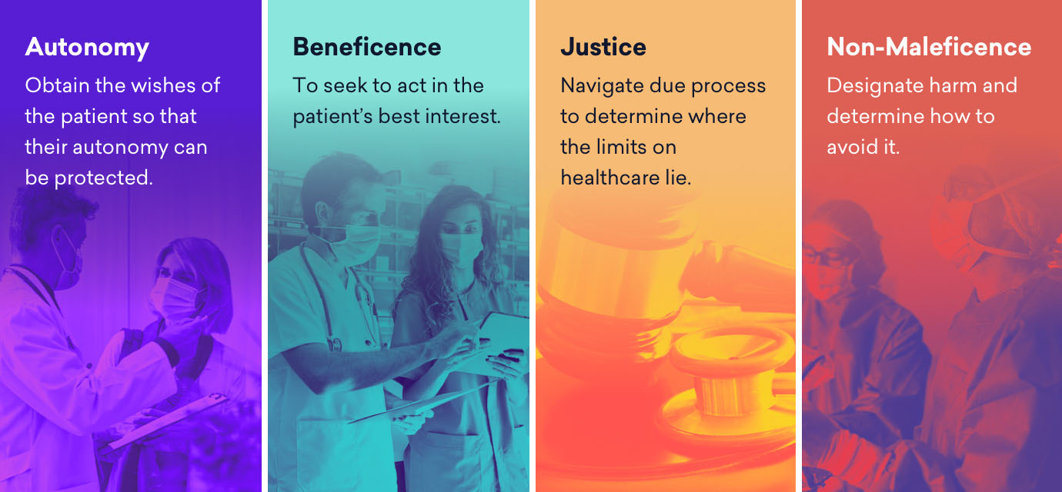

Slide 27
The Importance of Ethics in Healthcare Professions
Because lives are at stake, the healthcare profession requires a strong ethical framework to guide decisions about patient care.
Healthcare practitioners who are educated and equipped to address ethical considerations (Ethics committee members) can make compassionate, fair, and effective choices for their patient’s treatment.
Ethics benefits not only the patients, but the health care professional also, in the work setting.
Ethically directed care and treatment of patients increases trust and opens communication.
Truth-telling, is a part of patient Autonomy .

Slide 29
The Benefits of Ethics for Patient Care
All the Core Ethical Principles are designed to benefit patients by ensuring:
Guaranteeing their respect.
Providing the patient with Autonomy to make their own decisions.
Equitable treatment (Justice)
Receive the best available care based on their beliefs and decisions.
Improved trust from the patient
More open communication between the patient and healthcare professional.
Improved health outcomes for the patient.
In a 2021 study by NORC found that only 78 % of participants trusted their PCP, which may suggest that a significant portion of Americans are unwilling to reveal important health information to their doctors, or agree to life-saving procedures or treatments.

Slide 30
Benefits for Practitioners
The Core Ethical Principles are designed to benefit patients, but they also benefit practitioners, in the following ways:
Ethical frameworks in the workplace allow healthcare workers to talk honestly and candidly with their patients and families about end-of-life care, or to quickly inform their patients about their emergency choices.
Practitioners can recommend a solution, when there are ethical disagreements, between patient, families, caregivers, or even other staff members.
Having ethical guidelines to support one’s decisions allows for one’s conscience to remain clear, as ethics will help dictate what the best decision should be for the ideal outcome.
Ethical frameworks that encompasses an entire facility, support healthcare workers to feel assured that their co-workers are operating with the same intent as they are , and that they have a solid foundation.
Ethical framework enhances communication and understanding between staff, this creates mutual trust.
Ethical guidelines help practitioners find the least obtrusive and most beneficial solution to a patient’s health concern available, reducing the risk for unnecessary procedures and treatments.
Nonmaleficence, extends to patients and colleagues. Healthcare workers can feel they are working in a safe
workplace. This reduces moral and personal distress.

Slide 31
Turfing

Slide 32
Turfing and Where Patients Belong?
Turfing is a colloquialism that refers to what clinicians do to patients whose needs do not fit neatly and tidily into a typical clinical placement protocol, especially during inpatient admissions from a hospital emergency department.
This term ”turfing” and this practice are both clinically and ethically problematic, because a patient is rarely, if ever, “turfed’ to their advantage.
Ethically speaking, turfing constitutes deferral of responsibility for a patients admission or care to colleagues.
We will discuss under what circumstances it is clinically and ethically appropriate to defer a patient’s care, and suggest why turfing happens despite its negative influence on patients, healthcare professionals, and physicians.
“What’s a TURF?” asked Potts.
“To TURF is to get rid of, to get off your service and unto another, or out of the house altogether.”
(SHEM, S. )

Slide 33
The Origins of Turfing and Dumping
Prior to 1986, patients with emergency conditions could be turned away because they did not have insurance or ability to pay for services.
The Federal Emergency Medical Treatment and Labor Act (EMTALA) was passed that year to increase health care access and prevent “dumping” based on insurance status.
The EMTALA mandate requires emergency physicians (EP’s) and their institutions to evaluate and stabilize all patients regardless of their ability to pay, which commonly requires the expertise of and further care from consultants.
EMTALA was intended to create both a more equitable health system by removing systemic barriers to care, and what could be called a culture of belonging by ensuring emergency care for “anyone, anytime”.
A consultant may decline emergency department (ED) evaluation of a patient, admission to that consultants’ service, or outpatient follow –up.
Both the EP and consultant must determine if the reasons for refusal to provide care to the patient are proper, and if reasonable, alternatives can be put in place to ensure that the patient’s needs are met.
In some instances, a consultant might have less altruistic reasons to deny care to another clinician, leading to the pejorative term” turfing”, popularized in the book, House of God.

Slide 34
Accountability in Turfing Practice
Physicians, other health care professionals, and institutions are accountable for inappropriate routing of patients, which could result in civil monetary penalties for hospitals, or physicians, physicians can be excluded from CMS (Center for Medicare and Medicaid services) and terminating its provider agreement with the hospital.
It is critical that clinicians understand the nature and scope of EMTALA-related care, their institutional policies and pathways to ensure compliance with the law, and the reasons for, implications of, and consequences of declining care.
Ethically, health professionals should be concerned about “Turfing/Dumping” because it may narrow a clinician
conception of what a patient deserves based on where that patient might be thought to belong, and belonging informs whom clinicians see, within the scope of their responsibility and concern.
We will discuss specific circumstances wherein deferral of care to another provider is clinically and ethically appropriate and situations wherein it is not, and we will explore why Turfing still occurs.
(Gillian R. Schmitz MD, and Robert W. Strauss, MD)

Slide 35
Legitimate Reasons to Defer Care
1. Patients require higher levels of care, specialized services, diagnostic testing, more intensive nursing, and expertise.
2. Patients insurance dictates where they are admitted. Insurance types require that care be given within a specific health system.( Hospital A or Hospital B, may have insurance contracts).
3. A surgical specialist requests admission to the medicine service for surgical patients with complex medical conditions. (Hip Service Geriatric Pathway for patients who had a fall).
4. Consultants defer admission to an outpatient setting for testing and follow-up. Administrative costs to hospital admission are a major driver of health care system costs.
5. Patient or consulting physician requests transfer to another facility, where patient has previously received care. Comorbidities, patient must be stabilized as stipulated by EMTALA. Once the patient is stabilized , EMTALA mandate no longer applies.
The Patient is best served by follow up with the physician or surgeon who provided previous, related care or who performed invasive surgery or procedure, an approach guided by the principles of beneficence, nonmaleficence, and respect for patient autonomy.

Slide 36
Turfing and other Inappropriate Deferrals
Turfing could reflect the following:
Concern over lower reimbursement for hospitals, physicians, and services.
Concern over lower compensation.
Perceived increased risk of complications.
Unclear Hospital/Administrative Policies.
Work Avoidance.
Physician Burnout.
Concern over their quality metrics, complication rates, and readmission rates, for hospital and physicians .
Turfing can cause both patients and physicians to feel unappreciated, undervalued, demoralized, and powerless to control their situation or environment. Moral Injury to physicians.
Because it is Unlawful and Unethical to deny care to or turf patients based on their Predicted outcome, specialties and hospitals should fight for RISK ADJUSTMENTS, to the CMS’s proposed quality metrics.
Turfing has an impact on how they perceive their care and how physicians deliver care.

Slide 37
More on Risk Adjustments for Hospitals and Physicians
A Risk Adjustment allowance would do the following:
Anticipate higher complication rate associated with underlying disease processes, and would decrease the financial risk physicians take when providing equitable care.
All patients deserve high-quality care, and physicians and providers are obligated to address patients’ acute needs regardless of their :
Race
Ethnicity
Gender
Sexual Orientation
Underlying Risk Factors
Socioeconomic status

Slide 38
Best Practices for Hospitals/Administrations
It is important that hospitals have clear policies regarding the appropriate admitting services for certain patient populations. Patients due not follow the textbook when presenting with an emergency condition.
Patient may have more than one chief complaint or acute issue that require admission. (MVA)
Emergency doctor (ED) often calls in many consultants when multiple injuries or conditions are present.
Best Practice encourages multidisciplinary meetings and policies that develop clear communication, proactive planning, and procedures, that are mutually agreed upon between the services and the ED.
Common situations involving more than one service should have admission guidelines, and protocols for several types of presentations:
A. Trauma patients with acute conditions (seizure, AMI, that caused a car crash).
B. Medical or pediatric patients with suicidal ideation.
C. Isolated fractures in geriatric, medically complex, or fragile patients. (Hip fracture pathway)
D. Pregnant patients with an acute surgical condition or other needs unrelated to pregnancy.

Slide 39
Best Practices for Hospitals and Physicians
Some Hospitals have created Multiple Teams responsible for certain types of patients (Cardiology, Orthopedics).
Department and hospital chain of command must be established to escalate resources when a consultant cannot be reached.
Create a Boarding metric/time tool to reduce boarding in the emergency room, relieving the ED of the boarding burden. Boarding occurs when a patient is kept in the ED after being admitted due to lack of beds on units.
Boarding in the emergency rooms results in:
Backlog of patients. Medication errors.
Limits the space for incoming patients needing acute care.
Overcrowding results in increased length of stay in the emergency department.
Boarding in the emergency department before transferring to ICU/CCU has resulted in worse patient outcomes
for both admitted and new patients.
Hospitals must have policies in place to determine disposition in circumstances in which services do not agree on optimal management, which leads to delays in care.
Patient flow and improved care are goals.

Slide 40
Sequential Organ Failure Assessment (SOFA) Score
Sequential Organ Failure Assessment (SOFA) Score and Mortality Prediction in Patients With Severe Respiratory Distress Secondary to COVID-19

Slide 41
Mortality During Intensive Care Unit Stay for maximum SOFA Score
Maximum SOFA score | Mortality during ICU stay
0-9 | <25%
10-14 | 40-60%
15 | >80%
>15 | >90%
Mortality during intensive care unit stay for maximum SOFA score

Slide 42
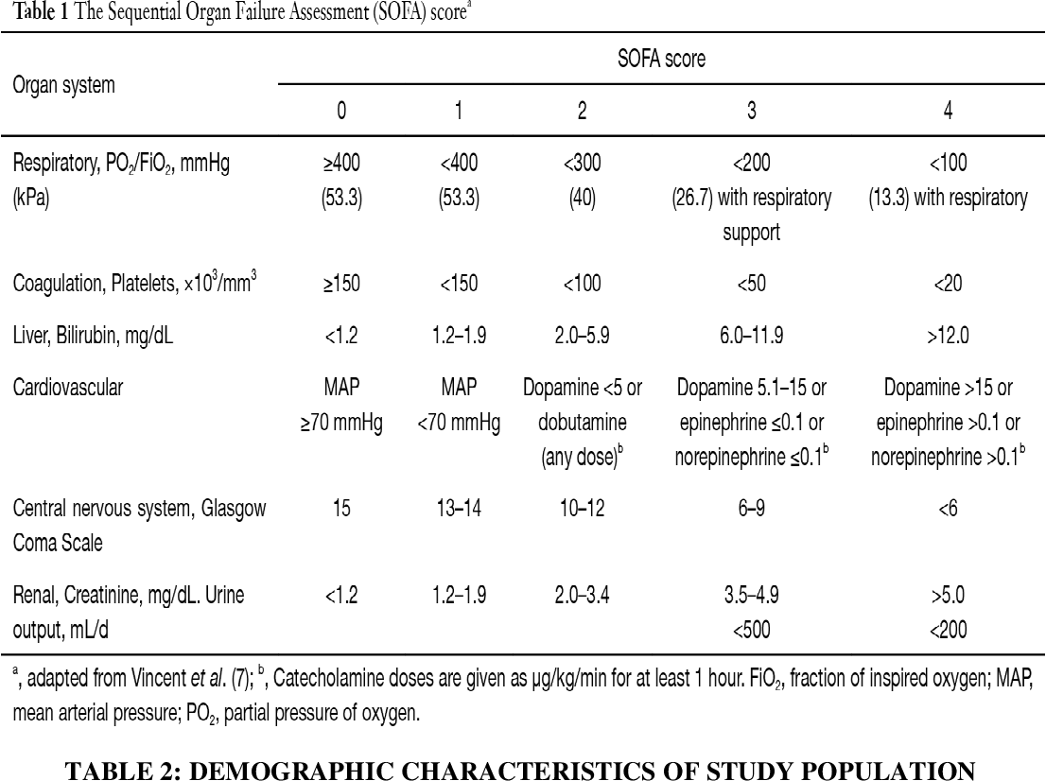

Slide 43
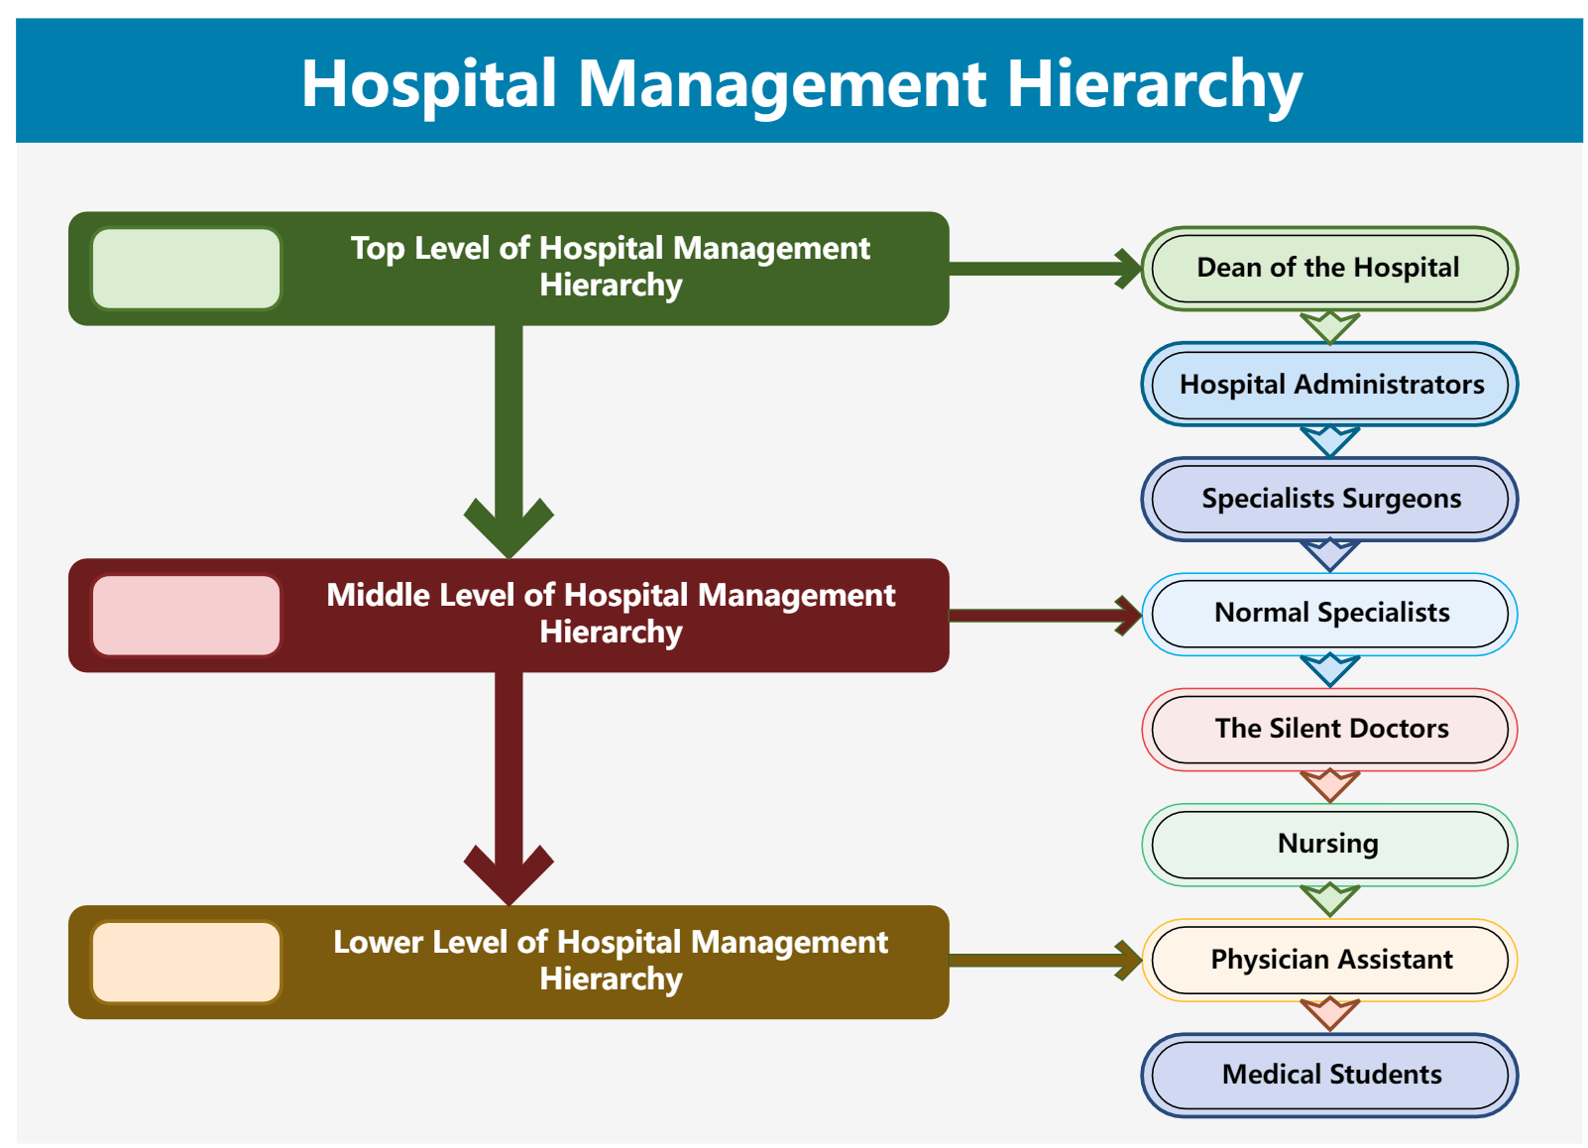

Slide 44
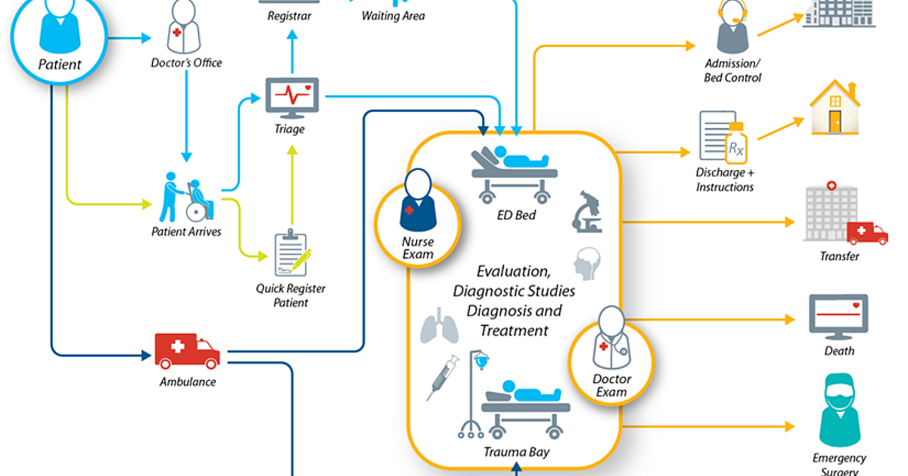

Slide 45
Conclusion for Ethics in Health Care
It is critical that the four Ethical Principles of Beneficence, Nonmaleficence, Autonomy, and Justice be understood by Health Care Professionals.
All Health Care Professionals must understand their hospital policies to ensure they are meeting the ethical and legal requirements of EMTALA.
As discussed there are many reasons consultants may defer admission from the ED, some of which are legitimate and patient centric.
We discussed how Turfing, defined as an inappropriate transfer or deferral of care, threatens both physician and patient’s wellbeing and undermines physicians ability to deliver the empathetic care that patients deserve.
Hospitals that have clear policies, protocols for their patient populations, multidisciplinary teams, and solutions, are using a patient-centered approach to addressing the many healthcare challenges , and realigns patient care with incentives grounded in ethics and equity.

Slide 46
References
Gillian R. Schmitz, MD and Robert W. Strauss, MD, What should Students and Trainees Be Taught About Turfing and Where Patient Belong? AMA Journal of Ethics, Medical Education, Dec. 2023.
Tulane University, School of Public Health and Medicine, Ethics in Health Care: Improving Patient Outcomes. January 19, 2023.
Shem, S. The House of God. Berkley/Penguin Random House; 2010.
Emergency Medical Treatment and Labor Act (EMTALA); Centers for Medicare and Medicaid Services. Updated September 2023.
Understanding EMTALA, American college of Emergency Physicians. October 31, 2023.
Caldicott CV. Turfing Revisited. Virtual Mentor. 2012:14(5): 389-395.
Powell JA., Toppin E. Jr. Health Equity and the Circle of Human Concern. AMA, J. Ethics. 2021:23(2): E16-E174.
Kaiser Permanente. Transition of Care Coverage: guidelines. Kaiser Foundation Health Plan of Washington. July 2023.
Laam, LA., Wary, AA. Strony, RS, Fitzpatrick, MH, Kraus, CK., Quantifying the impact of patient boarding on emergency department length of stay: all admitted patients are negatively affected by boarding. J AM Coll. Emergency Physicans , 2021:2(2):e12401.
Revolutionizing Healthcare: the role of artificial intelligence in clinical practice. BMC Medical Education, November 19, 2024. BMCMededuc.com articles/10.1186/s.
Pros and Cons of AI in Healthcare: A Complete Guide. William Dom, July 29, 2024. Willdom.com.
AMA Future of Health Report-Potential applications of AI. AMA-assn.org, November 2024.
Artificial Intelligence Pros and Cons: What are the Advantages and Disadvantages of AI. Barbara Von Der Osten, June 27, 2024
Rockcontent.com/blog/author/barbaraosten).

Slide 47
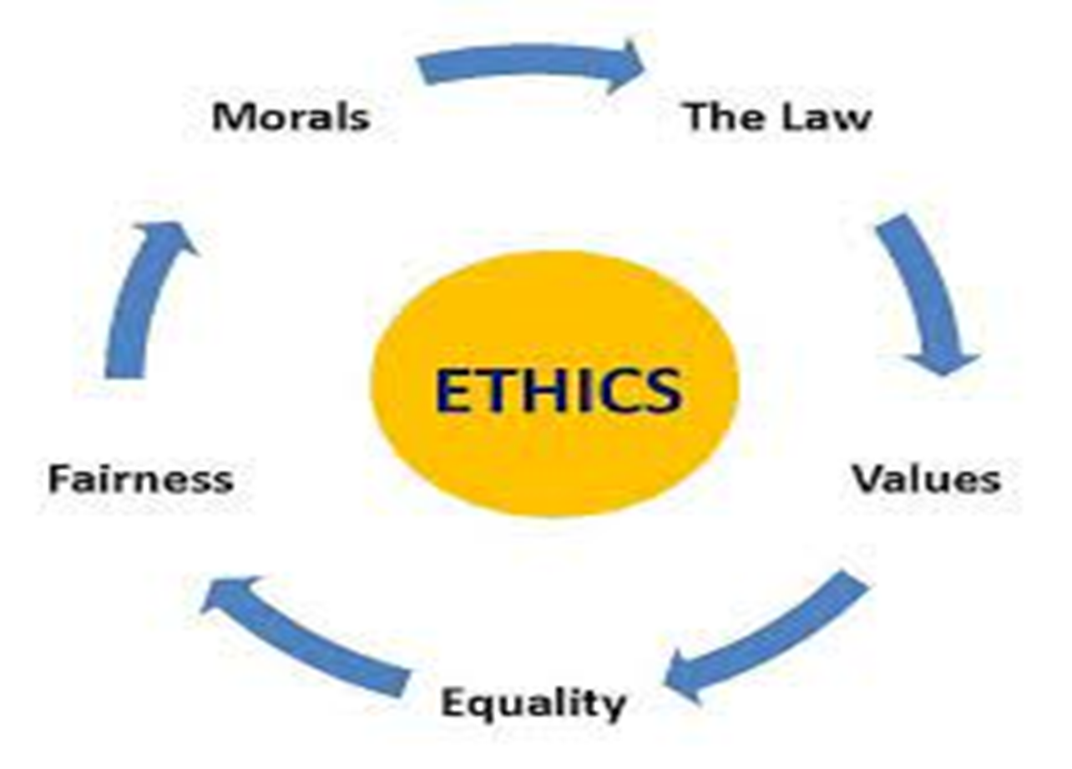
Thank you for attending this presentation today.
Dana Rizzo RN
Area Manager for Business Development for Waltonwood Senior Living Communities.
Dana.Rizzo@singhmail.com

