Slide 1
Approach to the Patient with Dysphagia By Dana Rizzo RN, BSN, ACM-RN

Slide 2
Objectives: Upon completion of this presentation the learner will be able to:
1. Discuss the normal process of swallowing.
2. Distinguish between Oropharyngeal dysphagia and Esophageal dysphagia with respect to underlying etiology and clinical symptoms.
3. Apply clinical approaches using the Yale Swallow Protocol (YSP) Tool, an evidenced based dysphagia screening tool that healthcare professionals can use to identify aspiration risk.
4. Discuss why Dysphagia is a key concern in relation to people with intellectual disabilities.
5. Apply 6 Current Management options used in dysphagia.
6. Implement effective Interpersonal team strategies for improving care coordination and outcomes in patients with dysphagia.

Slide 3
Definition of Dysphagia
Dysphagia is a medical term for difficulty swallowing. Dysphagia can be a painful condition. In some cases, swallowing is impossible.
Occasional difficulty swallowing, such as when you eat too fast, or don't chew your food well enough, usually isn't cause for concern. But ongoing dysphagia can be a serious medical condition that needs treatment.
Dysphagia can happen at any age, but it's more common in older adults. The causes of swallowing problems vary, and treatment depends on the cause.

Slide 4
The Process of Swallowing
Swallowing is a series of processes that transmit food from the oral cavity to the stomach.
Transit from the oral cavity(mouth) to the pharynx is a voluntary process (contraction of oropharyngeal muscles).
Transit of a bolus of food from the oropharynx through the esophagus and into the stomach is an involuntary process.
Dysphagia, or difficulty swallowing, can be characterized by the part of the swallowing process that is affected.
Dysphagia can be acute or chronic, and can have many causes.
Depending on the cause, dysphagia can be treated with medication, surgery, dilation, stenting, or a feeding tube.
Oropharyngeal Dysphagia or Esophageal Dysphagia are two distinct issues.

Slide 5
Phases of Swallowing | Description | Key Actions
Oral Phase( Oral Preparatory Stage) | Voluntary phase where food is chewed and prepared into a bolus in the mouth. | Tongue movement, chewing by teeth, saliva mixing, bolus formation
Pharyngeal Phase | Involuntary phase where the bolus moves from the mouth to the esophagus, with airway protection mechanisms activated. | Soft palate elevation, larynx elevation, epiglottis closure, upper esophageal sphincter opening, pharyngeal muscle contractions
Esophageal Phase | Involuntary phase where the bolus is propelled through the esophagus to the stomach by muscle contractions (peristalsis). | Peristaltic waves in the esophagus, lower esophageal sphincter relaxation, bolus movement to stomach

Slide 6
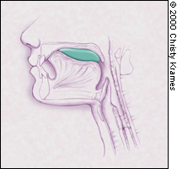
The tongue initially forms the food bolus (green) with compression against the hard palate. Oral Preparatory Stage and Oral Phase.

Slide 7
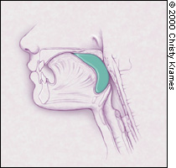
Displacement of the food bolus into the pharynx by the tongue initiates deglutition.(swallowing) Pharyngeal Phase

Slide 8
Relaxation of the cricopharyngeal muscle (the physiological upper esophageal sphincter) permits movement of the food bolus into the proximal esophagus. Esophageal Phase.

Slide 9
Eating and swallowing are complex neuromuscular activities, involving over 30 muscles and nerves to perform the swallowing activity. They have two crucial biological features:
A. Food passage from the oral cavity into the stomach.
B. Protecting the individual from food entering the airway.
Normal swallowing can be divided into four stages:
1. the oral preparatory stage
2. the oral transit stage
3. pharyngeal stage
4. esophageal stage.
The four stages are dynamic and overlapping.

Slide 10
Oral Preparatory Phase
The oral preparatory stage begins when food is introduced into the oral cavity. Food is chewed into smaller pieces and mixed with saliva to form a bolus of material.
Mastication and mixing the food with saliva require the muscles of mastication including the masseter, temporalis, medial and lateral ptergoids and facial muscles including the orbicularis orris and buccinator muscles.
After liquid is taken into the mouth from a cup or by a straw, the liquid bolus is held in the anterior part of the floor of the mouth or on the tongue surface against the hard palate surrounded by the upper dental arch (upper teeth).
The oral cavity is sealed posteriorly by the soft palate and tongue contact to prevent the liquid bolus leaking into the oropharynx before the swallow.
There can be leakage of liquid into the pharynx if the seal is imperfect, and this leakage increases with aging.

Slide 11
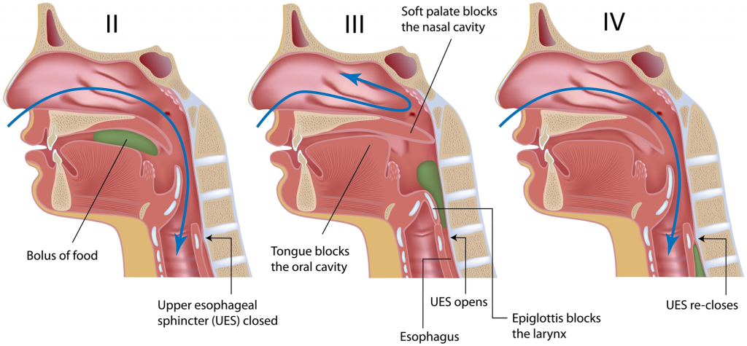

Slide 12
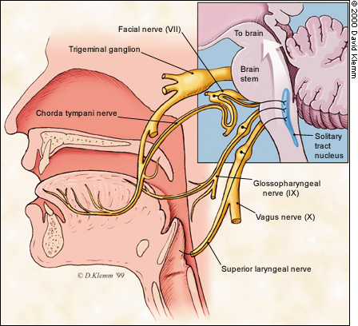
At Least 5 CRANIAL NERVES ARE DIRECTLY INVOLVED IN THE ACT OF SWALLOWING IN ADULTS.

Slide 13
Oral Transit Phase
The oral transit phase is a voluntary phase that begins with the posterior propulsion of the bolus by the tongue, and ends with initiation of the pharyngeal swallow.
(Oropharyngeal Dysphagia : Can be caused by Neurological disorders like Parkinson’s disease, or CVA, or by weakened throat muscles.

Slide 14
Pharyngeal Phase
Pharyngeal swallow is a rapid sequential activity, occurring within a second.
The pharyngeal phase begins with the initiation of a pharyngeal swallow which in turn propels the bolus through the pharynx via involuntary peristaltic contraction of the pharyngeal constrictors.
The pharyngeal phase has two crucial biological features:
Food passage, propelling the food bolus through the pharynx and Upper esophageal sphincter (UES) to the esophagus; and
Airway protection, insulating the larynx and trachea from the pharynx during food passage to prevent the food from entering the airway.
Breathing momentarily stops and the vocal folds come together.

Slide 15
Esophageal Phase
The esophagus is a tubular structure from the lower part of the UES to the lower esophageal sphincter (LES).
The lower esophageal sphincter is also tensioned at rest to prevent regurgitation from the stomach.
It relaxes during a swallow and allows the bolus passage into the stomach.
Esophageal dysphagia is difficulty moving the food through the esophagus to the stomach. Causes include: GERD, Esophageal motility disorders, or strictures.

Slide 16
Causes of Dysphagia
Swallowing is complex, involving 30 muscles and many nerves.
Any condition that weakens or damages these muscles and nerves or causes narrowing of the back of the throat or esophagus can cause dysphagia.
Dysphagia generally falls into one of the following categories.
Oropharyngeal dysphagia
Esophageal dysphagia

Slide 17
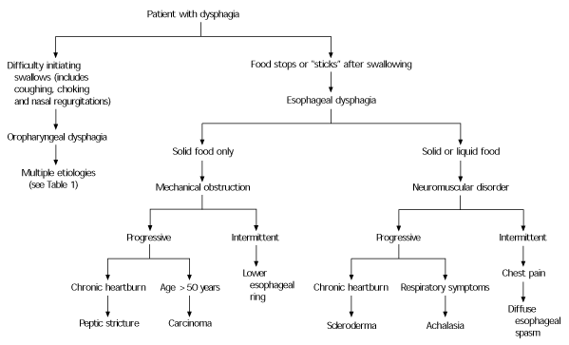

Slide 18
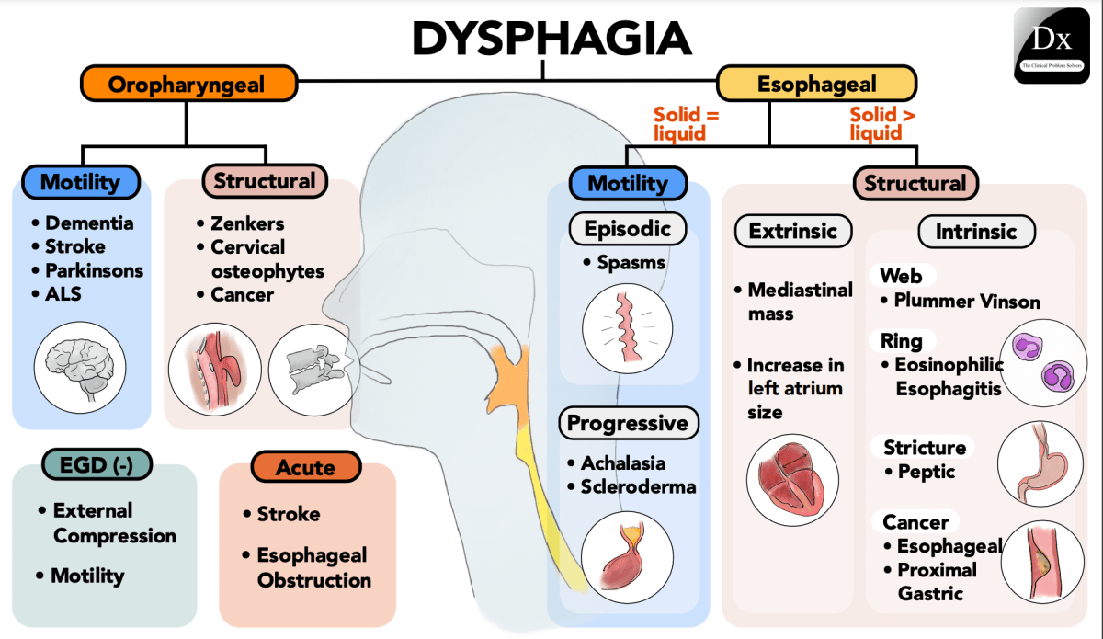

Slide 19
Two Main Types of Dysphagia
1. Oropharyngeal Dysphagia (OD)
Certain conditions can weaken the throat muscles, making it difficult to move food from the mouth into the throat and esophagus during swallowing.
A person might choke, gag or cough when trying to swallow, or have the sensation of food or fluids going down the windpipe, called the trachea, or up the nose.
OD seen with difficulty initiating swallowing.
This can lead to pneumonia.

Slide 20
Causes of Oropharyngeal Dysphagia include:
Neurological disorders. Such as, multiple sclerosis, muscular dystrophy, and Parkinson's disease — can cause dysphagia.
Neurological damage. Sudden neurological damage, such as from a CVA or a brain or spinal cord injury, can affect the ability to swallow. Affects the cerebral, brain stem, cranial nerve and straited muscle function.
Pharyngoesophageal diverticulum, also known as Zenker’s diverticulum. A small pouch, known as a diverticulum, that forms and collects food particles in the throat, often just above the esophagus, leads to difficulty swallowing, gurgling sounds, bad breath, and repeated throat clearing or coughing.
Cancer. Certain cancers and cancer treatments, like radiation, can make it difficult to swallow. Head and neck cancer or esophageal cancer, can create compression from mediastinal lymph nodes or lung cancers.
(JAMA: Approach to the Patient with Dysphagia)

Slide 21
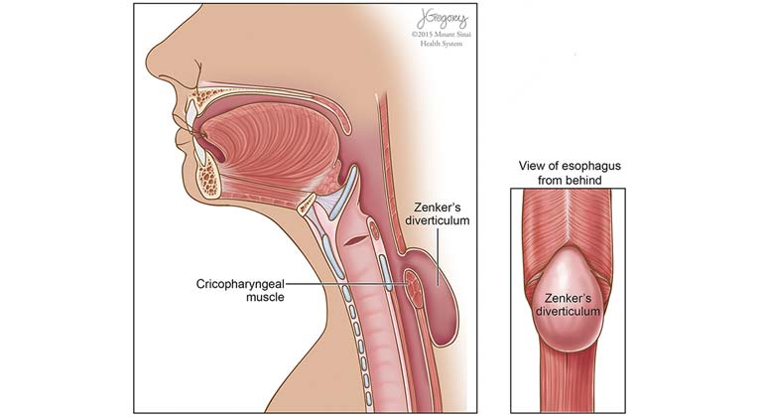
Zenker’s Diverticulum

Slide 22
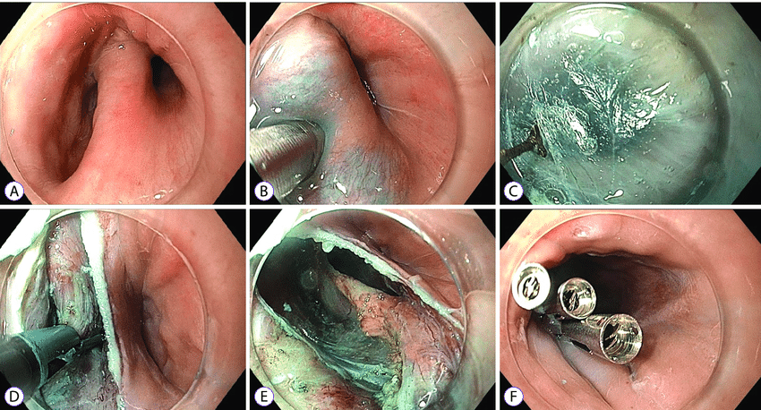
Endoscopic images of the Zenker's diverticulum using the peroral endoscopic myotomy technique.
Endoscopic view of Zenker's diverticulum with a clear cap attached to the endoscope tip.
A mucosal bleb is created over the septum.
Tunneling is performed along both sides of the septum using the triangular tip knife.
Following septum exposure, septotomy is performed using the rotatable scissors-type knife.
Septotomy is extended to the base of the septum.
Closure using clips.

Slide 23
2. Esophageal Dysphagia (ED)
Esophageal dysphagia refers to the sensation of food sticking or getting caught in the base of the throat, or in the chest after swallowing begins. ED usually occurs a few seconds after swallowing:
Some causes of esophageal dysphagia include:
Achalasia: Achalasia is an esophageal motility disorder, characterized monometrically by aperistalsis and incompletely relaxing the lower esophageal sphincter (LES). Damaged nerves or muscles make it hard for the esophagus to squeeze food and liquid (peristalsis)into the stomach.
Achalasia tends to worsen over time.
Esophageal spasm: This condition causes high-pressure, poorly coordinated contractions of the esophagus, usually after swallowing.
Esophageal spasm affects the involuntary muscles in the walls of the lower esophagus.

Slide 24
Esophageal Dysphagia (ED) Causes:
A Narrowed Esophagus: Known as a stricture, a narrowed esophagus can trap large pieces of food. Tumors or scar tissue, often caused by gastroesophageal reflux disease (GERD), can cause narrowing.
Esophageal Cancer: Adenocarcinoma is a growing concern in Western society. Growing tumors steadily narrow the esophagus. May be related to central obesity and GERD disease.
Foreign bodies: Sometimes food or another object can partially block the throat or esophagus. Older adults with dentures, and people who have difficulty chewing their food may be more likely to have a piece of food become stuck in the throat or esophagus.
Esophageal Ring ( Schatzki Ring): A thin area of narrowing in the lower esophagus can occasionally cause difficulty swallowing solid foods.

Slide 25
Esophageal Dysphagia Causes continued
GERD: Stomach acid backing up into the esophagus can damage esophageal tissues.
This can lead to spasm or scarring and narrowing of the lower esophagus. Adenocarcinoma of the esophagus outnumbers the previous common cancer, squamous cell carcinoma.
Barrett’s esophagus is the most dominant precursor to adenocarcinoma.
Eosinophilic esophagitis (EOE): Eosinophilic esophagitis is a disease of the immune system.
It is caused when white blood cells, called eosinophils, build up in the esophagus. Unknown etiology. Younger patients. Related to GERD or atopy.

Slide 26
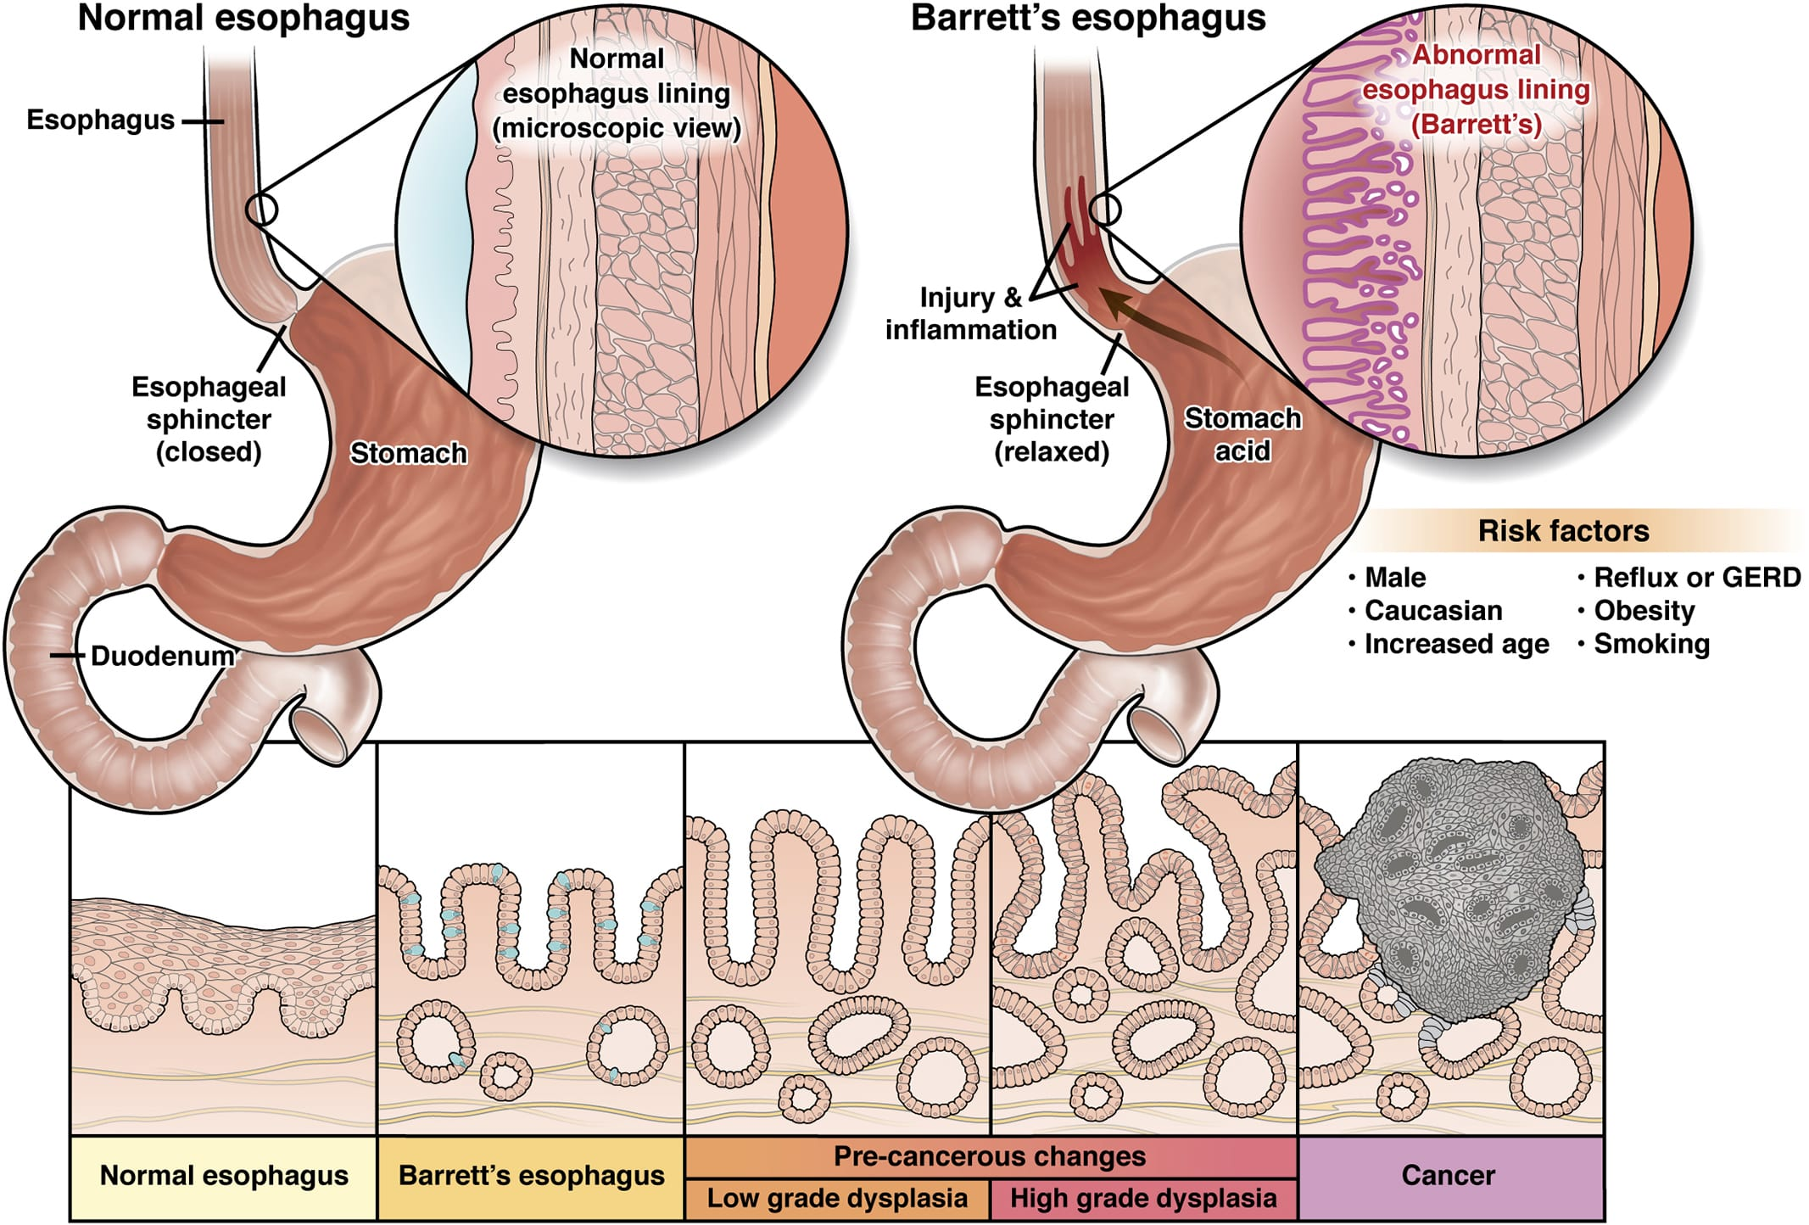

Slide 27
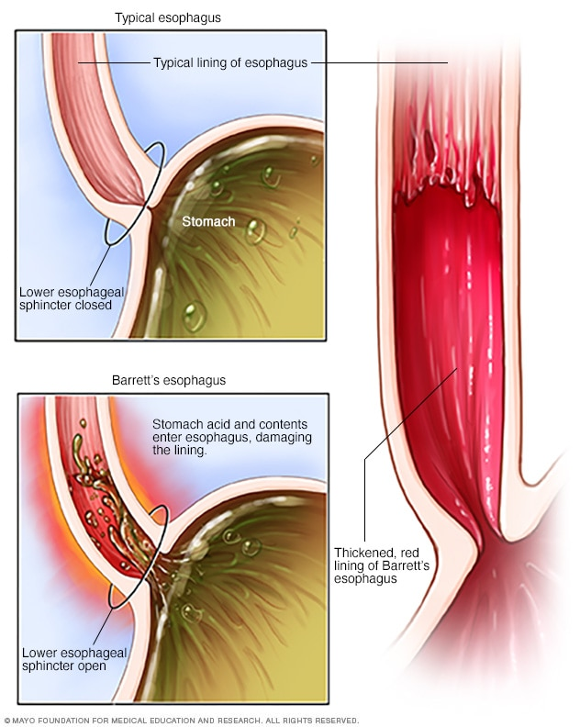

Slide 28
Esophageal Dysphagia Causes continued
Scleroderma. Scleroderma causes the development of scar-like tissue, resulting in stiffening and hardening of tissues. This can weaken the lower esophageal sphincter. As a result, acid backs up into the esophagus and causes frequent heartburn.
Radiation therapy. This cancer treatment can lead to inflammation and scarring of the esophagus.

Slide 29
Dysphagia: Mechanical Obstruction or Mobility Disorder? EoE= eosinophilic esophagitis IEM= ineffective esophageal motility

Slide 30
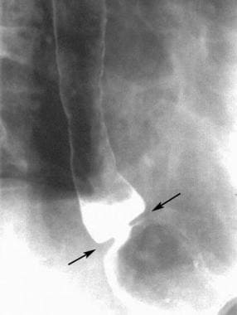
Schatzki ring on an erect, double-contrast barium esophagogram. Image demonstrates a thin, ringlike narrowing (arrows) in the lower esophagus just above a hiatal hernia.
View Media Gallery

Slide 31
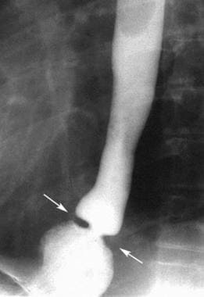
Schatzki ring. Prone, single-contrast barium esophagogram demonstrating a thin, ringlike narrowing (arrows) in the lower esophagus just above a hiatal hernia. This view is most sensitive for detecting lower esophageal rings, provided adequate esophageal distention is achieved. View Media Gallery

Slide 32
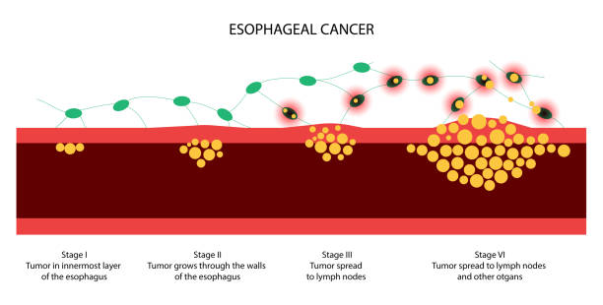

Slide 33
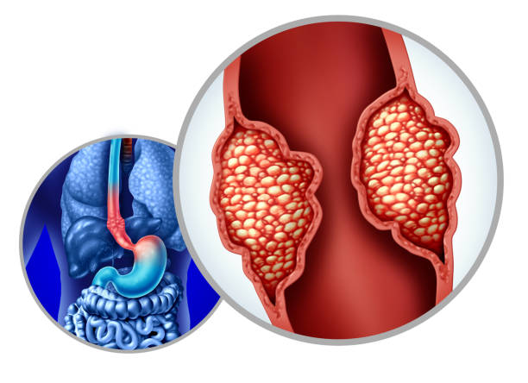

Slide 34
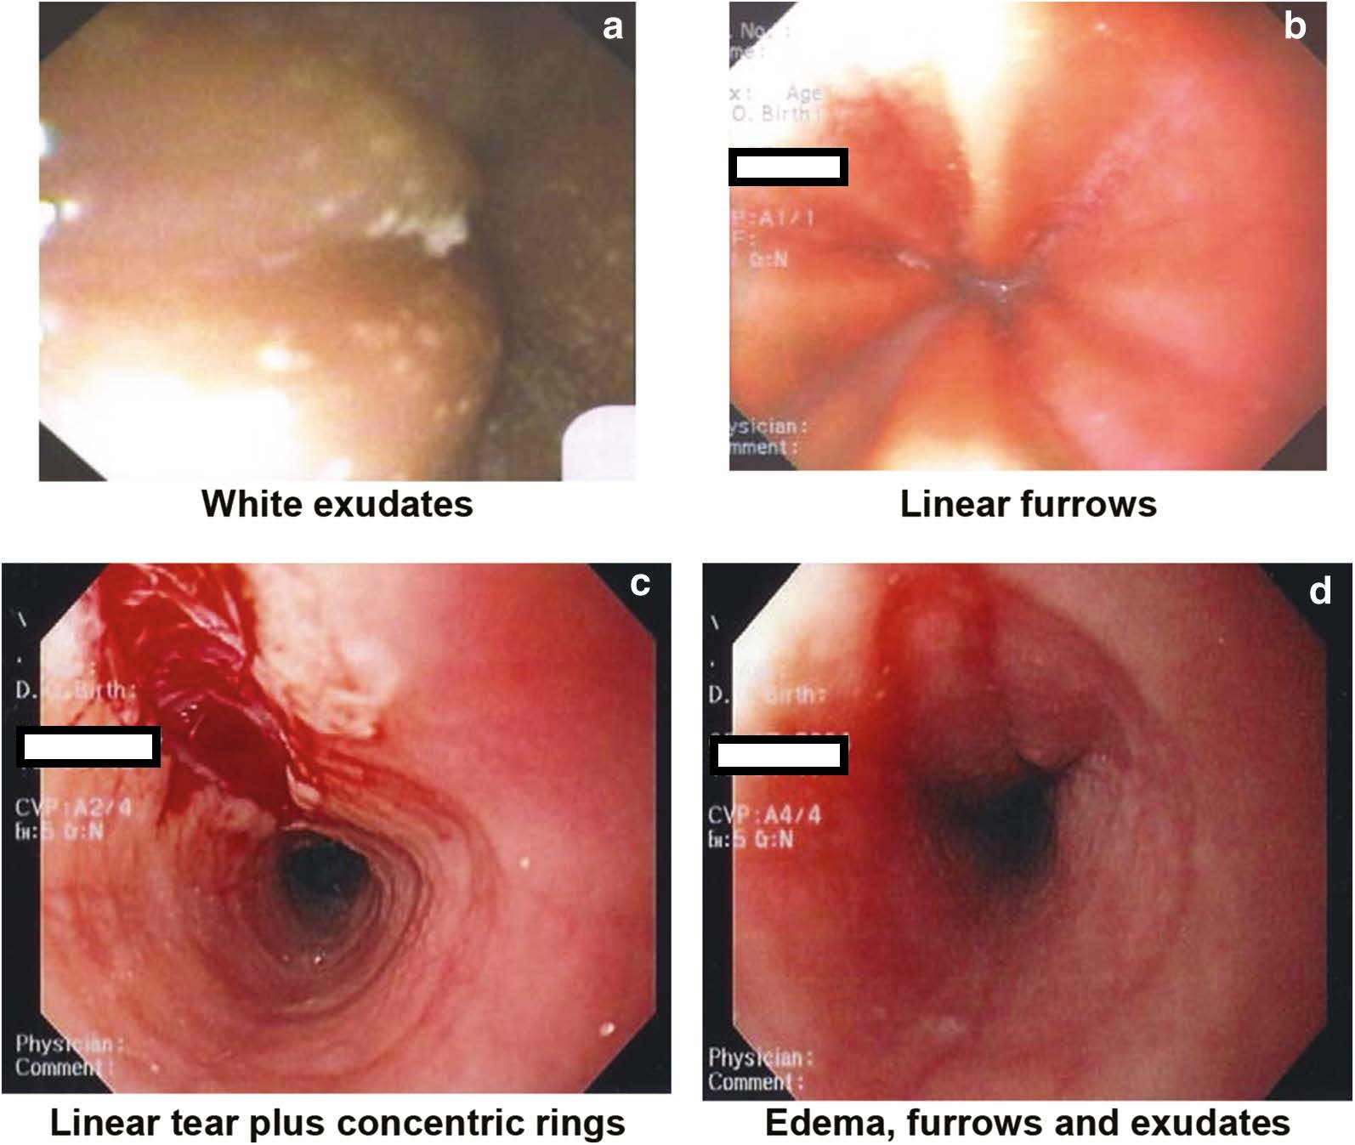
a. White exudates. Courtesy of Dr Hien Huynh.
b. Linear furrows. Courtesy of Dr Hien Huyn.
c. Linear tear plus concentric rings. Courtesy of Dr Adrian Jones.
d. Edema, furrows, and exudates. Courtesy of Dr Adrian Jones. From Carr S, Chan ES, Watson W. Eosinophilic esophagitis. Allergy Asthma Clin Immunol. 2018, 14(Suppl 2):58.

Slide 35
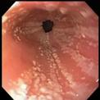
Eosinophilic Esophagitis EoE

Slide 36
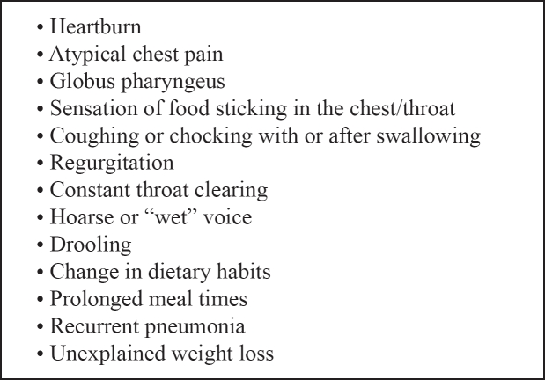
Symptoms Associated with Dysphagia
Symptoms often associated with dysphagia and/or aspiration.
Symptoms often associated with dysphagia and/or aspiration.
graphic file with name hippokratia-13-143-i001.jpg

Slide 37
Diagnosis of Dysphagia

Slide 38
Symptoms Predictive of Oropharyngeal Dysphagia
A delay in oropharyngeal initiation of swallowing
Deglutive (act of swallowing) cough, seconds after eating
Nasal aspiration during swallowing
There is a need for repetitive swallow to clear secretions
Global sensation

Slide 39
Symptoms Predictive of Esophageal Dysphagia
Symptoms occur a few seconds after initiation of the swallow
Associated regurgitation of undigested food
Dysphagia felt more within the chest

Slide 40
History and Physical
Medical History: dysphagia to solids, liquids, or both?
Dysphagia with solids: suggests obstruction or mechanical problem( esophageal webs or rings, intermittent)
Progressive dysphagia: due to progressive stricture or malignancy.
Dysphagia with liquids suggests motility disorder, such as, achalasia, or systemic sclerosis; if intermittent then esophageal spasm.
Onset and duration of symptoms
Problems with initiation of swallowing or after a few seconds of swallowing.
Symptoms in the neck or chest?
Occurrence with solids, liquids, or both?
Self-imposed dietary changes, regarding food consistency, preference for liquids or semisolids.
Eating meals slowly
Throat clearance during or after meals
Associated coughing, choking, or postnasal regurgitation
Recurrent chest infections
Functional decline

Slide 41
History and Physical Continued
Functional decline
Neurological deficits
Weight loss
Feelings of embarrassment
Social isolation, frustration, or depression
Physical Signs:
Loss of dentition
Gingival disease(gums)
Abnormal lip closure
Local mucosal changes
Neurological changes

Slide 42
People with Intellectual Disabilities and Dysphagia
Dysphagia(difficulties with eating, drinking, or swallowing) is associated with serious health complications and psychosocial sequelae.
Dysphagia in people who have Intellectual Disabilities have been under researched.
Very few studies to date, that have researched individuals with intellectual disabilities and dysphagia.
Gaps in health care have been identified in the following areas:
1. Intervention effectiveness in supporting people with intellectual disabilities.
2. Quality of life for people with intellectual disabilities that have dysphagia.
3. Lack of caregiver support, who care for people with disabilities that have dysphagia.
4. Lack of research in the area of improving recognition and management of dysphagia in people with intellectual disabilities.
The goal is to educate caregivers about dysphagia, reduce occurrence of associated health conditions, and reduce hospital admissions, and premature death in people with intellectual disabilities.

Slide 43
Caregiver Considerations when working with people with Intellectual Disabilities
Mealtime supports (while eating and/or drinking), may be required for individuals with Intellectual Disability Dysphagia, (IDD) who struggle with dysphagia, and/or other physical or behavioral difficulties, in order to decrease risk of choking and/or aspiration.
• Caregivers should ensure proper positioning of an individual at a 90o angle (a normal upright sitting posture) to reduce risk of choking and/or aspiration when the individual is eating or drinking.
Mealtime supports may also include protocols for:
1. Sitting with an individual during meals.
2. Verbal prompting for the individual to take another bite of food or drink.
3. Offer 100% assistance, which would require a caregiver to spoon feed an individual their meals.
4. Use of adaptive utensils to assist individual to eat and be more independent.

Slide 44
Caregiver Considerations continued
Mealtime protocols should include input from an individual’s Speech Language Pathologist (SLP), and their PCP, and must be signed by a physician.
Mealtime protocols ensure caregivers deliver a consistent level of support to individuals at risk for dysphagia, while ensuring safe and adequate nutritional intake.
Feelings of being “left out” of social events which include a particular food, (e.g., movie and popcorn night) and/or an individual’s dissatisfaction with the taste and texture of their modified diet are common reasons for non-compliance .
Training on how to prepare food/drink texture modifications is strongly recommended and will increase a caregiver’s level of confidence and ability to follow recommendations and PCP orders accurately .

Slide 45
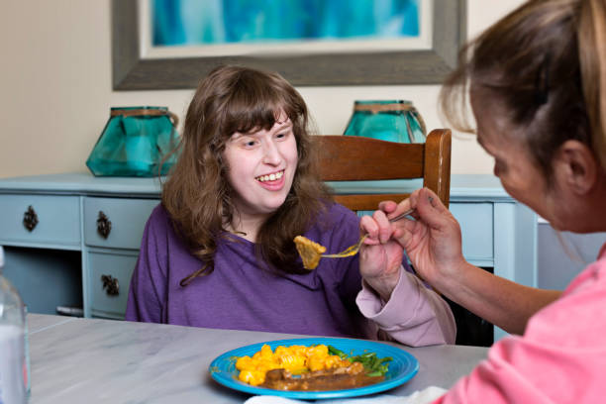

Slide 47
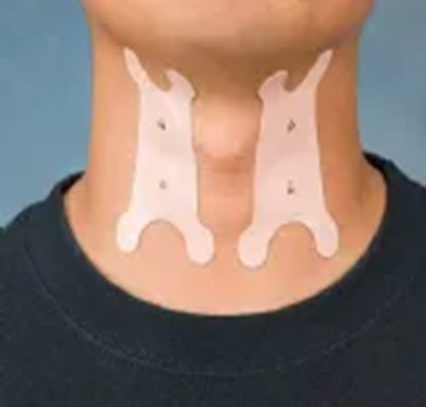
SLPs may place tape on a patient’s throat as part of Thermal Stimulation therapy, which is used to stimulate the swallowing reflex and improve swallowing. This increases sensitivity and muscle activation in the throat, ultimately aiding in the safe and efficient transfer of a bolus of food or liquid into the esophagus, improving dysphagia. A cold swab in the back of the throat may also be used to stimulate the facial arches.

Slide 48
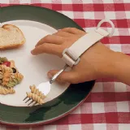

Slide 49
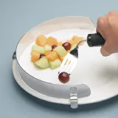
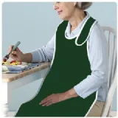
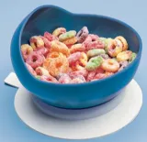

Slide 50
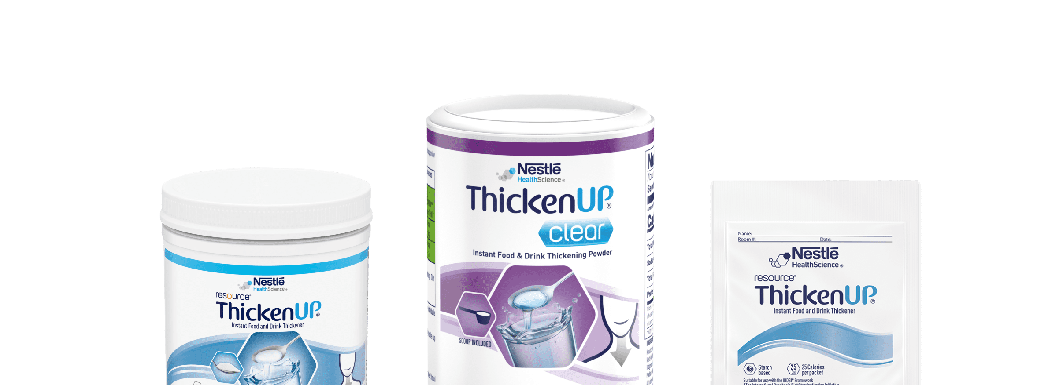

Slide 51
Screenings for Dysphagia
Depending on the setting, screens are done by speech-language pathologists, nurses, physicians, or other healthcare providers. SLPs often train other disciplines on how to do the swallow screen.
While there’s no one preferred tool, there are quite a few evidence-based swallowing screens, including:
3-ounce water test (Yang et al, 2023)
Yale Swallow Protocol. Includes a 3-ounce water test and brief oral mech and cognitive screen. Attachment to be sent.
EAT-TEN Nestle Screening Tool (Eating Assessment Tool). Questionnaire that doesn’t require swallowing water or food.
V-VST (Volume Viscosity Swallow Test). Includes a hierarchy of food boluses with different textures and consistencies.

Slide 53
Key Elements of a Bedside Swallow Test
1. Patient Interview: swallowing symptoms, food sticking in throat, choking episodes, changes in voice quality after eating.
2. Oral Motor Examination: assessing strength and coordination of facial muscles, tongue movement and jaw function.
3. Water Swallow test: Observing how you drink small sips of water, noting any coughing, choking, or voice changes.
4. Different liquid consistencies: SLP may ask you to swallow liquids of varying thicknesses like thin liquids, nectar-thick liquids, or honey-thick liquids.
5. Good observation: Watching how you chew and swallow small bites of soft food to assess potential issues.
6. Palpation: Feeling the movement of the larynx(voice box) in the neck while swallowing to assess elevation.
POINTS TO REMEMBER:
A Bedside Swallow Test is a screening tool and cannot definitively diagnose dysphagia.
Referral for further testing: if the SLP observed concerning signs during the bedside evaluation, the SLP will
Recommend further testing like a barium swallow or FEES (Fiberoptic Endoscopic Evaluation
Of Swallowing).

Slide 54
Diagnosis
Barium Swallow versus Endoscopy: These two tests are complimentary not duplicative.
The decision on which test is used is based on which will yield the diagnosis.
Endoscopy gives accurate information on esophageal anatomy; it is used commonly as the first test to evaluate solid food dysphagia. It allows for precise mucosal inspection and the ability to biopsy.
Endoscopy also serves as a potential therapeutic tool because dilation may be performed if needed at the same time of the diagnostic study.
Endoscopy is helpful for suspected mechanical causes of dysphagia.
Barium Swallow: Barium is a contrast medium you drink, and x-rays identify the muscular activity of the esophagus. Can be done in-patient or out-patient .
Barium Esophagography is more sensitive than endoscopy for detection of esophageal strictures.
For suspected distal esophageal motility disorders such as, achalasia or scleroderma, involving the esophagus
Barium evaluation has been shown to be superior to endoscopy.
An exact diagnosis of achalasia by barium may allow for pneumatic dilation or injection of intra-sphincteric botulinum toxin during endoscopy.
Barium esophagography can identify an esophageal fistula or perforation.

Slide 55
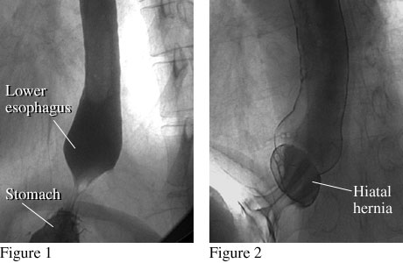
Barium Swallow: fistulas and perforation
Figure 1 shows the lower end of a normal esophagus with a smooth connection between the lower esophagus and stomach.
Figure 2 shows the lower end of the esophagus with a small hiatal hernia, which occurs when a small portion of the stomach pushes up into the chest.

Slide 56
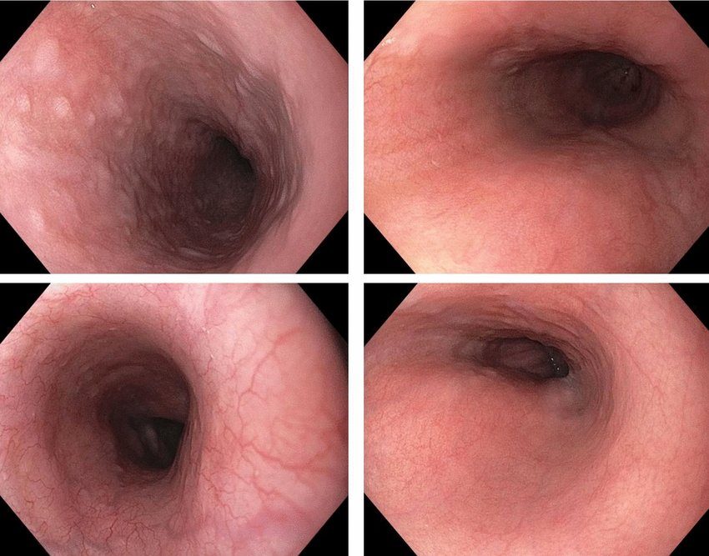
Endoscopy of the Esophagus: Mechanical issues: Normal esophagus

Slide 57
Diagnosis
Esophageal Muscle test, called a Manometry: A small tube is inserted into the esophagus and connected to a pressure recorder to measure the muscle contractions of the esophagus during swallowing.
High Resolution Impedance Manometry(HRIM): is a modern adaptation of the traditional esophageal manometry, but with greater accuracy and visualization based on having 32 pressure transducers that span the esophagus –as opposed to the limitations of a few transducers used in the past.
HRIM gives a clear pan esophageal pressure tracing that can be generated and then described through a colorimetric graphic presentation (the Clouse plot).
Impedance Measurement has also been added to this technique with added electrodes that measure the conductivity of a substance based on the characteristics and speed of the bolus.
Produces clearer reading of peristaltic and sphincter function.
High Resolution Impedance Manometry is the most sensitive test to measure for abnormal esophageal motility.

Slide 59
Diagnosis
Fiber-optic endoscopic evaluation of swallowing (FEES). During a FEES study, a healthcare professional examines the throat with an endoscope during swallowing.
Imaging Scans: these can include a CT scan or an MRI scan.
A CT Scan combines a series of x-rays views and computer processing to create cross-sectional images of the body’s bones and soft tissues.
An MRI Scan: uses a magnetic field and radio waves to create detailed images of organs and tissues.

Slide 60
Treatment Oropharyngeal Dysphagia
Referral to Speech Language Pathologist (SLP):
1. Learning exercises to help coordinate your swallowing muscles or restimulate the nerves that trigger the swallowing reflex.
2. Learning swallowing techniques: teaches you to place food in your mouth or position your body and head to help you swallow. Helpful if dysphagia is caused by a neurological problem , such as, Alzheimer’s disease or Parkinson’s disease.

Slide 61
Throat Exercises taught by SLP
Throat exercises, such as the Mendelsohn maneuver and Shaker exercises, are used by SLPs (Speech-Language Pathologists) to strengthen throat muscles for swallowing and voice control.
These exercises can be visualized with illustrations showing the correct posture and action.
Here's a breakdown of some common throat exercises and how they can be visualized:

Slide 62
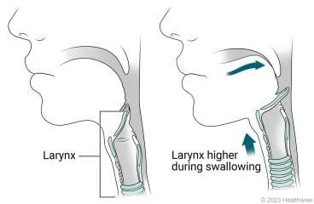
Mendelsohn Maneuver
Start to swallow normally.
When your larynx (voice box) is at its highest point, squeeze your throat muscles to hold it in that position for 3 counts, and then relax. You can use your fingers to feel your larynx move.
Repeat these steps as many times as directed.
Sit or stand comfortably.

Slide 63
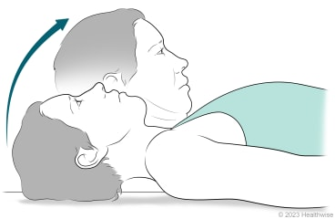
Shakers Exercise
There are two ways to do the Shakers exercise. Your doctor or speech therapist may have you do it one or both ways.
Lie on your back on a firm surface.
Keep your shoulders flat. Don't lift your shoulders.
Bend your head forward so that your chin tucks. Try to see your toes.
Hold the position as your doctor or speech therapist tells you to. You can either:
Hold this position for 1 minute, and then lower your head and rest for 1 minute.
Or hold this position for 1 minute, and then lower your head and go on to the next repetition.
Repeat these steps as many times as directed.

Slide 64
Effortful Swallow exercise
1. Sit or stand comfortably. Squeeze your throat muscles as hard as you can, and then swallow. Imagine that you have a grape-sized piece of food stuck at the back of your throat, and try to swallow it.
Repeat these steps as many times as directed.

Slide 65
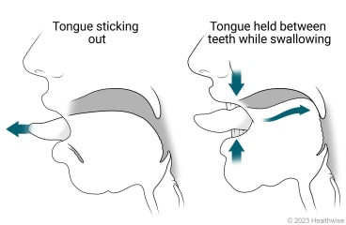
Masako maneuver
Sit or stand comfortably.
Stick your tongue out as far as is comfortable.
Hold your tongue gently between your front teeth, and then swallow.
Let go of your tongue.
Repeat these steps as many times as directed.

Slide 66
Esophageal Dysphagia Treatment
1. Esophageal dilation: dilation involves placing an endoscope into the esophagus and inflating an attached balloon to stretch it. Used for Achalasia, esophageal stricture, motility disorders, or an irregular ring of tissue at the junction of the esophagus and stomach, known as Schatzki ring. Long flexible tubes of varying diameter also may be inserted through the mouth into the esophagus to treat strictures and rings.
2. Surgery: for esophageal tumors, achalasia, or pharyngoesophageal diverticulum, clears the esophageal path.
3. Medicines: Dysphagia caused by GERD can be treated with prescription medicines to reduce stomach acid.
Corticosteroids might be recommended for Eosinophilic Esophagitis(E0E). New drug is Dupixent the only FDA approved drug that is a dual inhibitor of IL-4 and IL-3 Signaling.
Muscle relaxants may be ordered for esophageal spasms.
4. Diet: Depending on etiology of dysphagia a special diet may be ordered. If you have Eosinophilic Esophagitis, diet might be used as treatment.

Slide 67
Treatment for Severe Dysphagia
1. If dysphagia prevents you from getting adequate nutrition a feeding tube may be recommended.
2. The type of dysphagia you have will determine the type of surgery you need.
A. Laparoscopic Heller Myotomy: cutting the muscle at the lower end of the esophagus, called the esophageal sphincter. In achalasia, the esophageal sphincter fails to open and release food into the stomach.
B. Peroral Endoscopic Myotomy (POEM): The (POEM) procedure involves creating an incision in the inside lining of the esophagus to treat achalasia (esophageal motility disorder). Then the surgeon cuts the muscle at the lower end of the esophageal sphincter.
C. Stent Placement: A metal or plastic stent may be used to prop open a narrowed or blocked esophagus.
Some stents are permanent used for people with esophageal cancer, while other stents
can be removed later.
D. Onabotulinumtoxin(Botox): injected into the esophageal sphincter. Causes relaxation, improving
swallowing in achalasia. Less invasive than surgery. Repeat injections.

Slide 68
Anxiety, Food Insecurity, and Being Homebound
Two HNS&CS papers published in 2023 analyzed health data from the National Health & Aging Trends Study in over 4,000 older adults living in the community who received Medicare benefits.
In the sample, over 10% of respondents self-reported dysphagia in the prior month.
Relationships between dysphagia and social determinants of health have received very little prior attention, and these papers highlight a need for further research.
According to Drs. Jones and Cohen, more participants reported dysphagia than not, among people in those who were:
Hispanic
Separated, divorced, widowed, or never married
Had less than a high school education
Had a total income of less than $27,600
Medicaid and Tricare recipients
Rural residents

Slide 69
Prognosis in Patients with Dysphagia
The consequences of dysphagia can be profound.
Although it is appreciated that nutrition, hydration, quality of life issues, and social isolation may arise, aspiration (especially if not immediately recognized) may be the pivotal factor that precipitates a significant decline in a patient's outcome.
Our research group has previously shown that in patients hospitalized with stroke, only 14% of those without dysphagia required more than 7 days of hospitalization.
When a patient with stroke also had dysphagia, their likelihood of hospitalization longer than 7 days was up to 73.9%.
These findings emphasize the importance of early diagnosis of dysphagia so that an appropriate plan of care can be instituted, and so that the potential economic impact of a prolonged hospitalization might be mitigated.

Slide 70
Dysphagia Resources:
ASHA - American Speech-Language-Hearing Association www.asha.org/public/
NFOSD - National Foundation of Swallowing Disorders www.swallowingdisorderfoundation.com
IDDSI - International Dysphagia Diet Standardization Initiative iddsi.org
Cerebral Palsy Group cerebralpalsygroup.com
Speech Language Pathology Education https://www.speechpathologydegrees.com/
http://www.onlinespeechpathologyprograms.org
Nestle Medical Hub https://www.nestlemedicalhub.com

Slide 71
Blogs:
SimplyHolahan - Reflections on swallowing disorders, IDDSI, thickeners and rheology
Dysphagia Ramblings - www.dysphagiaramblings.net
Speech@NYU - Caring for Aging Adults with Dysphagia
Dysphagia Facebook Groups:
NFOSD Pediatric Support Group: Babies with Swallowing/Feeding Disorders
The Dysphagia Outreach Project
Dysphagia Therapy
NFOSD Pediatric Swallowing Support Group
Pediatric Dysphagia & Aspiration
Sherri Gunn RN, IBCLC http://www.successwithbreastfeeding.com/
http://www.breastmilksolutions.com/about.html
http://www.lovetummytime.com/
Lip Tie/Tongue Tie Revision:
https://www.drghaheri.com/
Nutritionist and Dietitian Facebook Groups:
Nutrition Hungry

Slide 72
Summary of Dysphagia Presentation:
Today we discussed the 3 phases of Swallowing.
We discussed the two main types of Dysphagia.
Causes for the different types of Dysphagia were listed.
Tests and treatments were discussed for each type of Dysphagia.
We discussed the various screening tools used to determine if dysphagia is present.
We discussed the special needs of individuals with dysphagia if they have other co-morbidities.
Thank you for sharing your time and thoughts with me today.
Dana Rizzo RN

Slide 73
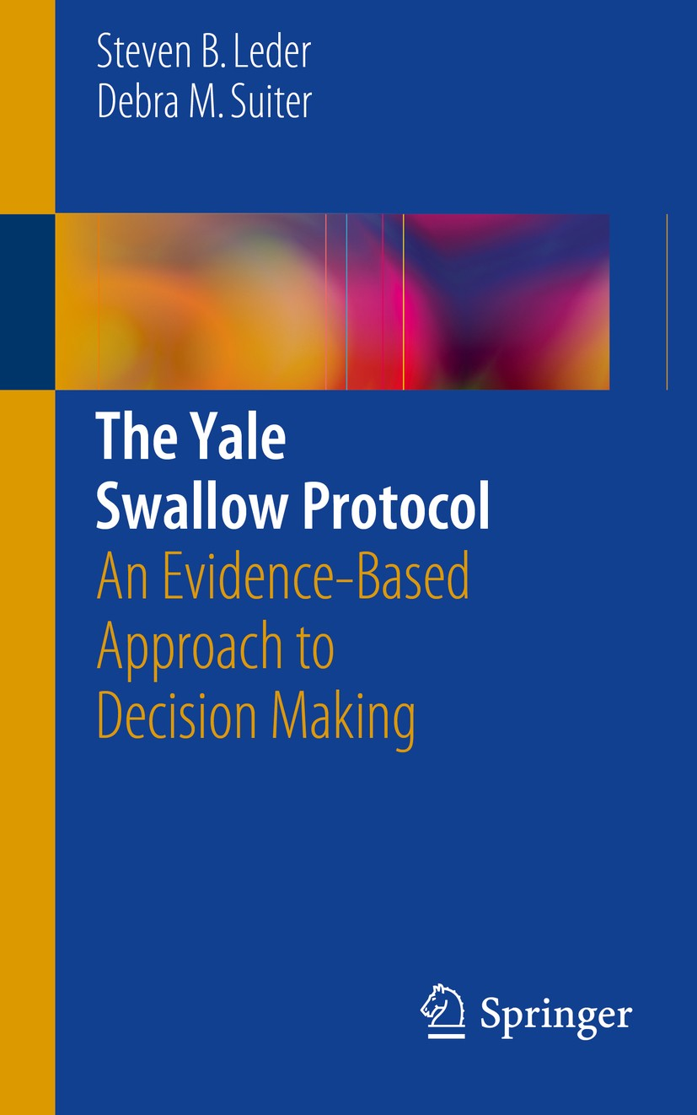

Slide 74
References:
Michael R. Spieker, CAPT, MC, USN, Evaluating Dysphagia, AM FAM Physician. 2021;06(12):3639-3648.
Ala’ A. Abdel Jalil ,MD, David A. Katzka, MD, Donald O. Castell, MD. Approach to the Patient with Dysphagia, AJM Review, Volume 128, issue 10, October 2015.
Prianka, Chilukuri, Florence Odufalu, Christine Hachem. Dysphagia, Mo Medicine. 2018 May-June, 115(3): 206-210.
Mayo Clinic, Dysphagia diseases and conditions, December 2024.
Dysphagia-clinical methods-NCBI Bookshelf, 2024.
Dysphagia in Older Adults: New Implications for Health Outcomes, Duke University 2024. Medschool.duke.edu.
Samy A. Azer, Ashok Kumar Kanugula; Ravi K. Kshirsager, Dysphagia, NCBI. Stat Pearls Publishing: 2024 Jan.
Ayano Nagano, Masami Onaka, Keisuke Maeda, et al: Prevalence and characteristics of the course of Dysphagia in
Hospitalized Older Adults, Nutrients. 2023 Oct. 15;15(20): 4371.
Steven B. Leder, Debra M. Suiter, The Yale Swallow Protocol, An Evidence Based Approach to Decision Making, Springer2023.
G. Cox , Supports Provided to People with Intellectual Disability and Dysphagia. Wiley online Library 2024.
TS Van Der Woude, Screening Instrument for Dysphagia in People with Intellectual disability. 2023 Springer.com.
Chadwick, et al, People with Intellectual or Learning Disabilities, Also have Higher Rates of Feeding and Swallowing
Disorders(dysphagia). 2014/ 2024 ResearchGate.net

Slide 75
Resources
Dysphagia: Symptoms, diagnosis, and treatment. Medical News Today. January 2025. www.medicalnewstoday.com.
S. Popadopoulour M.D. Dysphagia I Rare Diseases and Syndromes, NIH 2024 , PMC.NCBI.NIH.gov.
“Adult Dysphagia” American Speech-Language-Hearing Association (ASHA) www.asha.org January 2025.
Dysphagia: What’s behind your swallowing difficulties” CVMC June 19, 2024.
“Dysphagia-symptoms and causes. July 31, 2024 Mayo clinic, www.mayoclinic.org.
JM Song, Dysphagia and Quality of Life: A narrative review. Annals of clinical Nutrition and Metabolism. ACNM 2024 www.e-acnm.org.
“Dysphagia in Adult Myopathies-Neuromuscular disorders”, NMD-Journal.com 2025.

