Slide 1
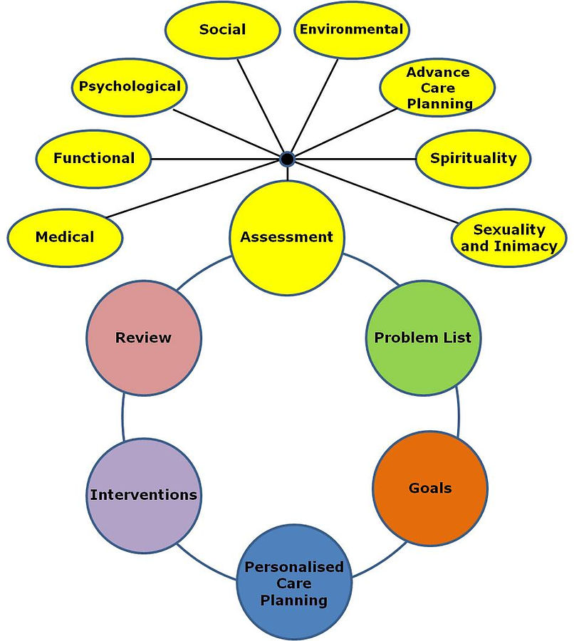
The Importance of a Comprehensive Geriatric Assessment in the Healthcare Setting.
Created by: Dana Rizzo RN, BSN, ACM-RN
Area Manager for Waltonwood Senior Living
Dana.Rizzo@singhmail.com

Slide 2
Objectives: After taking this course, you should be able to:
1. Define what the Comprehensive Geriatric Assessment (CGA) treatment process is and its purpose.
2. Define Frailty
3. List common health conditions that fall under the heading of the Geriatric Syndrome.
4. List the 9 Core Components of the Comprehensive Geriatric Assessment (CGA) in the United States.
5. List the 5 Domains of Health in the Comprehensive Geriatric Assessment (CGA) in the United States.
6. Discuss the indications for a Comprehensive Geriatric Assessment (CGA).
7. List 6 types of Elder Abuse .
8. Discuss Social Determinants of Health (SDoH).

Slide 3
Human Frailty
Human Frailty is defined as physical weakness or lack of strength. 10 % of people over age 65 years old are considered frail.
Indications:
Unintentional weight loss of 10 or more pounds within the year.
Muscle loss or weakness (Sarcopenia)
Feeling of fatigue and exhaustion (Geriatric Depression Scale)
Slow walking speed (measured using the Short Physical Performance Battery SPPB)
Low levels of physical activity (Morton Mobility Index DEMMI) or (Timed Up and Go TUG)
Ie. Failure to Thrive
Clinical Frailty Scale components:
a. Very Fit
b. Well
c. Managing well

Slide 4
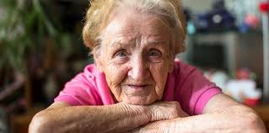

Slide 5
The Comprehensive Geriatric Assessment (CGA)Process Defined:
CGA is defined as a multidisciplinary diagnostic and treatment process that identifies medical, psychosocial, and functional limitations of a frail older person in order to develop a coordinated plan to maximize overall health with aging (1,2).
The healthcare of an older adult extends beyond the traditional medical management of illness.
The CGA requires evaluation and assessment of multiple issues, including physical, cognitive, affective, social, financial, environmental and spiritual components that influence an older adult’s health.
The purpose of the CGA is based on the premise that a systematic evaluation of frail, older persons, by a team of healthcare professionals may identify a variety of treatable health problems, and lead to better health outcomes. Helps to tailor rehabilitative needs to the individual.
The CGA is over 20 years old.
Hospital based CGA starts on admission.
CGA is used in emergency departments, medical units, trauma, oncology, orthopedic,
and in community dwellings, Assisted Living Communities, and in private homes.
CGA can be applied in SNF, Long Term Care Facilities, Residential Communities and Transition Care Programs (TCP).
Time to perform a CGA is 55 minutes.

Slide 6
The Five Domains of the Comprehensive Geriatric Assessment: (T J Welsh, A L Gordon, J R Gladman)
1. Physical Medical conditions- Comorbid conditions and disease severity
Medication Review: Polypharmacy
Nutritional status: height and weight/Elder Abuse Assessment
Create a problem list
2. Mental Health Issues - Cognition, mood, anxiety, depression (Mini Mental State Examination MMSE)
3. Functioning- Core Functions such as mobility and balance (Modified Barthel Index MBI)
Activities of daily living (ADL)
Life roles that are important to patient (Patient Health Questionnaire-9 PHQ-9)
4. Social circumstances- Social determinates of health (SDOH)
Social networks, informal support available from family, the wider network of
friends and contacts, and statutory care
Poverty (Social Determinants of Health)
5. Environment- Housing comfort, facilities, and safety
Use or potential use of “Telehealth” technology
Accessibility to local resources, clinics, community centers

Slide 8
Indications for a Comprehensive Geriatric Assessment include:
Indications for referral for a CGA is based on identifying appropriate patients( ie. Excluding patients who are either too well or are too sick to derive benefit).
Specific criteria used by CGA programs to identify patients include:
A. Age 65 years of age or older. In Australia the age is 60 years of age.
B. Medical comorbidities such as heart failure or cancer.
C. Psychosocial disorders such as depression, anxiety, isolation, hoarding.
D. Specific geriatric conditions, such as, dementia, delirium, falls, or functional disability.
E. Previous or predicted high health care utilization, length of stay concerns, readmissions.
F. Consideration of change in living situation (ie. From independent living to assisted Living, SNF or caregivers).
G. Those needing geriatric health maintenance (ie. Mood disorders, ADL and IADL, fall risk, cognitive problems).
CGA is not indicated for patients who have a terminal illness, severe dementia, complete functional
dependence, or inevitable nursing home placement.
(Katherine T Ward, MD David B. Reuben, MD.)

Slide 9
Common Health Conditions in the frail population that indicate that a CGA should be done:
Arthritis
Cancer
Chronic Kidney disease
COPD
Dementia, Alzheimer’s Disease, and Parkinson’s disease
Diabetes
Osteoporosis
Stroke
Heart conditions
Sepsis
Signs of Elder Abuse

Slide 11
What is the Geriatric Syndrome?
The conceptualization of geriatric syndromes has been evolving over time (Flacker JM, 2003).
In general terms, a “syndrome “ has been identified as “a group of signs and symptoms that occur together and characterize a particular abnormality” (Merriam Webster Dictionary) or “the aggregate of symptoms and signs associated with any morbid process, and constituting together the picture of the disease” (Steadman’s Medical Dictionary).
Geriatric Syndromes, by contrast, refer to “multifactorial health conditions that occur when the accumulated effects of impairments, in multiple systems, render an older person vulnerable to situational challenges”. (Tinetti ME, 1995).
Thus , the geriatric usage of the term “syndrome” emphasizes multiple causation of a unified manifestation.

Slide 12
Geriatric syndromes include the following 6 conditions:
1. Falls
2. Urinary Incontinence
3. Pressure Ulcers
4. Sleep Disorders
5. Delirium
6. Dementia
The health care provider must always assess for Elder Abuse signs and symptoms.

Slide 13
What is the Geriatric Syndrome : Multifactorial Health Conditions that occur when the accumulated effects of impairments in multiple systems render an older person vulnerable to situational challenges.

Slide 14
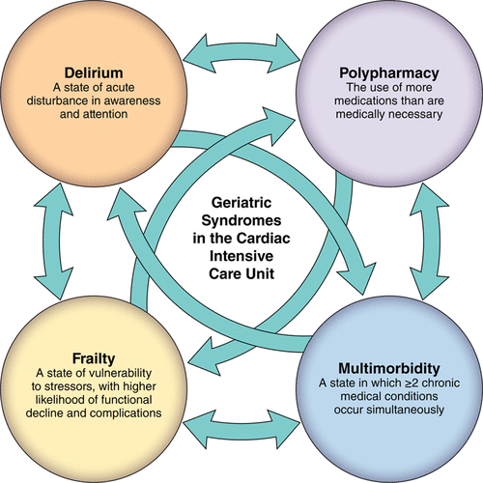

Slide 15
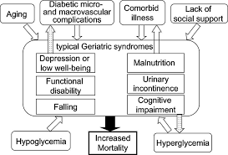

Slide 16
Sarcopenia
Sarcopenia is the loss of muscle and strength that can happen when someone gets older and does less physical activity. This may cause trouble with daily activities like standing from a chair, walking, twisting the lid off a jar, or carrying groceries’.

Slide 17
Core Components of the CGA, that should be evaluated during the assessment process are :
A. Functional Capacity (falls history, Elder Abuse signs and symptoms)
B. Fall Risk
C. Cognition
D. Mood
E. Polypharmacy
F. Social support
G. Financial concerns(Social Determinants of Health Factors, SDoH)
H. Goals of Care
I. Advance care preferences (POLST, Advance Directives)

Slide 18
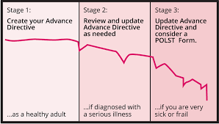

Slide 19
Advance directives and POLST forms are both tools for expressing healthcare wishes, but they serve different purposes.
Advance directives are legal documents that name a healthcare agent and outline general treatment preferences, while POLST forms are medical orders completed by healthcare professionals for seriously ill patients, specifying what level of care they want in an emergency.

Slide 21
Additional Components of the CGA may include evaluation of the following:
Nutrition/weight change
Urinary continence
Sexual function
Vision/hearing
Dentition
Living Situation/Social Determinants of Health/Access to Health Care
Spirituality
Signs and Symptoms of Elder Abuse

Slide 22
Specific criteria used by CGA programs to identify patients include:
Age ie. Everyone over 85 years old (Criteria is determined by the agency or hospital)
Medical comorbidities such as heart failure or cancer, CGA prompts referrals to specialists.
Psychosocial disorders such as depression or isolation the CGA prompts referral to specialties.
Specific geriatric conditions such as, dementia, falls, failure to thrive, functional disability, signs and symptoms of elder abuse, the CGA prompts referrals to specialties.
Previous or predicted high health care utilization(frequent trips to ED), the CGA prompts referrals to case managers and other specialties.
Consideration of change in living situation (ie. Going from independent living to assisted living, nursing home, or in-home caregivers).
(Katherine T Ward, MD David B Reuben, MD)

Slide 23
The Comprehensive Geriatric Assessment Core Team
The CGA Multidisciplinary Team comprised of a core of professionals:
Clinician
Nurse/ Case Manager/ may contact Adult Protective Services
Social worker/ Case Manager
Physical and Occupational Therapists
Dietitians
Pharmacists
Psychiatrists
Psychologists
Dentists
Audiologists
Podiatrists
Opticians

Slide 24
The CGA often uses resources within the hospital, but limitations of services involves access difficulties and reimbursement concerns for the specialists. Early CGA programs focused on restorative and rehabilitative goals (Tertiary prevention), but no longer, due to pressure to reduce length of stay . Current trends have evolved.
Currents Trends for the Comprehensive Geriatric Assessment include:
A “Virtual CGA Team” concept in which members are included as needed, assessments are conducted at different locations, on different days, and CGA Team communication is completed by telephone or electronically, often through the electronic health record. (Portals).
A follow up appointment may be needed for further evaluation, such as, a dietician consult, or a hearing test by an audiologist.
Longitudinal assessment data is collected and used by the multidisciplinary team.
Newer CGA programs are focused on primary and secondary prevention.
The CGA must assess all 5 Domains to deliver wholistic medical care.

Slide 25
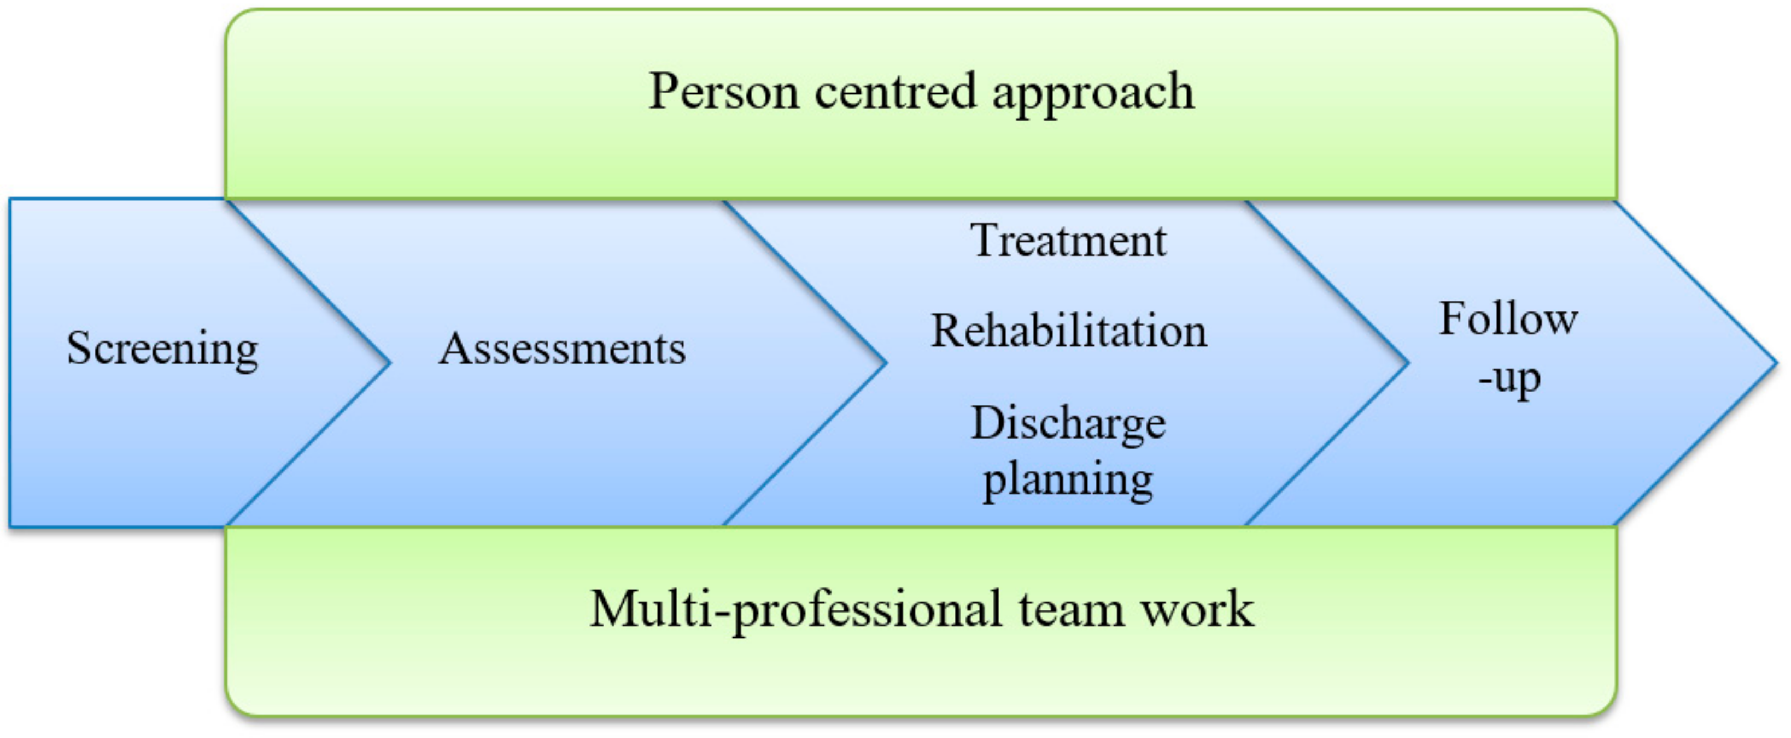

Slide 26
Assessment tools include:
Ability to perform functional tasks and level of need for assistance
Fall History/risk- Neurologic gait disorders
Urinary and or fecal incontinence/skin condition
Pain
Sources of family, friend and social support.
Depressive symptoms-(Late-life unipolar depression)
Vision or hearing impairments
Whether the patient has completed the durable power of attorney (DPOA) or POLST (Physician orders for life-sustaining treatment).
Nutrition/weight change/tools used to assess malnutrition/Failure to Thrive
Sexual function
Dentition
Spirituality
Cognition – evaluate etiology: TSH, depression assessment, CT scan.
Polypharmacy-medications must be evaluated at each visit. “Deprescribing”

Slide 27
Activities of Daily Living : An older person’s functional status can be assessed at three levels:
1. BADLs: Basic activities of Daily living: refer to self-care tasks which include:
Bathing, dressing, toileting, maintaining continence, grooming, feeding, and transferring.
2. IADLs: Intermediate activities of Daily living:
Shopping for groceries, driving or using public transportation, using the telephone, performing housework, doing home repair, preparing meals, doing laundry, taking medications, handling finances. Using technologies using the cell phone, internet, ability to keep a schedule of activities.
3. AADLs: Advanced activities of daily living:
Ability to fulfill societal, community, and family roles, recreational
Activities or occupational.
Vulnerable Elders Scale 13, The VES 13,
Clinical Frailty Scale , The Katz index for ADL, Lawton scale for IADLs
(Katherine T Ward, MD, David B Reuben, MD 2023)

Slide 28
Goals of Care (GOC)
Older Adults who are appropriate for CGA have limited potential to return to fully healthy and independent lives.
Goals of Care are viewed as positive, for example, regaining a previous health status, attending a future family event.
Person-centric and individualized, for example, regaining independent ambulation after a hip fracture, however, others might be content with a walker.
Short term GOC progress toward overall Goal of Care.
Long Term GOC progress toward overall Goal of Care.

Slide 29
Advanced Care Preferences
Cognitive Capacity
Discussions with patients as soon as possible while they have capacity to make their own decisions.
Choosing an appropriate decision maker(DPOA or Health Care Proxy) to serve in the event of personal incapacity.
Patient’s values and stated preferences
Tools have been developed to help providers elicit and document care preferences and promote end of life decision making among seriously ill patients.
For Example: POLST: Physician Orders for Life-Sustaining Treatment, Five Wishes, Prepare for Your Care.

Slide 30
Efficacy of the Comprehensive Geriatric Assessment
Most research studies have found that the Comprehensive Geriatric Assessment leads to improved detection and documentation of geriatric problems and co-morbidities.
However, the ability of CGA to improve outcomes, such as, decreased hospitalization, nursing home admission, and mortality depends on specific CGA models and the setting where they have been implemented.
Patients who had a CGA felt it was a positive experience because :
They expressed satisfaction at knowing how they performed on the CGA.
They felt it was not too time consuming.
CGA tools was easy to comprehend.
They appreciated the staff’s time in getting to know them better.
CGA helped them understand their own abilities and wellbeing.
CGA helped relieve boredom.
They felt it helped them understand what they were capable of and could improve.
(Ying Git Wong, Jo-Anne Hang, Jacqueline Francis-Coad, Ann-Marie Hill 2022)

Slide 31
Five Models of CGA have been evaluated in the US
1. The Home Geriatric Assessment performed by Home Health Care Agency Nurses and Social workers. Followed patients for 1 year.
2. The Acute Geriatric Care Unit (ACE Units)Assessment performed in the acute hospital setting. US Department of Veterans Affairs Hospitals use the Geriatric Evaluation and Management Units (GEMUs).
3. The Post-hospital Discharge Assessment follow up calls and assessments performed by Rn and SW. Target most vulnerable patients. Multidisciplinary approach.
4. The Outpatient Consultation Assessment follow up with patient in a clinic or doctors office. Target Adherence to program recommendation and treat patients at higher risk of hospitalization have lead to improved outcomes.
5. The Inpatient Consultation Assessment performed by case managers in an acute hospital. Showed short term benefit of 6 to 8 month survival, but no effect on functional status, readmission, or length of stay.

Slide 32
New applications of Comprehensive Geriatric Assessment include the following
Principles and processes of the CGA are increasingly being applied to subspecialities and subspeciality conditions, including oncology patients, undergoing chemotherapy, infective endocarditis, considerations of surgery or transcatheter aortic valve replacement (TAVR) for patients with aortic stenosis, vascular surgery, and postoperative mortality risk.
In addition, CGA has been incorporated into new models of care for hospital and home use.
CGA has improved outcomes based on the following :
Accurate assessment across all 5 domains is the first step in appropriate management and to avoid over and under-prescribing.
Multimorbidity rises with age, resulting in complex clinical picture and increased needs of the patient.
Polypharmacy, prescribing errors, adverse drug effects, hospital acquired infections, venous thromboembolism, pressure ulceration-all associated with medical intervention-all become more common the older patients get.
Medication appropriateness indices remind us that harm not only comes from prescription of unnecessary medications, but also the omission of those which evidenced based practice would support.
(T J Welsh, A L Gordon, J R Gladmon 2014)

Slide 33
Summary and Recommendations of the CGA
The Comprehensive Geriatric Assessment (CGA) is not the panacea and further work is needed to explore its applicability in different settings.
Evidence for its use in hospitals remains strong, with Baztan and colleagues review, suggesting that older people treated on an acute geriatric unit improved functional outcome.
Creating a Streamlined CGA in the Emergency Department with a transfer to an Acute Geriatric Unit within the acute hospital has shown to improve outcomes in all 5 Domains for the Geriatric patient.
The CGA and its interface between community and acute care to date must still be studied, to date , no clear benefit is evident.
Future research challenges therefore remain to evaluate the use of CGA in the community and at the interface between community and hospital care.
Comprehensive Geriatric Assessment provides a contrasting model of care to traditional approaches focused on single problems by single clinicians, being multidimensional and multidisciplinary .
It generates Problem Lists, as well as diagnoses.
CGA establishes Goal -Oriented Management Plans and ensures they are reviewed.
Done well, the CGA it delivers effective healthcare to vulnerable groups who otherwise would have
received an ineffective, inefficient and potentially unsafe response.
( Dr Welsh, Professor Gordon Gladmon)

Slide 35
Comprehensive Geriatric Assessment Summary
If the CGA is implemented into service models and clinical pathways it could go a considerable way to minimizing harm and ensuring that the right healthcare gets practiced, at the right time to this vulnerable population.

Slide 36
Elder Abuse Screening Tools for Healthcare Professionals
WHO definitions of Elder Abuse is, “A single or repeated act, or lack of appropriate action, occurring within any relationship where there is an expectation of trust which causes harm or distress to an older person.”
Currently there is no gold standard for elder abuse screening tools.
Most abuse is identified in health care settings, however, rates of abuse identification by health care providers remains low.
Only 1% of cases that are reported to Adult Protective Services (APS) come from physicians.
Normal aging changes can mimic signs of elder abuse.
Population aging will result in higher abuse rates of older persons, a worldwide problem.
Elder victims may be reluctant to disclose evidence of abuse to professionals out of fear, shame or a sense of hopelessness.
World Elder Abuse Awareness Day (WEAAD) is commemorated every June 15th.

Slide 37
Six Types of Elder Abuse
Physical Abuse
Psychological Abuse
Sexual Abuse
Financial Abuse
Neglect
Violation of personal rights

Slide 38
Elder Abuse Screening tools Discussed with CMS at the Mistreatment Symposium.
1. Elder Abuse Suspicion Index (EASI): 6 items, HCP administers to assess Risk, neglect, verbal, psychological, emotional, financial, physical, and sexual abuse over a 12-month period. Takes 2 minutes to complete. Validated in family practices and ambulatory care settings.
2. Hwalek-Sengstock Elder Abuse Screening Test (H-S/EAST): 6 items, self report or HCP. Predictive validity, good cross-cultural adaptation. Used in ED or outpatient setting.
3. Vulnerability to Abuse Screening Scale (VASS): 12 items, self-report of dependency, dejection, coercion, and vulnerability. Moderate reliability, good validity. Validated in family practices, and ambulatory care settings.

Slide 39
References
Lay Khoon, Lau, Penny Lun, Jonathan Gao, Edward Tan, Application and Implementation of Brief Geriatric assessment in Primary Care and community Settings: A Scoping Review. BMC Geriatric. 2025 Jan. 2: 25:2.
T J Welsh, A L Gordon, J R Gladmon, Comprehensive Geriatric Assessment- a guide for the non-specialist, Int J Clin Pract.2014 March; 68 (3) 290-293, 2014.
Katherine T Ward MD, David B Reuben MD, Comprehensive Geriatric Assessment , July 22, 2022
Ying Git Wong, Jo-Aine Hang, Jacqueline Francis-Coad, Anne-Marie Hill, Using Comprehensive Geriatric Assessment for Older Adults undertaking a facility based transition care program to evaluate functional outcomes a feasibility study. BMC Geriatrics, 2022;22:598
National Institutes of Health Consensus Development Conference Statement: geriatric assessment methods for clinical decision-making; J Am Geriatrics Soc; 1988. pp.342-347.
Hemmy LS, Linskens EJ, Silverman PC et al. Brief Cognitive Tests for Distinguishing Clinical Alzheimer-Type Dementia from Mild cognitive Impairment or Normal Cognition in Older Adults with Suspected Cognitive Impairment. Ann Intern Med 2020; 172:678.
Rockwood DB, Song X, Macknight C, et all. A global clinical measure of fitness and frailty in elderly patients.
CMAJ 2005;173:489.
Levis B, Sun Y, He C , et al. Accuracy of the PHQ-2 and in combination with the PHQ-9 for Screening to Detect major Depression: Systematic Review and Meta-Analysis. JAMA 2020; 323:2290.

Slide 40
References
Wilhelmson K, Andersson Hammar I, Westgard T, et al. Positive Effects of Daily living one year after receiving comprehensive geriatric assessment-results from a randomized controlled study CGA-Swed. BMC Geriatrics 2022; 22:180.
Briggs R, McDonough A, Ellis G, et al. Comprehensive Geriatric Assessment for community-dwelling, high risk, frail, older people. Cochrane Database Syst Rev 2022; 5:CD012705.
Counsell SR, Holder CM, Liebenauer LL, et al. Effects of a multicomponent intervention on functional outcomes and process of care in hospitalized older patients: a randomized controlled trial of Acute Care for Elders (ACE) in a community hospital. J Am Geriatric Soc 2000; 48:1572.
Stephen J Evans, Margaret Sayers, Arnold Mitnitski, Kenneth Rockwood, The Risk of adverse outcomes in hospitalized older patients in relation to frailty index based on a comprehensive geriatric assessment. Oxford Academic, Age Ageing. 2014 Jan; 43 (1) 127-132.
BC Sohn, Clinician’s Guide to Geriatric Assessment, Mayo Clinic Proceedings. November 2024. volume 99, Issue 11.
Sibel Cavadar, Fatama Ozge, Kayhan Kocak, Sumru Savas, Oral Care Assessment. BMC Geriatrics 2025 25:249.
Aseel Mohmoud, Victoria A. Goodwin Et Al, “How Can we Improve CGA for older people living with fraility in primary care community settings? A Qualitative Study. BMJ Open, April 2025- Volume 15-4.

Slide 41
THANK YOU FOR SPENDING YOUR TIME WITH ME
Dana Rizzo RN, BSN, ACM-RN
Dana.Rizzo@singhmail.com
703-967-4777

