Slide 1
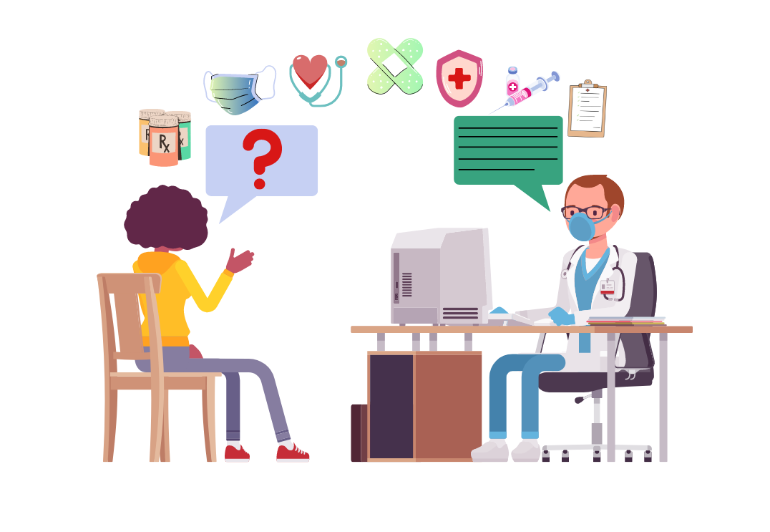
The Correlation Between Health Literacy & Health Outcomes
By: Hawra Khraizat LMSW, MA

Slide 3
Health Literacy:
The ability to obtain, understand, and assess health information.
Helps people make informed decisions about their health.
Involves both cognitive (thinking) and social skills.
Health literate people are more likely to:
Manage health conditions.
Take steps to avoid getting sick.
Live a healthier lifestyle.
Make informed health choices.
High-quality care and communication are important for health literacy.

Slide 4
Public Health Literacy vs. Individual Health Literacy:
Public Health Literacy:
Skills to access, understand, evaluate, and use health info for the community. Example: Knowing how to find reliable health information during a flu outbreak.
Impacts ability to engage in public health programs and follow health campaigns. Example: Understanding and participating in a vaccination campaign.
Helps communities follow preventive care measures. Example: Following guidelines to prevent the spread of COVID-19.
Individual Health Literacy:
Affects how people manage their personal healthcare. Example: Understanding how to take prescribed medications correctly.
Includes understanding instructions, diagnoses, treatment plans, and prevention. Example: Knowing how to follow a doctor's advice on managing diabetes.

Slide 5
Why is it important? The impact of low health literacy:
Poor understanding of medical instructions: Patients may struggle to follow medication instructions, leading to improper use and ineffective treatment.
Higher rates of hospital readmissions: Misunderstanding discharge instructions or follow-up care can increase the likelihood of returning to the hospital.
Increased emergency room visits: Lack of knowledge about when to seek care or how to manage symptoms leads to unnecessary emergency visits.
Delayed diagnosis and treatment: Patients with low health literacy may not recognize warning signs or understand when to seek medical advice, leading to late diagnoses.
Failure to prevent or manage chronic diseases: Inability to understand how to manage chronic conditions like diabetes, hypertension, or asthma can worsen these conditions over time.
Reduced ability to navigate the healthcare system: Difficulty understanding health insurance, benefits, and available healthcare resources can result in avoiding necessary care.
Non-compliance with preventive care: Low health literacy can prevent patients from understanding the importance of preventive measures like screenings or vaccinations, leading to missed opportunities for early intervention.
Increased reliance on caregivers: Patients with low health literacy may require additional support from family members or caregivers to manage their health, increasing the burden on those individuals.

Slide 7
Research:
Self-Reported Health Status: Patients with inadequate health literacy are more than twice as likely to report poor health compared to those with adequate literacy. (ncbi.nlm.nih.gov)
Hospitalization Rates: Individuals with inadequate health literacy have a 52% higher risk of hospitalization over a two-year period. (ncbi.nlm.nih.gov)
Mortality Risk: Low health literacy is associated with a 32% increased risk of death among patients hospitalized for acute heart failure, even after adjusting for factors like age, sex, and comorbidities. (ahajournals.org)
Quality of Life in Hypertension: A positive correlation exists between health literacy and health-related quality of life in patients with hypertension; higher health literacy is linked to better quality of life scores. (pmc.ncbi.nlm.nih.gov)
Overall Quality of Life: A meta-analysis of 23 studies involving over 12,000 participants found a moderate positive correlation (r=0.35) between health literacy and quality of life, suggesting that higher health literacy is associated with better quality of life. (hqlo.biomedcentral.com)

Slide 8
Factors Influencing Health Literacy:
Educational Level:
Lower education levels are linked to lower health literacy. Example: A person with limited education may struggle to understand a health pamphlet.
Language Barriers:
Non-native speakers may struggle to understand healthcare information, so clear communication is crucial. Example: A person who speaks Spanish may need translation services to understand a doctor's instructions.
Cultural Factors:
Cultural beliefs and values impact how people receive and understand health information. Example: Some cultures may prefer traditional medicine over modern treatments, which affects how they interpret health advice.
Access to Technology:
Lack of technology and digital skills can limit access to online health resources. Example: A person without internet access might miss out on important health information available only online.
Health System Complexity:
Complex medical terms and complicated healthcare systems make it harder to understand health information. Example: A patient may struggle to understand a doctor's explanation of a medical procedure due to “technical jargon”.

Slide 9
Effective Health Communication Strategies:
Active Listening: “It sounds like you're saying...”
Listen attentively to the patient’s concerns and responses to ensure clarity and understanding.
Teach-back Method: “Tell me how you are hearing this”
Ask patients to explain the information back in their own words to verify comprehension.
Visual Aids: “Which visual might help you remember this better?”
Use charts, diagrams, and infographics to simplify complex information.
Contextualize Information: “How does this relate to your personal situation?”
Tailor the message to the patient’s specific cultural, social, and health context.
Evidence-Based Practices:
Studies show these strategies enhance patient engagement, compliance, and health outcomes.

Slide 10
Demonstrating Effective Health Communication Messaging:
Understand the Audience:
Assess the literacy levels and cultural backgrounds of your audience.
Simplify Content:
Use plain language and visual aids to convey key messages.
Make it Actionable:
Provide clear, step-by-step instructions for self-care or medical procedures.
Test Your Messages:
Conduct small focus groups or surveys to ensure your messages are clear and impactful.

Slide 11
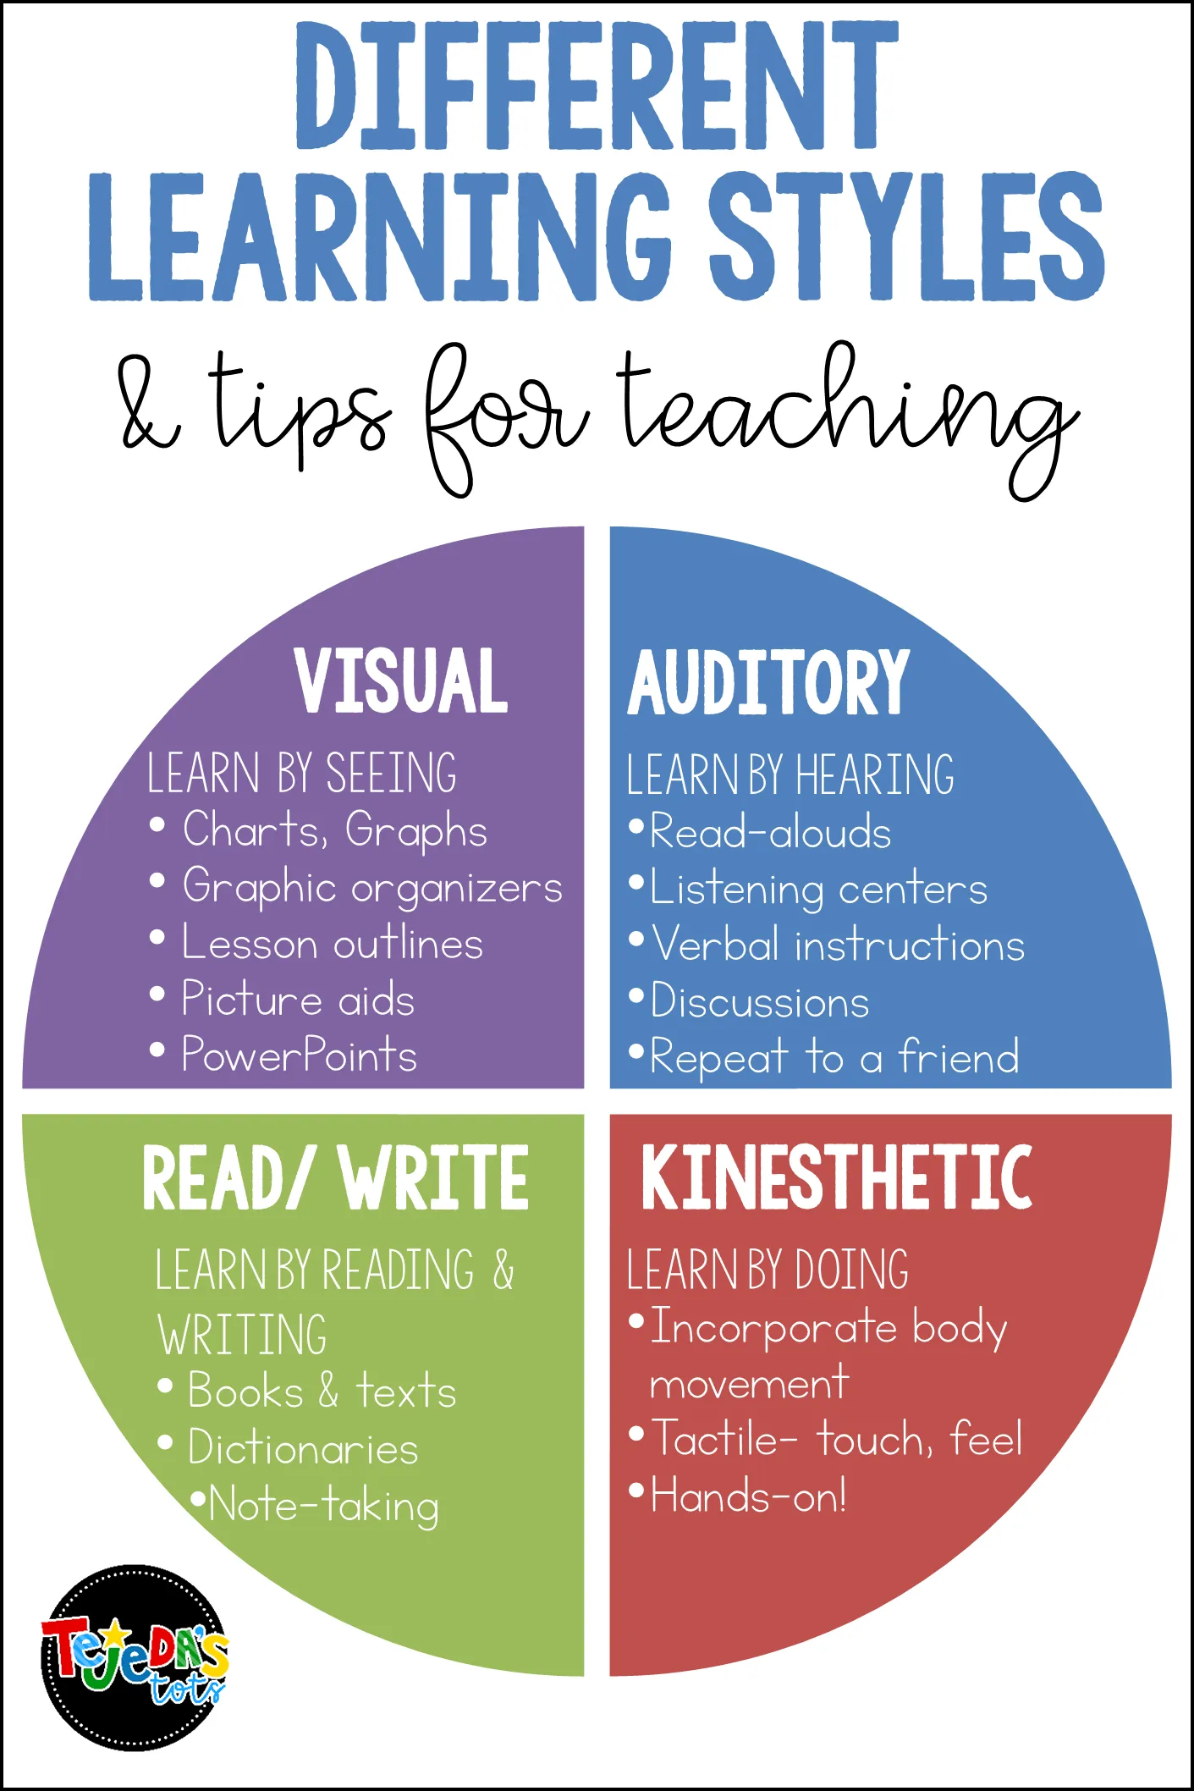

Slide 12
Plain Language and Its Importance in Health Communication:
What is Plain Language?
Simple, clear, and straightforward language that eliminates unnecessary complexity.
Ensures that information is accessible to individuals of varying literacy levels.
Key Principles of Plain Language:
Use short, clear sentences.
Avoid medical jargon and technical terms.
Use bullet points for clarity.
Include visual aids like diagrams or charts when possible.
Research Evidence:
Plain language has been shown to improve patient comprehension and increase the likelihood of following health instructions.

Slide 13
Telehealth: Advantages: - Cost Savings and Resource Efficiency: Telehealth can save money and healthcare resources by enabling virtual evaluation and treatment, but only when used for certain types of diseases. ​UT Austin News - Accessibility and Convenience: Telehealth brings healthcare to your doorstep, especially benefiting those in rural areas or with mobility issues, allowing patients to see a doctor from the comfort of their own home. ​Toxigon Disadvantages: - Limitations in Physical Examination: Telemedicine visits are not a complete substitute for in-person visits; conducting comprehensive physical examinations is not possible remotely, which may affect diagnosis and treatment. ​U.S. Pharmacist - Technological Barriers: Not everyone is comfortable with or has access to the necessary technology for telehealth, potentially leading to disparities in healthcare access. ​Toxigon - Privacy and Security Concerns: With any digital platform comes the concern of privacy and security; protecting sensitive healthcare data is paramount, and breaches can occur despite regulations like HIPAA. ​Toxigond

Slide 14
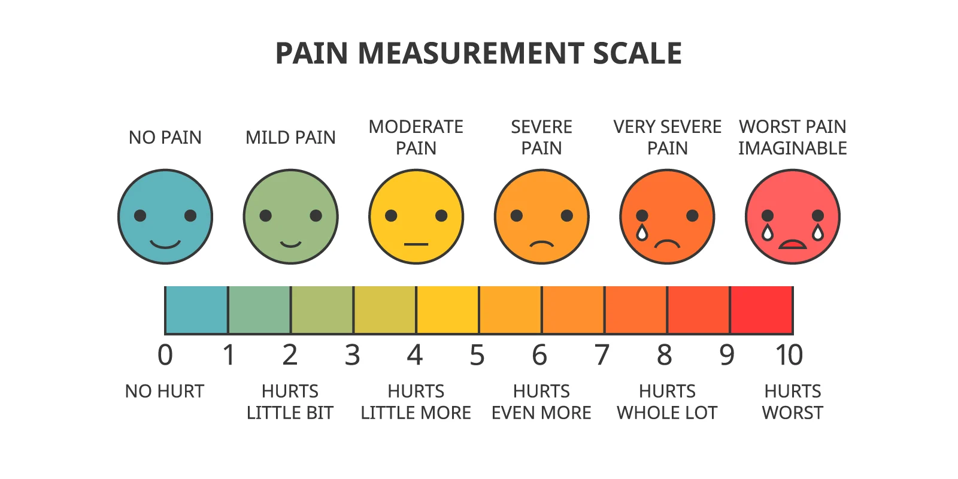
Cultural Competence in Health Communication:
We must understand and respect the cultural backgrounds of patients.
Communication styles, health beliefs, and practices differ across cultures, influencing health literacy and outcomes.
Culturally tailored health messages improve comprehension and engagement, leading to better health behaviors and outcomes.
​A study on pain management in elderly patients highlighted that cultural beliefs, such as stoicism and religious views, often lead to underreporting of pain, posing challenges for effective pain assessment and management ​(BMC Nursing, 2024).

Slide 15
Intention vs. Impact:
A nurse praises only one patient's medication adherence in a group class.
Intent: The nurse wants to reinforce positive health behavior.
Impact: Other patients may feel embarrassed, ashamed, or discouraged, especially if they struggle with understanding or managing their medications.
A public health educator compliments only those with private insurance during a workshop.
Intent: To show appreciation for participation or prompt discussion on health coverage.
Impact: Individuals with Medicaid or no insurance may feel judged, marginalized, or reluctant to engage further.
A social worker jokes, "Come on, everyone here finished high school — this material shouldn’t be hard for us to understand."
Intent:
Impact:
A healthcare worker says to a patient, “You speak English so well!” after reviewing forms.
Intent:
Impact:
During a care team meeting, a physician says, “We’re all clinicians here, we don’t need to dumb it down for people.”
Intent:
Impact:

Slide 16
What matters the most?

Slide 17
Scenario: Religious Preference as a Barrier in Health Decision-Making
Patient background:
A 50-year-old man with strong religious beliefs is diagnosed with cancer.
The oncologist recommends chemotherapy, which may cause side effects such as hair loss.
The patient is hesitant to undergo chemotherapy due to:
His belief in the sanctity of the body.
His view that suffering is part of a divine plan and should not be avoided.
Discomfort with body alterations, including hair loss, which feels unnatural to him.
Concern that chemotherapy may conflict with his identity and spiritual beliefs about healing.
These factors create emotional and spiritual barriers that complicate his decision-making process.
Open-Ended Question:
How can healthcare professionals engage with the patient to:
Understand and respect his religious beliefs?
Guide him to make an informed decision about his treatment plan?
What strategies can be employed to:
Bridge the gap between his religious values and available medical options?

Slide 18
“Knowing-Doing Gap”
The gap between knowing and doing in healthcare is a significant and complex issue.
It affects both patients and healthcare professionals.
The gap refers to the disconnect between:
What individuals know about health behaviors or medical recommendations.
The actual steps they take to implement them.
It can contribute to:
Poor health outcomes.
Suboptimal care.
Inefficiencies in the healthcare system.

Slide 19
Key Factors Contributing to the Gap Between Knowing and Doing in Healthcare:
1. Health Literacy
Health literacy is key in bridging the knowledge-action gap.
Many know healthy behaviors but struggle to understand medical instructions and apply them.
Research shows patients with low health literacy are less likely to follow advice or manage conditions effectively. Nearly 9 out of 10 adults in the U.S. have limited health literacy.
2. Behavioral and Psychological Barriers
Psychological factors (e.g., stress, fear, denial) can prevent action despite knowledge of healthy behaviors.
Example: A person may know exercise is important for diabetes management but feels overwhelmed or lacks motivation.
Research shows that knowledge of health risks doesn’t always lead to behavior change due to factors like fear of failure or lack of confidence.
3. Social Determinants of Health (SDOH)
Social and economic factors influence the ability to act on health knowledge.
Example: A person may know a balanced diet is important but live in an area with limited access to nutritious food.
Research links low socioeconomic status to poor health outcomes, with lack of access to healthy food, safe environments, or healthcare limiting action.

Slide 20
Key Factors Contributing to the Gap Between Knowing and Doing in Healthcare (Continued):
4. Healthcare System Barriers
Fragmentation in the healthcare system creates confusion, making it harder to act on health advice.
Example: Conflicting advice from a primary care physician, specialist, and nutritionist can leave patients unsure of what to prioritize.
Research shows communication breakdowns, unclear treatment plans, and inconsistent follow-up contribute to poor adherence and gaps in care.
5. Complexity of Health Behaviors
Healthcare recommendations often require significant lifestyle changes, which can be overwhelming.
Example: A patient with hypertension may struggle to manage medication, exercise, and diet changes simultaneously.
Research indicates the complexity of health regimens is a major reason for non-adherence. Simplified treatment plans and step-by-step guidance can improve compliance.
6. Motivation and Intentionality (Intrinsic and Extrinsic)
Lack of motivation can prevent action despite knowing what is needed for better health.
Example: A person with chronic pain may know exercise is beneficial but lack the motivation due to pain or past failures.
Research suggests motivation, intentions, and perceived control are key in deciding whether individuals will act. Interventions targeting motivation and self-efficacy can reduce the gap.

Slide 21
Real-Life Examples of the Knowing-Doing Gap in Healthcare:
1. Medication Non-Adherence
Patients know the importance of taking medications but may not follow through due to forgetfulness, side effects, or misunderstandings.
Research: Non-adherence results in $100 billion in avoidable healthcare costs annually. Interventions like reminders and follow-up calls improve adherence.
2. Diet and Exercise for Chronic Disease Management
People understand the need for exercise and a balanced diet for conditions like diabetes or heart disease but struggle to follow through due to competing priorities or lack of resources.
Research: Behavioral interventions like goal-setting, self-monitoring, and social support help reduce the gap and improve patient outcomes.
3. Preventive Health Screenings
Many individuals skip preventive screenings (e.g., mammograms, colonoscopies) despite knowing their benefits, often due to fear, discomfort, lack of time, or access.
Research: Educational campaigns alone aren’t enough. Effective interventions must address both practical (e.g., transportation, insurance) and emotional barriers (e.g., fear of results).

Slide 22
Strategies to Bridge the Knowing-Doing Gap:
Improved Health Communication:
Use of plain language, visual aids, and culturally tailored messages to ensure that individuals understand health recommendations and can apply them in their lives.
Teach-back method: Asking patients to explain instructions in their own words helps confirm comprehension and improves the likelihood of action.
Patient-Centered Care:
Involve patients in decision-making and respect their values and preferences. This can increase their motivation to take action.
Shared decision-making approaches empower patients to choose the treatment options that best align with their goals and lifestyles.
Behavioral Interventions:
Use evidence-based strategies like goal-setting, self-monitoring, and motivational interviewing to help patients take actionable steps toward behavior change.
Addressing Social Determinants of Health:
Provide community resources, access to affordable medications, and social support to help patients overcome barriers related to socioeconomic status or access to healthcare services.
Follow-Up and Support:
Provide continuous follow-up through phone calls, text messages, or health apps to support patients in taking consistent action toward their health goals.

Slide 23
Prevent provider burnout by encouraging self-care and well-being!
Set aside quality time for yourself and those you care about.
Engage in activities you enjoy, no matter how big or small they might be.
Participate in calming practices like meditation, yoga, reading, or listening to music.
Focus on nurturing your physical, mental, and spiritual health.
Manage your work hours and caseload to avoid overload.
Stay in touch with your loved ones.
Practice what you preach and lead by example.
Remember, self-care is incredibly important! 😊

Slide 24
Interested in a specific presentation topic? Lets connect! My Contact Information: Hawra Khraizat, LMSW, MA Hawrakhraizatpresents@gmail.com

