Slide 1
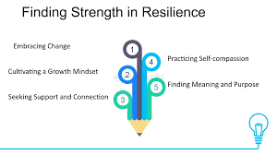
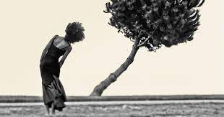
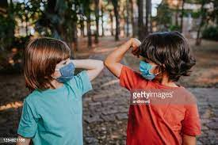

Resilience and How to Develop it!
Created by Dana Rizzo RN, BSN, RN-ACM
Dana.Rizzo@singhmail.com
571-918-4854

Slide 2
Objectives for Resilience:
Upon completion of this presentation the participant will be able to:
1. Define and discuss the definition of Resilience.
2. Define Resilience Theory.
3. List the 7 C’s of Resilience by Ken Ginsburg, M.D.
4. List Dr. Sood’s Five Principles that involve Resilience.
5. List the Four Categories or Types of Resilience.
6. Discuss why a Recovery Period is necessary to build Resilience.
7. Identify Five ways to Build and Cultivate your Resilience.
8. Define Self Regulation and the four steps to take before you react.

Slide 3
What is Resilience ?
According to the American Psychological Association (APA) Resilience refers to both the process and the outcome of successfully adapting to difficult or challenging life experiences.
Resilience Theory is having the mental, emotional, and behavioral flexibility and ability to adjust to both internal and external demands according to the APA.
“Resilience is our ability to withstand adversity and bounce back and grow despite the downturns in life”, says Amit Sood, M.D.
Resilience requires a Skill Set that you can work on and grow over time. Resilience is about how you Recharge, Not how you Endure.
Building Resilience takes, time, strength, and support from people around you.
We need a Recovery period to build Resilience.

Slide 4
Resilience Theory is the ability to withstand, recuperate or rebuild quickly;
Possessing elasticity.
People face all kinds of adversity in life.
Personal crisis: illness, loss of loved ones, abuse, bullying, job loss, financial instability.
Tragic events in the news, such as, terrorist attacks, mass shootings, natural disasters, global pandemic, and war.
People have to learn to cope with the reality of the world events, and cope with and work through challenging life experiences.
We must allow ourselves time to Recover after these events.
Research shows us the direct correlation between lack of recovery and increased incidence of health and safety problems.

Slide 5
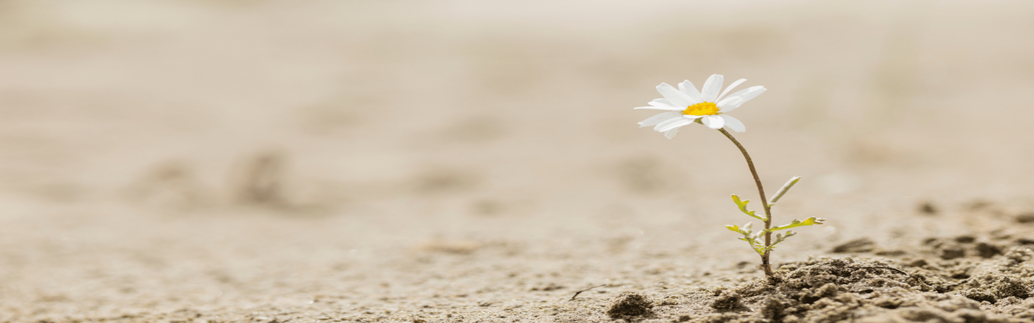
Dr. Regina Koepp, states ”People are not the sum of their problems. People are profoundly resilient. I have observed, as a Hospice Physician, the Resilience of the Human Spirit”.
As a society we are VERY focused on physical aspects of successful aging, like exercise, healthy diets, and a good nights sleep.
While these are important aspects of healthy aging, Resilience is the key ingredient that improves health outcomes and wellbeing, even when living with a chronic illness or facing the end of our lives.
Psychological resilience increases as we age. Adults 85 years or older appear to have a greater capacity for resilience compared to those younger.

Slide 6
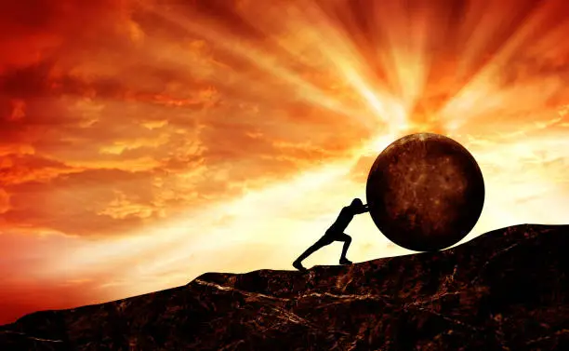
When older adults have higher rates of resilience, they are better at adapting to change and coping with health challenges. Here’s how:
Adapting to Change: As they face life transitions like retirement, loss of loved ones, or physical limitations, resilience helps them adapt and find new meaning in life.
Coping with Health Challenges: Resilient older adults are better equipped to handle chronic illnesses or recover from medical setbacks.

Slide 7
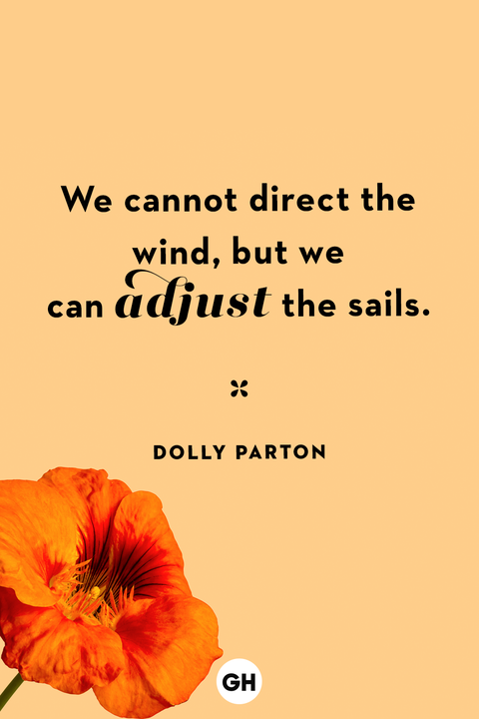

Slide 8
Resilient People experience personal stress, emotional upheaval in their lives, and suffering.
They demonstrate resilience while working through their emotional pain and suffering.
Resilient people build a skill set as they progress through life.
Personal behaviors and skills, like self-esteem and communication skills, as well as external support, having social support and the resources available to you.
External resources: church groups, community groups, boy scouts, girl scouts, clubs, senior groups, adult senior centers, exercise groups, meditation groups, etc.
Psychology, Health and Medicine, February 2022 published a study that surveyed 1,032 college students. The Research showed emotional resilience was linked to reduced stress and a more positive life satisfaction, overall, during the early stages of the Covid-19 Pandemic.
Allowing a Recovery Period for you to recharge will help build resilience.

Slide 9
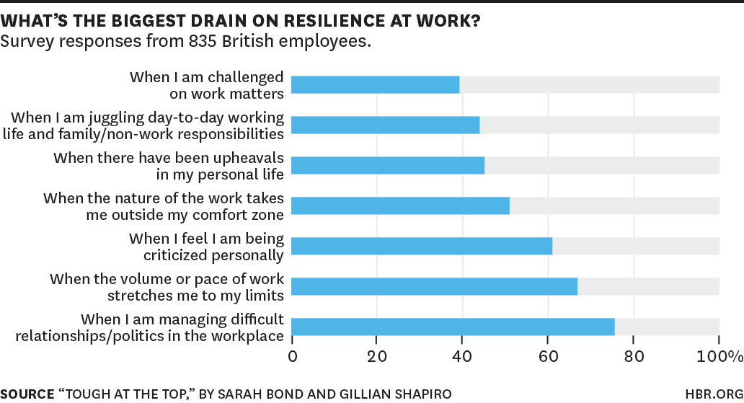
A Lack of Resilience in our workforce whether by disrupting sleep with thoughts of work or having continual cognitive arousal by watching our phone, lap tops, etc- is costing our companies $62 billion a year in lost productivity.

Slide 10
The Key to Resilience
“We must try very hard, work hard, then allow ourselves to STOP, recover, and then try again.”
This conclusion is based on biology per Shawn Achor and Michelle Gielan.
Homeostasis is a biological concept describing the brain and how it works to continuously restore and sustain our well-being.
Dr. Brent Furl coined the term “Homeostatic Value” Creating equilibrium and thus well-being, in the body.
Workaholism is defined as being overly concerned about work, driven by uncontrollable work motivation, and investing so much time it impairs other important life areas.

Slide 11
The Seven C’s of Resilience by Dr. Ginsburg
1. Competence: the ability to know how to handle situations effectively. To build competence, individuals develop a set of skills to help them trust their judgements and make responsible choices.
2. Confidence: Dr. Ginsburg says that true self-confidence is rooted in competence. Individuals gain confidence by demonstrating competence in real-life situations.
3. Connection: Close family ties to family, friends, and community provide a sense of security and belonging.
4. Character: Individuals need a fundamental sense of right and wrong to make responsible
choices, contribute to society and experience self-worth.

Slide 12
The 7 C’s of Resilience continued
5. Contribution: Dr. Ginsburg says having a sense of purpose is a powerful motivator. Contributing to one’s community resources and developing positive reciprocal relationships makes one feel they are contributing.
6. Coping: When people learn to cope effectively, they are better prepared to handle adversity and setbacks.
7. Control: Developing an understanding of internal control helps individuals act as problem-solvers instead of victims of circumstance. When individuals learn they can control the outcomes of their decisions, they are more likely to view themselves as capable and confident.

Slide 13

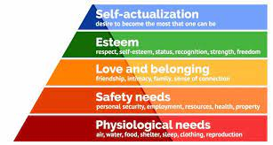

Slide 14
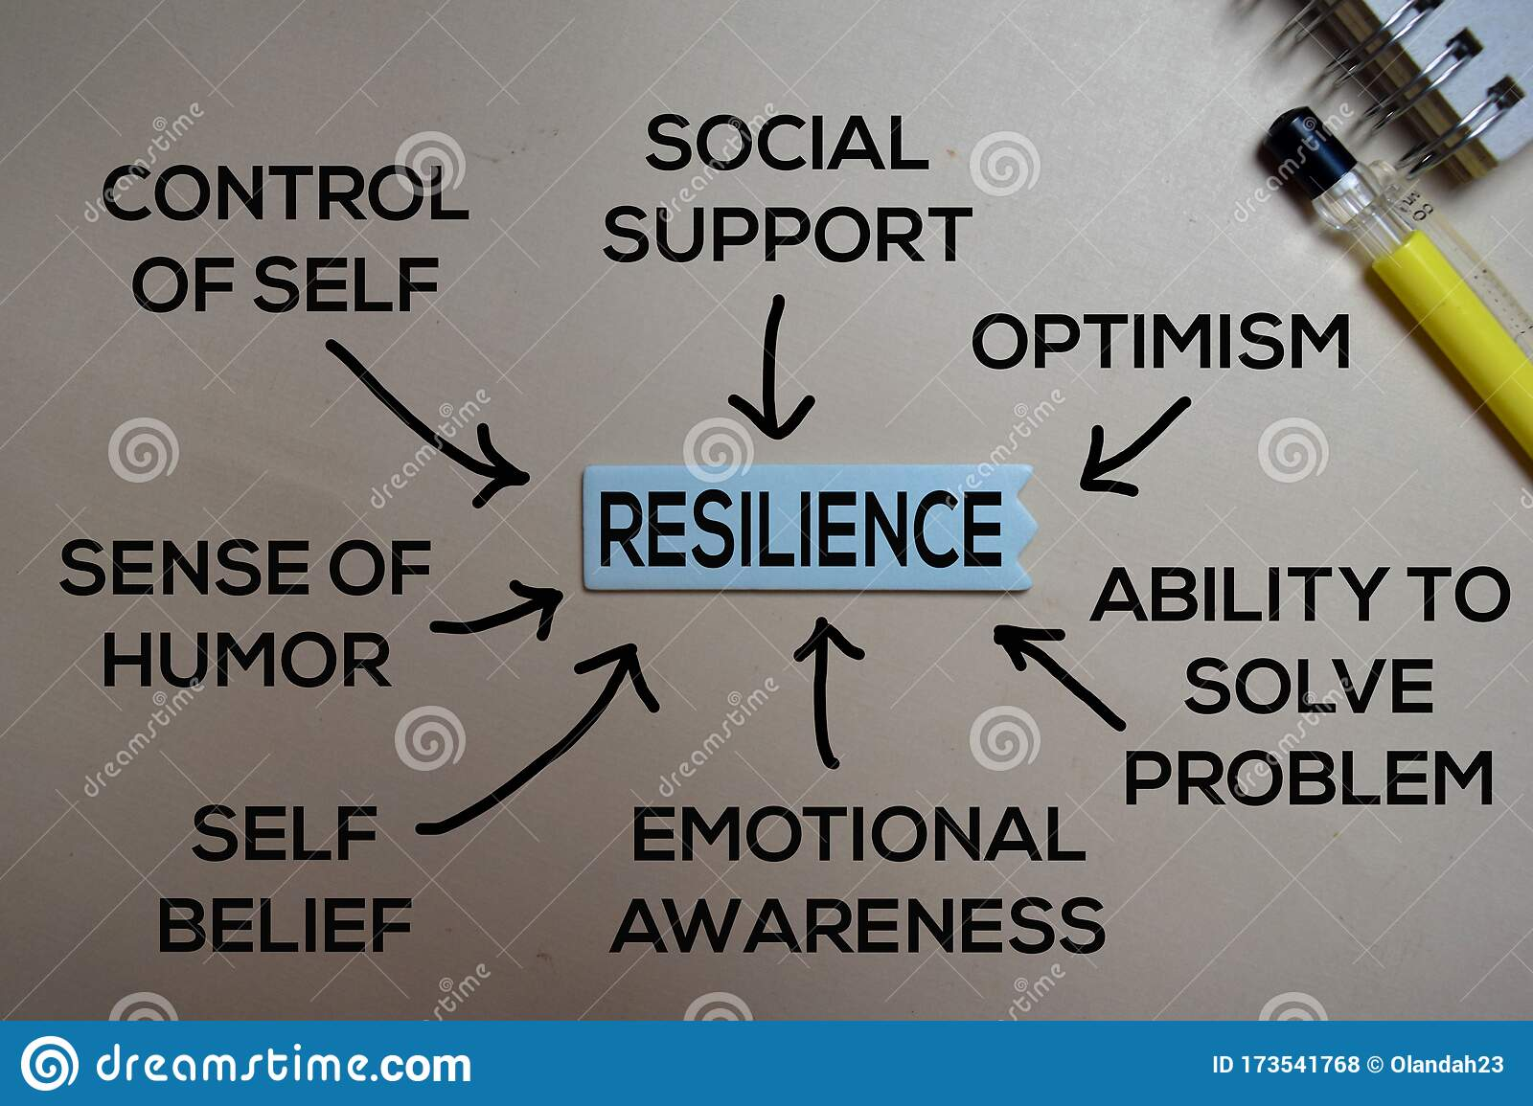
Resilience and how we can become more Resilient

Slide 15
Five Principles that involve Resilience by Dr. Sood.
The Resilience theory states that resilience is not a fixed trait you can grow, but you can grow your capacity to practice resilience. It is not constant, in that you might demonstrate a lot of resilience when it comes to one challenge you are faced with, but struggle more with being resilient when it comes to another stressor you are up against. ( job loss, versus sick child).
Key behaviors that help develop resilience are; Flexibility, Adaptability, and Perseverance.
Research has shown that when people believed that both intellectual abilities and social attributes can be developed, and improved, they increased their own resilience, showing lower stress response to adversity, and improved performance, and overall health.
Individuals with Resilience take inventory on how they are feeling, they allow themselves to rest and recover after a challenging event.

Slide 16
Five Principles that involve Resilience by Dr. Sood.
1. Gratitude
2. Compassion
3. Acceptance
4. Meaning
5. Forgiveness
Building resilience is complex and personal. It involves a combination of our inner strengths and external resources, and there is not a universal formula for becoming more resilient.

Slide 17
Four Categories or Types of Resilience
1. Psychological Resilience: Is the ability to mentally cope with and adapt to uncertainty, challenges, and adversity. “mental fortitude”. Calm and focused during a crisis, and move on without long-term negative consequences, including distress and anxiety. Allowing your body time to recover after an event.
2. Emotional Resilience: How people cope emotionally with stress and adversity varies from person to person, according to APA. Some people, by nature, are more or less sensitive to change. A situation can trigger a flood of emotions in some people and not in others. Emotionally resilient people understand what they are feeling and why. They tap into realistic optimism, even when dealing with a crisis. They are proactive in using internal and external resources to get through. They are able to mange external stressors in a healthy, positive way. They make healthy Life Style choices to cope with stressors.

Slide 18
Four Categories or Types of Resilience
3. Physical Resilience: Is our bodies ability to adapt to challenges, maintain stamina and strength, and recover quickly and efficiently. They are allowing their bodies to return to Homeostasis. It is a person’s ability to function and recover when faced with illness, accidents, or other physical demands. Research shows physical resilience plays an important role in healthy aging, as people encounter medical issues and physical stressors. ( healthy life style choices, connections with friends and neighbors, deep breathing, meditation, exercise, time well spent to rest and recover, and engagement in enjoyable activities all play a role in physical resilience), and full recovery.
4. Community Resilience: Refers to the ability of groups of people to respond and recover from adverse-situations, such as, natural disasters, acts of violence (9/11 New York Community Resilience), economic hardship, and other challenges as a whole. ( Covid -19 Pandemic, Fires in Canada, War in Ukraine, Newtown Connecticut, after the Sandy Hook Elementary Shootings: New Orleans, following Hurricane Katrina, Mass Shootings in the Communities of Gilroy, California, El Paso, Texas, Dayton, Ohio, and Uvalde Texas).

Slide 19
Research and Statistics on Resilience: Neuroscience
Research suggests that certain protective resources, rather than the absence of risk factors, play a significant role in a person’s capacity to confront and work through stressors.
Our bodies seek to return to Homeostasis after a stressful event. We strengthen resiliency by:
Seeking Social support
Using our Adaptive coping skills
Tapping into One’s inner strengths
Natural Resilience or a person’s innate ability to recover from adversity, is under research.
Some studies suggest, human resilience-natural resilience, in the face of adversity is fairly common. To support this, the study stated that though 50-60 % of the US population is exposed to traumatic events, only 5-10% percent of those people develop post-traumatic stress disorder(PTSD).
More research is needed, Resilience is difficult to quantify and study.

Slide 20
Training yourself to be more Resilient
Remember the following:
Resilience can be learned, you do not have to “Grin and Bear it”, or to simply “Get Over It”.
Resilience is not learning how to avoid obstacles or resist change.
Building Resilience is a process, not an event, It takes time to build your skill set.
Building resilience is a process where people learn to become better at reframing thought patterns and tapping into a strength based approach to work through obstacles.
If you are already resilient, it’s something you have to work at, to maintain.
The Three Hallmarks Characteristics of Resilient People are: Flexibility, Adaptability, and Perseverance. “Plasticity” as we face challenges.
Resilience is about how we Recharge, not how we endure.

Slide 21
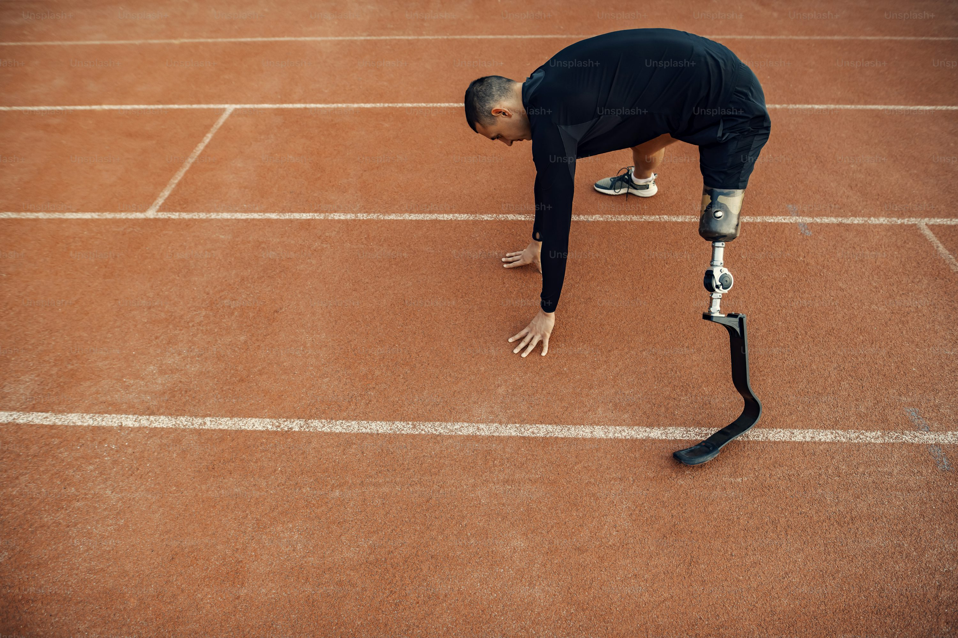

Resilience and the Human Spirit

Slide 22
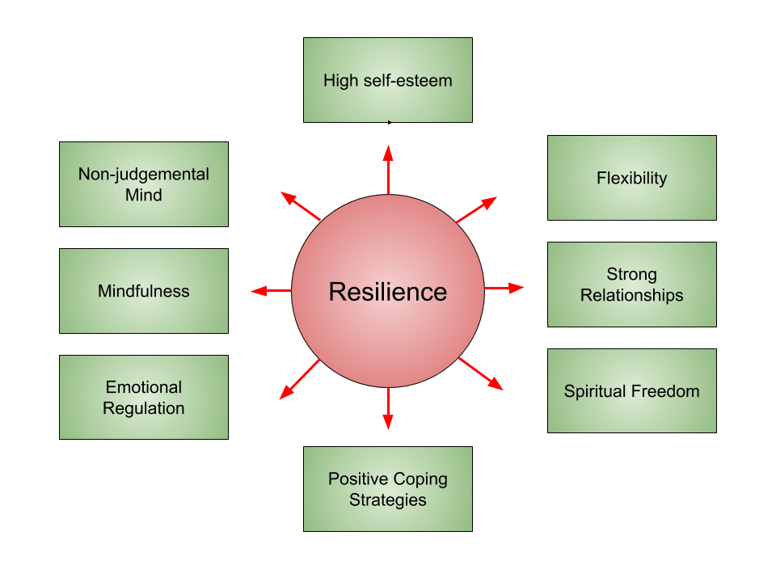

Slide 23
Adapt Techniques to help you cope with stress:
1. Stop striving for perfection: Redefining success might result in less guilt and frustration.
2. Practice Thought-stopping: Stop gloomy thoughts immediately. If you refuse to think of a stressful situation as negative, it may stop being negative.
3. Reframe your situation: Look at the situation differently, reframe it, see a situation as an opportunity, not a negative situation.
4. Adopt a mantra: Create a saying like, “I am strong enough to handle this,” and mentally repeat your it in tough situations.
5. Create an assets column: List the things that bring you joy in life, like vacation, children, and pets. Thinging about this list when you are stressed can reconnect you to life’s many joys.
6. Look at the big picture: Ask yourself, “will this matter in a year from now, or five years from now?” Realsing this can make a stressful situation seem less overwhelming.
(Manage Stress. U.S. Department of Health and Human Services. April 3, 2023)

Slide 24
What is Self-Regulation?
Self-regulation is the act of controlling your behaviors, thoughts, emotions, choices, and impulses.
Self-regulation skills help you keep negative emotions in check and think before you react.
In essence, it's a type of self-control or emotion regulation.
Negative emotions are disruptive. They can interfere with your happiness, productivity, and relationships. While you can't always avoid negative feelings, you can change the way you react to them.
Self-regulation draws upon:
emotional stability
self-discipline
flexibility in adapting to different situations
persistence in getting through tough times
strong personal values that guide your reactions and decisions.
( Lisa Catanese ELS, Gregory Fricchione, M.D, August 2024)

Slide 25
Techniques for improving self-regulation
Improving your emotion regulation skills can help you be better prepared when you encounter obstacles — big or small — throughout your life.
Self-regulation starts with exploring and understanding your behaviors, emotional reactions, and impulses.
For example, do you notice that you are triggered by certain environments or people?
Are you responding to an experience in your past rather than the current situation?
You then consider the consequences of possible responses, and consciously choose those that can lead to a more positive outcome.
Mindfulness and cognitive behavior strategies are two ways to do this.

Slide 26
Mindfulness and self-regulation
Mindfulness plays a strong role in self-regulation.
It involves focusing one's awareness on the breath and then expanding awareness in an open way to passing thoughts, and taking the time to calm them by focusing on the present moment without judgement.
Practicing mindfulness helps you appreciate the simple pleasures of life.
Then, when you face stressful situations, you can tap into those feelings of peace and satisfaction to help you self-regulate and keep your emotions under your control.
Practicing mindfulness can help you build the capacity to deal with problems.

Slide 27
Cognitive behavioral strategies for self-regulation
Cognitive behavioral strategies help one reduce internal drivers of emotional dysregulation by replacing unhelpful thoughts and behaviors with positive ones.
These techniques are often done with the help of a therapist, but they can be practiced at home as well.
Cognitive behavioral techniques (CBT)include identifying and labeling your emotions, understanding the reasons for your emotions that may include distorted thoughts or catastrophizing, and learning to let painful feelings go.
You might also consider any regrettable responses you have had to difficult and stressful situations in the past, and replace those behaviors with positive alternatives.

Slide 28
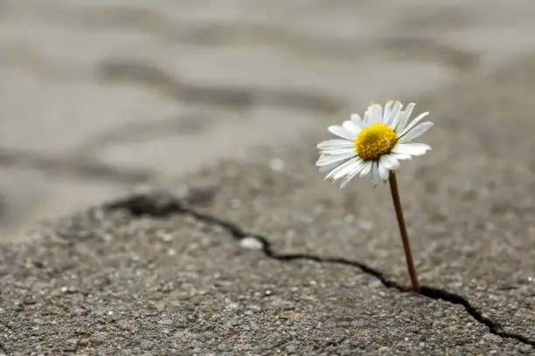
Practical tips for daily self-regulation
The ability to self-regulate can be learned and improved.
One tip to help you practice improving your self-regulation skills involves using the four-step:
Stop-Breathe-Reflect-Choose approach:
STOP: When you feel upsetting emotions, tell yourself to calm down and think more clearly.
BREATHE: Try to relax by taking deep slow breaths, counting to 10, or taking a walk.
REFLECT: Don't react until you feel like you have your emotions under control.
CHOOSE: Think about responding instead of simply reacting.
(Lisa Catanese ELS, Gregory Fricchione, M.D. Harvard Health August, 2024)

Slide 29
Training yourself to be more Resilient over time.
1. Develop self-awareness. Understanding how you typically respond to stress and adversity is the first step. Knowing and understanding your strengths and knowing your weaknesses. Be aware of your Self Care routines. Are you sleeping 7-9 hours a night, are you balancing work and play, Nutrition and exercise?
2. Build self-regulation skills. Remaining focused in the face of stress, and adversity is important , but not easy. Stress-reduction techniques, such as, guided imagery, breathing exercises, mindfulness training, Meditation, can help you regulate your emotions, thoughts, and behaviors. Remember the importance of adequate sleep.
3. Learn coping skills: There are many coping skills that can help in dealing with stressful and challenging situations. Examples are, journaling, reframing thoughts, exercising, spending times outdoors, socializing, good sleep hygiene, creative outlets.

Slide 30
Training Yourself to be more Resilient
4. Increase optimism: People who are more optimistic tend to feel more in control of their outcomes. To build optimism, focus on what you CAN DO when faced with a challenge, and identify positive, problem-solving steps that you can take.
5. Strengthen connections: Support systems can play a vital role in resilience. Bolster your existing social connections and find opportunities to build new ones. Social engagement throughout life is key.
6. Know your strengths. People feel more capable and confident when they can identify and draw on their talents and strengths. Build your Self-worth.

Slide 31
Benefits of Resilience and Health Conditions:
Resilience and Health Conditions: Studies have shown that characteristics of resilience, particularly social connections and a strong sense of self-worth, help people confront chronic illness.
Research shows a direct correlation between a lack of recovery and increased incidence of health and safety issues.
Research suggests that a person’s level of resilience can influence both the progression and outcome of illnesses. ( Cancer patients watching I Love Lucy every day.) Laughter is important in recovery.
Resilience is a protective factor against psychological distress in adverse situations involving loss or trauma. Psychological resilience refers to the mental fortitude to handle challenges and adversity.
Rheumatoid Arthritis(RA) and Resilience: Research found that behavioral and emotional strategies to cultivate resilience can benefit patients with RA and other chronic diseases.
Research showed quality of life was greater with the higher resilience rating.

Slide 32
Benefits of Resilience and Health Conditions:
Immunological Disorders and Resilience: Research supports the idea that physical resilience can reduce the adverse effect that stressors have on the Immune system.
Low resilience is associated with worsening of the disease
High resilience is associated with better quality of life.
Exercise builds physical resilience.
Brain Injuries and Resilience: One Study found that people with traumatic brain injury (TBI)who tested moderate-high on the resilience scale reported fewer post-injury symptoms and better quality of life than those with low resilience.
Type 2 Diabetes and Resilience: According to Mayo Clinic, High resilience levels are associated with lower A1C levels including better glycemic control and disease management.

Slide 33
Benefits of Resilience and Health Conditions:
Cancer and Resilience: Research published in April 2019 in the journal, Frontiers in Psychiatry, linked resilience, notably personal strengths and social factors, to improved psychological and treatment-related outcomes for cancer patients.
Digestive Conditions and Resilience: People suffering from anxiety and depression frequently report gastrointestinal distress as a primary symptom.
Research shows a connection between low resilience and worse Irritable Bowel Syndrome (IBS).
Building resilience can reduce anxiety and depression associated with some GI Symptoms.
Skin Conditions and Resilience: Dermatological disorders are often accompanied by anxiety and stress. Stress can trigger flare-ups of skin conditions , such as psoriasis and eczema.
Endometriosis and Resilience: Studies have linked endometriosis and chronic pain to low resilience.

Slide 34
Research shows us that high resilience later in life can help older adults:
achieve improved quality of life, better mental health, overall self-perceived successful aging, despite the adversities they may face
experience greater happiness, wellbeing, and satisfaction with life
improve resistance to stress
lower rates of depression.
experience positive physical outcomes, like independence in activities of daily living, increased longevity, lower mortality risk, and faster cardiovascular recovery
(Dr. Regina Koepp, January 2024)

Slide 35
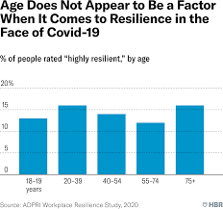

Slide 36
Top Books on Resilience
1. Freedom from Anxious thoughts and Feelings: A Two-Step Mindfulness Approach for Moving Beyond Fear and Worry by Scott Symington, PhD
2. Option B: Facing Adversity, Building Resilience, and Finding Joy, By Sheryl Sandberg and Adam Grant
3. How to Change Your Mind: What the New Science of Psychedelics Teaches Us About Consciousness, Dying, Addiction, Depression, and Transcendence, by Michael Pollan
4. Resilient: How to Grow an Unshakable Core of Calm, Strength and Happiness, by Rick Hanson, PhD
5. Beauty in the Broken Places: A Memoir of Love, Faith, and Resilience, by
Allison Pataki

Slide 37
Instructions for the BRS
The tool Brief Resilience Scale (BRS) asks individuals to decide how much they agree or disagree with six statements.
Each answer is allocated a number.
Once all six statements have been assessed, the individual can total up their numbers.
This summing up will give them an overall resilience score of between 6 and 30.
The tool does not provide any specific guidance in relation to what different scores mean.
All it says is that lower scores mean lower levels of resilience.
The brief resilience scale benefits from being used by individuals over a period of time.
As individuals take action and work on improving their resilience they should start to see changes in their scores.

Slide 38
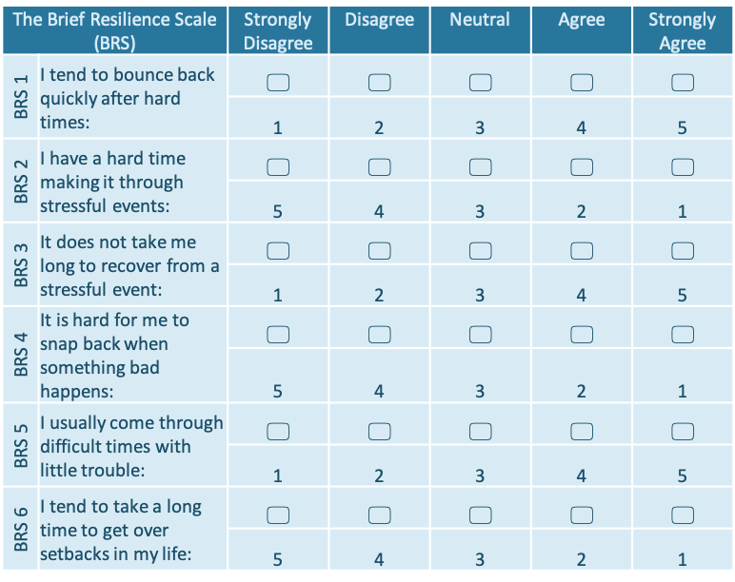

Slide 39
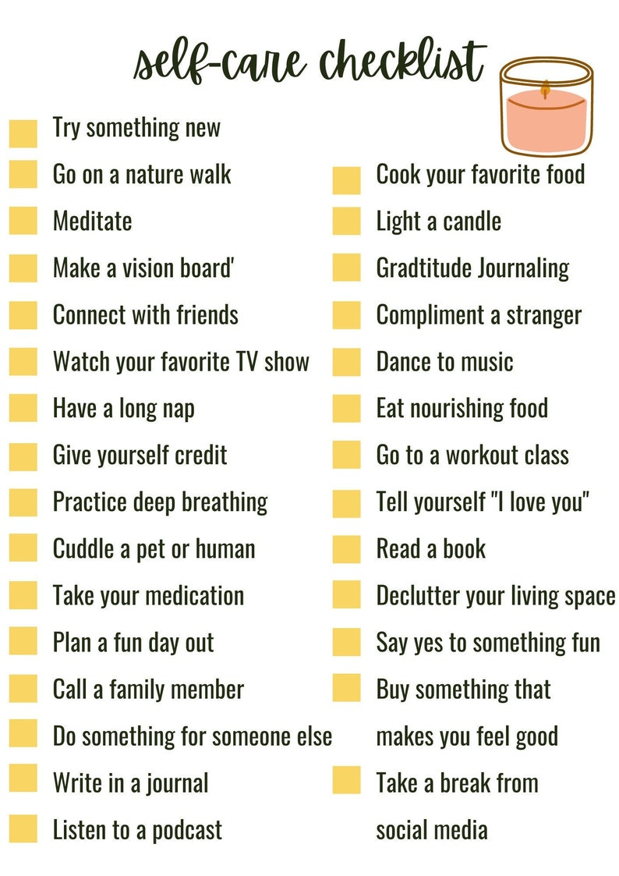

Slide 40
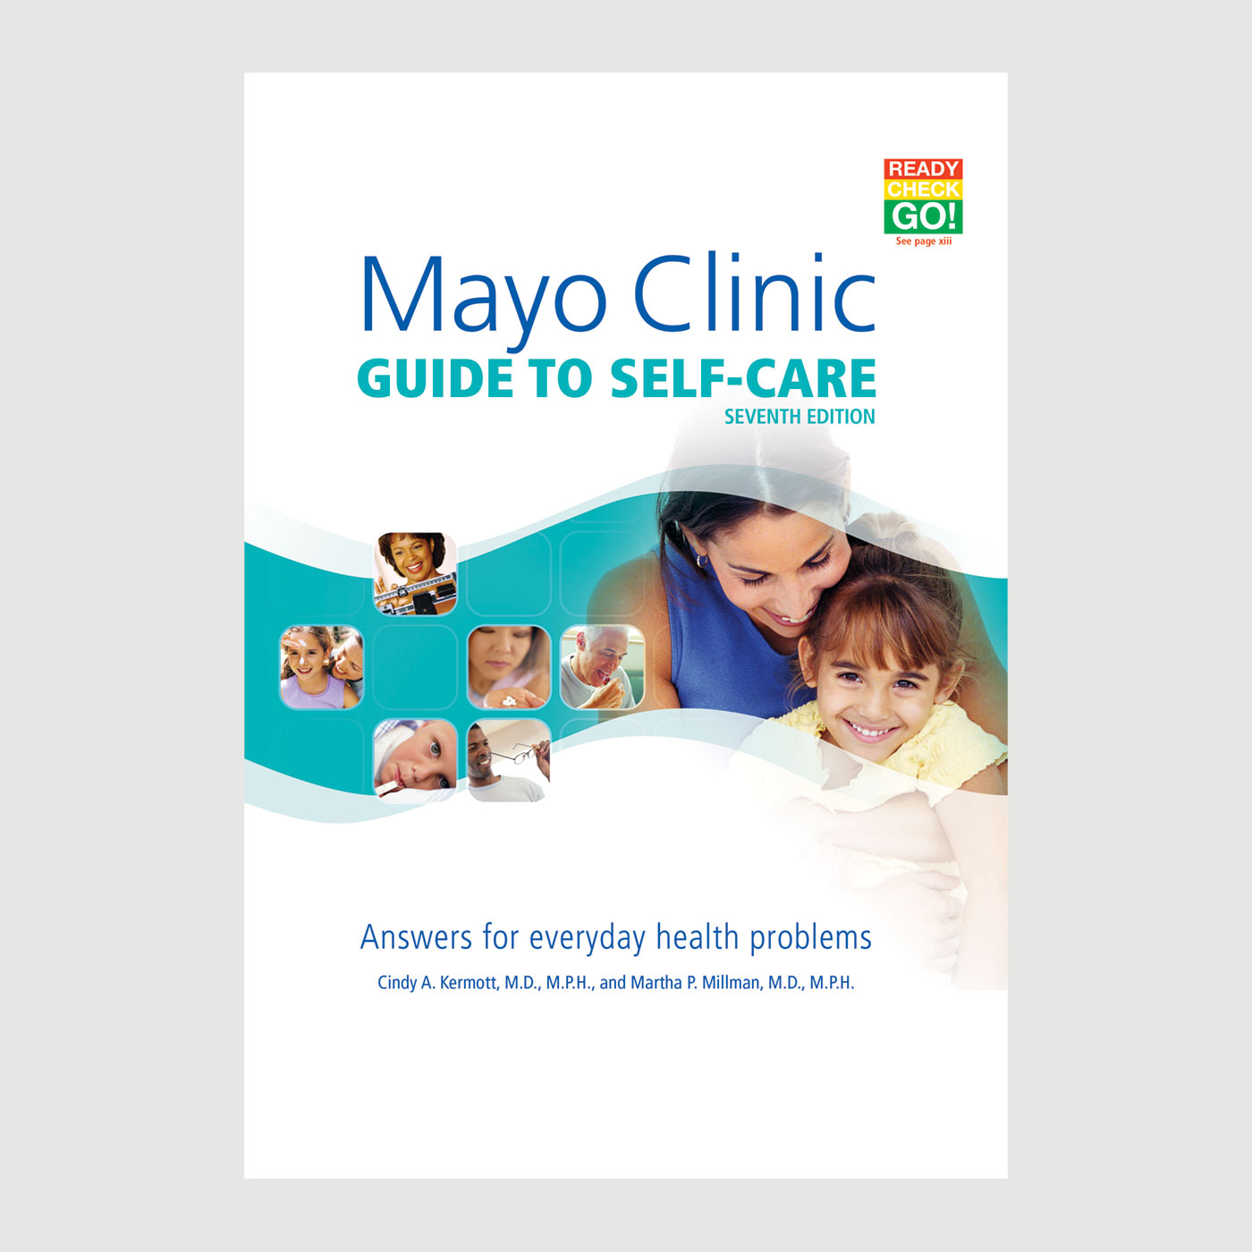

Slide 41
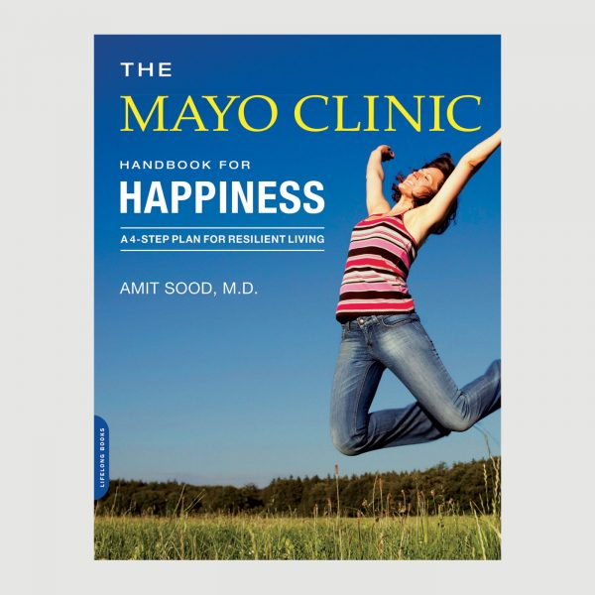

Slide 42
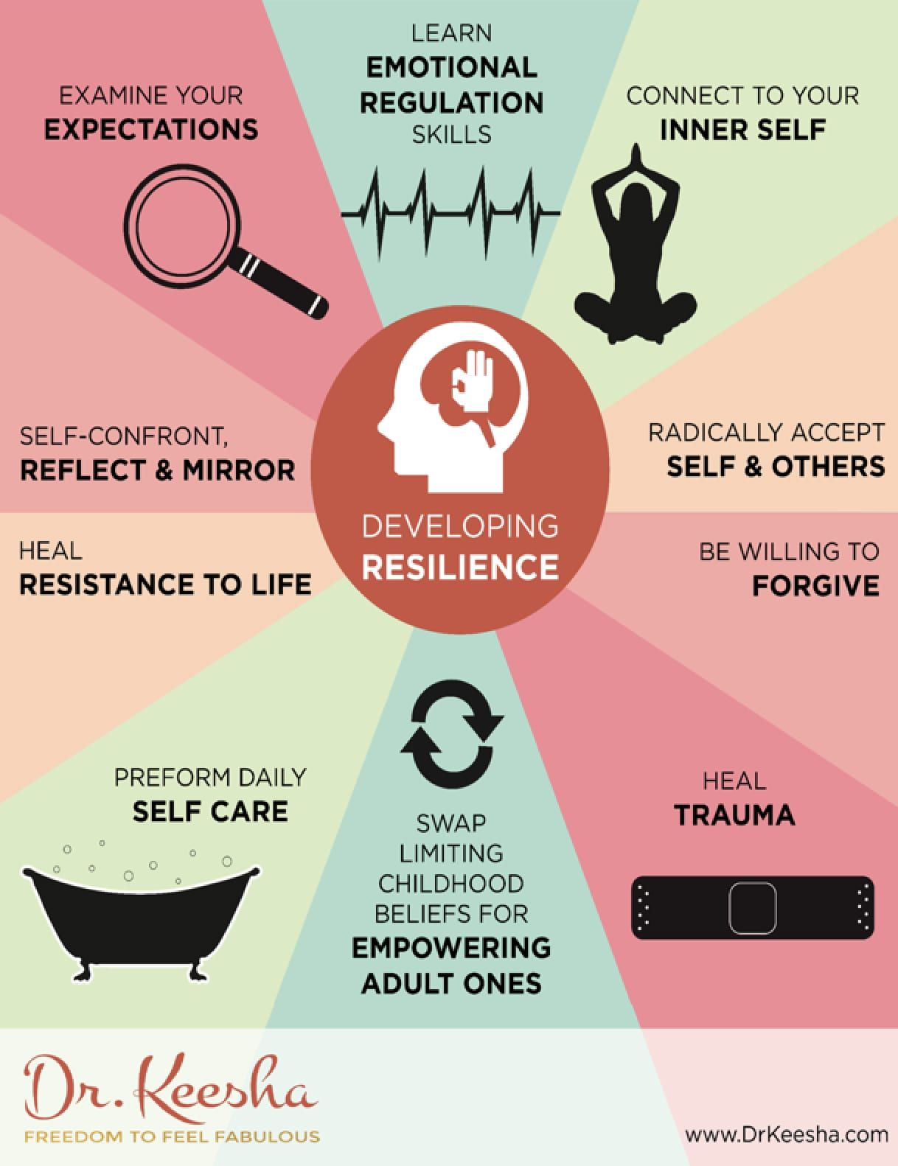

Slide 43
In Summary today we discussed:
The Definition of Resilience
The Resilience Theory
The 7 C’s of Resilience
The Four Categories or Types of Resilience
Resilience Techniques and concepts that can build our Resilience.
The research studies that support that high resilience and a improved resilience skill set can increase our overall health and quality of life.
Discussed the four steps for Self Regulation: Stop, Breathe, Reflect, and Choose before you react.

Slide 44
References:
Resilience Examples: What Key Skills Make You Resilient? 20 Jan. 2019, by Leslie Riopel MSc, and Salma Latiff, PhD.
Understanding Individual Resilience in the workplace: The International Collaboration of Workforce Resilience Model. CS. Rees, LJ. Breen, L. Cusack, D. Hegney- Frontiers in Psychology. 2015-Frontiersin.org
The Amazing Bounce-Backable Women: Resilience and the Psychological Turn in Neoliberalism. R. Gill, S. Orgad, Sociological Research online 2018.
Resilience and Mental Health: Challenges Across the Lifespan. SM. Southwick, BT.Litz, D. Charney, MJ. Freedman, 2011-books google.com
Resilience and Mental Health During Covid-19 Pandemic. N. Verdolini, S. Amoretti, L. Montejo- Journal of Affective…,2021-Elsevier
The Influence of Resilience on Mental Health: The Role of General Well-Being. T. Gao, X. Ding, J. Chai, Z. Zhang, H. Zang. Journal of Nursing 2017 –Wiley Online Library.
How to Build Resilience in Older Adults: ( Hint it is not a diet and exercise). Regina Koepp, MD. January 19,2024
Self-Regulation for Adults: Strategies for getting a Handle on emotions and Behavior. Lisa Catanese ELS, Gregory Fricchione, M.D. Harvard Health Publishing, August 8, 2024.
3 Tips to Manage stress. American heart Assoication: Healthy Living/Healthy lifestyle. April 3. 2023.
Manage Stress. U.S. Department of Health and Human Services. April 3, 2023.

Slide 45
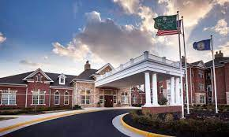
Dana Rizzo RN, BSN, ACM-RN
Dana.Rizzo@singhmail.com
703-967-4777

