Slide 1
^{Institute of Gerontology}

Slide 2
^{Lesson 4: Memory Tricks}
^{Institute of Gerontology}
Notes:
BEFORE YOU START – On your lesson plan outline, note the activity about memorizing objects on a tray. Prepare the tray beforehand.
Toward the end of this presentation, you will ask all participants to write down as many objects as they can remember from the tray. Discuss the results and have people share their strategies for remembering.
Intro to Memory Tricks: Everyone’s brain ages, but we experience those changes in different ways. Some 90-year-olds can remember everything, while some younger adults are forgetful. It is common for people to complain that their memory gets worse when they age. You can’t remember where you put your keys or the name of the person you just met. Various parts of your brain ages differently, and different types of memory normally change with age. Today we will learn how the brain changes when we age, and how different types of memory work. We will learn some tricks and habits to keep your brain sharp and your memory working well.

Slide 3
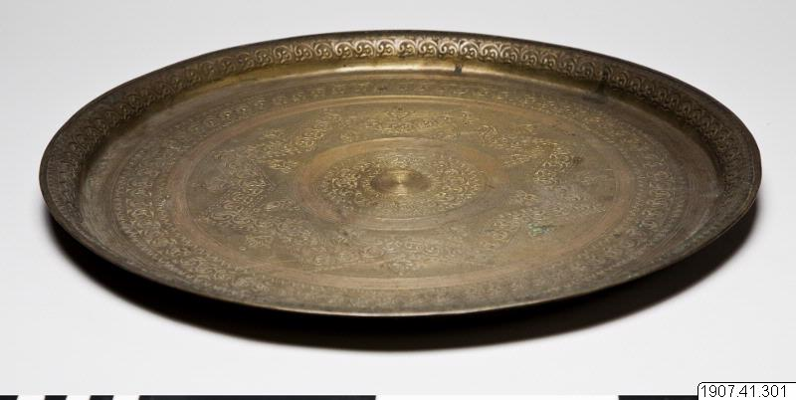
Remembering Stuff
Try the Tray
Notes:
The tray will have been already prepared with various objects, about 12. Use a variety of everyday objects but try to find some that would naturally be grouped together, such as office supplies, or kitchen tools. Have the attendees look at the tray for about a minute. Then cover it.
If you can’t use an actual tray, use our virtual tray on the next slide.
Attendees should not write down anything, simply try to remember.

Slide 4
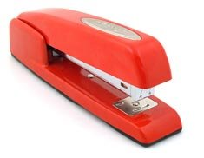
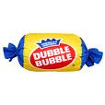
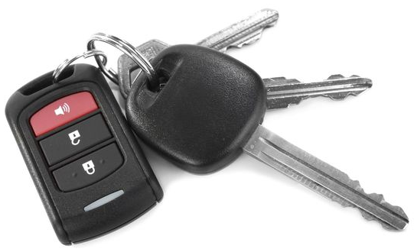
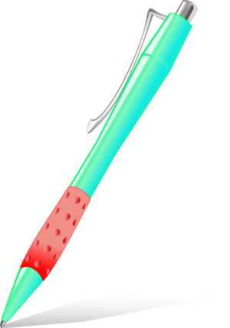
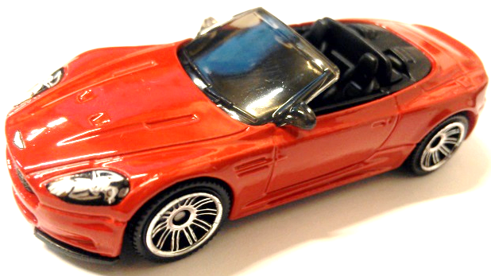
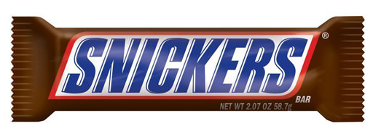

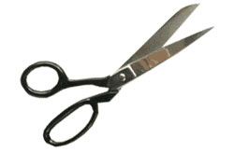
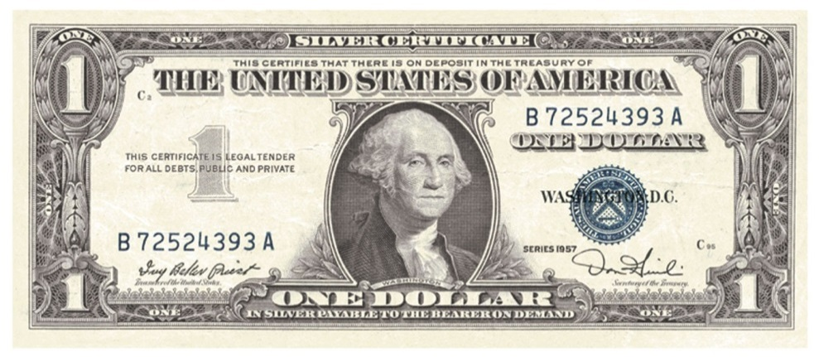
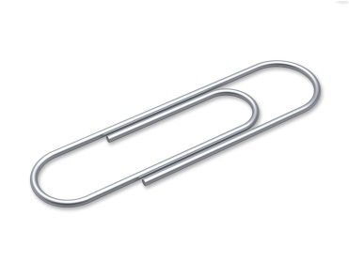
Memorize These
Notes:
Keys
Bubble gum
Toy car (convertible)
Stapler
Snickers bar
Peacock feather
Pen
Scissors
Paper Clip
Dollar Bill

Slide 5

Not To Worry
Normal
Memory
Troubles
Notes:
Some of these problems become more pronounced with age, but unless they are extreme and persistent, none is considered an indicator of dementia.

Slide 6

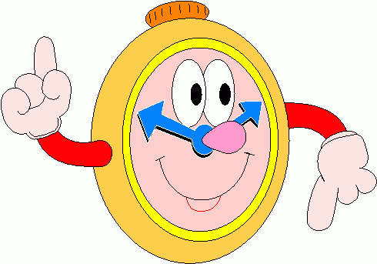
Transience
Forgetting over time.
Notes:
This is the tendency to forget facts or events over time. Although transience might seem like a sign of memory weakness, brain scientists regard it as beneficial because it clears the brain of unused memories, making way for newer, more useful ones.

Slide 7

Absent-mindedness
Not paying attention. Multi-tasking instead of single-tasking. Good memory requires us to be intentional. Focus. Focus. Focus.
Notes:
Absent-mindedness. This type of forgetting occurs when you don't pay close enough attention to what you are doing or hearing; for example, misplacing your glasses or car keys. Because you were thinking of something else, your brain didn't encode the information securely. Absent-mindedness also involves forgetting to do something at a prescribed time, like keeping an appointment.

Slide 8

Blocking
Temporary inability to retrieve information. Often similar (but wrong) information will emerge, which blocks the ability to find the correct information.
Notes:
Blocking. This is the temporary inability to retrieve a memory — "It's on the tip of my tongue." Blocking occurs when a memory is properly stored in your brain but something keeps you from finding it. In many cases, the blocked memory is similar to another one, and you retrieve the wrong one. This competing memory, though, is so intrusive that you can't think of the memory you want — like when you call your younger son by your older son's name.

Slide 9

Misattribution
Close but not complete.
You remember most of the information but get some of the details wrong.
Like playing horseshoes – you get credit for coming close even if it’s not a ringer.
Notes:
Misattribution. This memory problem occurs when you recall something accurately in part, but incorrectly recall some detail, like the time, place or person involved. As with several other kinds of memory lapses, misattribution becomes more common with age, for two reasons. First, as you age, you absorb fewer details when acquiring information, because you have somewhat more trouble concentrating and processing information rapidly. Second, when you get older, your memories grow older as well — and old memories are especially prone to misattribution.

Slide 10
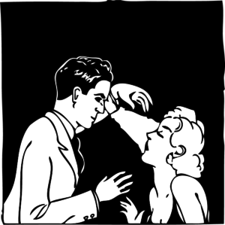
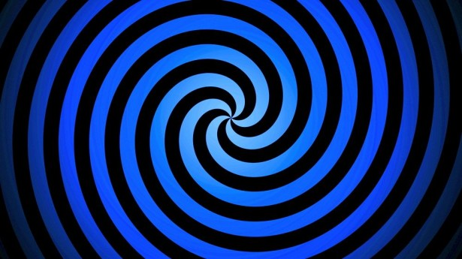
Suggestibility
Memory is altered based on outside suggestions (or even photographs).
Notes:
Suggestibility. This is the vulnerability of memory to the power of suggestion — information that you learn about an occurrence after the fact. Suggestibility can be the culprit in recollections of incidents from your childhood that never really happened.

Slide 11

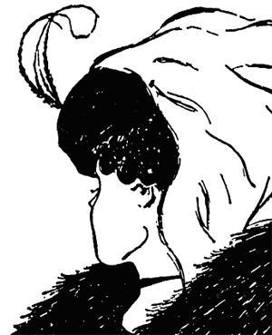
Bias
Memory “data” is recorded differently based on personal experiences, emotions, beliefs. Our perceptions filter the memory as it is stored.
Notes:
Bias. One enduring myth about memory is that it records what you perceive and experience with complete, objective accuracy. In reality, your perceptions are filtered and influenced by personal biases — your experiences, beliefs, prior knowledge and even your mood at the moment — both when a memory is being encoded in the brain and when it is being retrieved. People prone to depression, for example, remember negative information better than positive information.
Is the figure on the left a white vase with a fluted pedestal or the profile of two people in black staring at each other?
Is the figure on the right a young woman turned away with a feather in her hair, a hood, a black choker and a fur coat, or an older woman with a large nose staring down toward her feet?
If we “see” these things differently, we remember them differently.

Slide 12
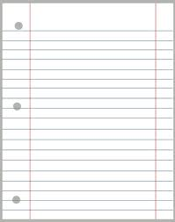
Grocery Lists
Bread
Milk
Apples
Eggs
Lettuce
Oranges
Notes:
Now we know what not to worry about. How can we make our memory sharper?
First let’s play a game. I would like you to memorize the items on this grocery list. Don’t write anything down, just try to memorize it.
Read the items out loud, about 1 sec each. Pause for approximately 5 sec when you’re done.
“Okay, does everyone have those?”
Transition the slide. Do not give more time.

Slide 13
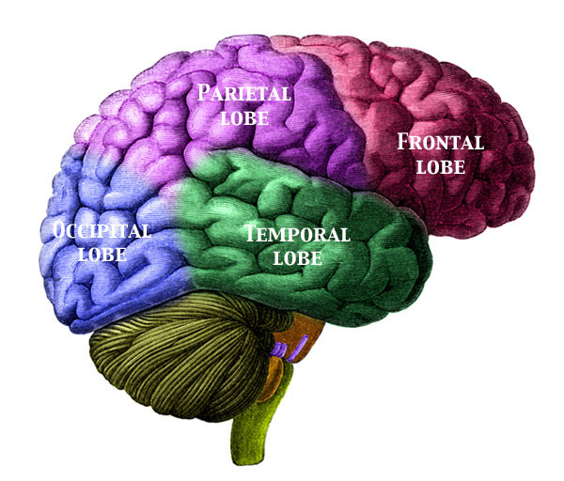
Brain Regions
Notes:
The grocery list we just reviewed will be used later. Let’s look at the main regions of the brain.
Right behind your forehead is your frontal lobe. This region is crucial for higher order thinking, reasoning, impulse control, critical evaluations and risk assessment. Up until about age 25 years, the frontal lobe is still growing and developing. When a teenager does a dangerous trick on his bike, it’s partly because his frontal lobe is underdeveloped and he can’t evaluate the risk very well.
In an older adult, a decrease in the function of the frontal lobe can mean that although they recently fell and hurt themselves, they are now carrying a heavy basket of laundry up the stairs. Their ability to evaluate that risk is impaired as the frontal lobe shrinks as we get older.
The parietal lobe is in purple. This region is important to memory and also has our motor control areas that help us move.
The temporal lobe is in green, it’s right behind your ears. This area is important for hearing and thinking about auditory stimuli. But it also houses the hippocampus – one of the most researched brain areas for memory.
If you move your hand down the back of your head to where your neck starts, this is where your occipital lobe for visual processing. Your eyes are in the front, but the part of the brain that interprets what we see is in the back of the head. This part of the brain stays stable with age, so when we have vision problems, it’s usually because our eyesight is getting worse not because our brain can’t interpret the images.

Slide 14
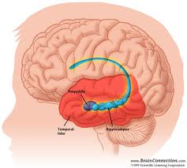
Memory Region of the Brain: Hippocampus
Notes:
The memory center of the brain – the hippocampus – is in the middle of the brain.” (Point out the hippocampus.)
If the human brain is a library that stock­s memories instead of books, the hippocampus is the main librarian.
It juggles the disposal of unnecessary short-term memories (like what you ate for breakfast last Tuesday) while cataloging materials for the permanent collection of long-term memory. It's not the only part at work, however, in storing this information. Different kinds of memory are stored in different areas of the brain. With such a large system, the brain needs a sophisticated way to store and retrieve memories.
The brain has to be able to pull information immediately, whether it's mundane data (such as a telephone number) or an experience that’s been in storage for years (your first kiss). No one likes a library that loses books or puts them on the wrong shelf. Yet sometimes our hippocampus is a confused or overworked librarian that doesn't pull up memories when we need them. Some of the memories are trivial, like when we tear apart our homes looking for glasses that were perched on top of our heads. Sometimes lapses are more embarrassing and worrisome, like calling an old friend "sport" because we simply can't remember his name.

Slide 15

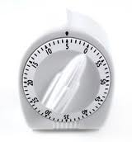
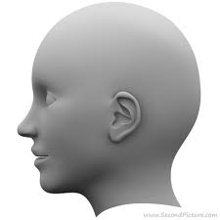

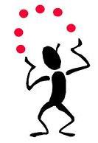
Memory Structure
Short Term Memory:
15-20 minutes
5-9 items
Experience
Long Term Memory:
Infinite Capacity
Brain Encoding
“Remembering”
Working Memory:
Juggling Ideas
Notes:
We experience the world as information enters our brains through our senses: touch, smell, sight, taste, and hearing.
This information is processed through different parts of the brain and then enters into short-term memory. Short-term memory is limited. It holds information for only 15-20 minutes at a time and can hold only about 5 to 9 items at a time. If information doesn’t leave short-term memory within 20 minutes to go into working or long-term memory, it is deleted as if you never knew it. Our short term memory can’t take in new information until it is cleared of old information. Which means if you aren’t paying deep attention right now to what I’m saying about memory, you won’t be able to remember it later.
From short term memory, information enters working memory, the work horse. Here we can rehearse information, manipulate and sort it, and think over ideas. Working memory is also limited -- think of it like a bucket of water that you can only have one of each day. You will have to ration it so you don’t run out. When it’s busy working, it takes up resources. Now, when it’s done, it can put the resources back in the pool to use later. This is similar to multi-tasking, your working memory can work with several different ideas at once, and can merge them or change them.
From working memory, information enters long term memory. Long term memory is like long term storage, once information makes it in, it can sit there forever. Long term memory is theoretically infinite. In theory, you can remember every moment of every day of your life. “Does anyone remember every moment of every day of their life?” (Pause for response.) Probably not, because not all the information we are exposed to will make it into long-term memory.
Only about 5-9 items at a time can exit short term memory and move into that limited bucket of working memory. So not everything makes it through the process into long-term memory. As we age, it may become harder to remember new information, like a doctor’s appointment, but we can recall details of our first ice-skating trip. This is because long term memory is very stable but short term memory gets shorter and can absorb fewer numbers of things.
Everything I’ve described up this point is about learning new information. We haven’t actually remembered anything yet.
The act of remembering is when we pull information out of long-term into working memory where it is used, manipulated or even changed. From working memory, we tell the stories of our childhood, we recite our phone number, we say the name of our friend. That’s why working memory is the true work horse of information processing, sorting and retrieving.
Any questions?

Slide 16
I’ll read a few pairs of words.
When I’m done, I’ll ask you to pick the two that go together.
Notes:
Let’s do a memory task. I will read lists of words. When I’m done, I’ll ask you to pick the two words that go together the best. It’s important that you don’t write anything down. I can only read the words once, so make sure you listen carefully.
Let’s start:
“Orange, Hot, Book, Cold,” What two words go together best? Have the group make their guesses.
NEXT SLIDE has the answer on it.

Slide 17
Hot, Cold
Notes:
“That’s right. Hot and cold are similar and describe temperature. Orange and book are not related.”
“Here’s another one. Ready?”
Read: “Soft, Dog, Boy, Hard”
“What two words go together?” CLICK NEXT.

Slide 18
Soft, Hard
Notes:
“That’s right, soft and hard. Here’s the next one.”
Read: “Hand, Nose, Ear, Toe”
“Which two go together best?”
You will hear mixed responses. Say. “Let’s vote. Raise your hand if you think, Hand and Toe. And who think Nose and Ear?” CLICK NEXT.

Slide 19
Nose, Ears
Notes:
“Nose and Ear are correct. They go together best, both are on the head. Hand and toe are different and don’t relate to each other as well. This one was harder because all four words are names of body parts, so it is more difficult to find the deeper comparison.” Foot and toe would have been similar, too, but that wasn’t an option.

Slide 20
You were using Working Memory
Listening and maintaining a list of information
Working with information you already know
Putting concepts together and making judgments
Notes:
This task is an example of working memory. You had to listen to what I read, maintain the list of words in your mind, and then decide what goes together best. Older adults commonly take longer to make respond to these kinds of tasks and make more mistakes than younger adults.

Slide 21

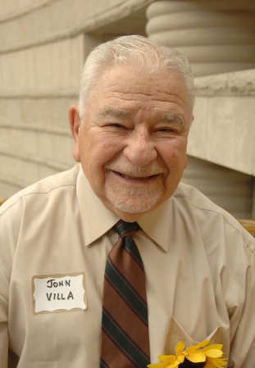



Brain
Association
Senses
John
Order
Memory
Principles
Movement
1,2,3
A,B,C
Symbols
Color
Numbers
2 + 2 = 4
Notes:
We can also distinguish memory functions by the different brain regions involved in capturing the experience: the Senses.
The brain processes each of the senses differently. Sense memories are very strong. If I ask what smell reminds you of home, almost everyone can recall their “home smell” quite vividly.
Our brains also process and remember are sense of motion different than stationary objects. When remembering movement, our brains actually recall a series of still scenes like pieces on a film strip. We can remember the act of moving, but we won’t actually remember images in motion, our memories work more like watching a movie.
Our brains will remember color differently than numbers, or symbols with meaning. And remembering information in a particular order, like 1,2,3, is different than just remembering the number 1.
For every type of information that we experience in our lives, our brains have a specialized process to capture, encode and store it. In addition, one particularly unique memory function is “Association.” Remembering a single item or a list of items is different than remembering bits of information associated with each other. For example, you may remember my name, or my face, but to remember my name when you see me in a few days requires associative memory.
We find that older adults can have worse associative memory, even though they may be able to remember a single item of information very well. So you may be able to remember my name later, but you’ll have a hard time recognizing me as “John” if we meet in grocery store a few days later.
TIP – we know that the more senses that we associate new information with, the greater the likelihood we will remember it. A conversation that takes place while hiking through the woods will be remembered more richly than one on the phone in your kitchen. The smells, sounds and colors of the forest add context to the conversation and strengthen the memory of it.

Slide 22
Do You Remember Your Groceries?
Notes:
Speaking of which, does anyone remember the grocery list? It’s been about 20 minutes since you saw it, so the list should have moved into long-term memory by now.
Have volunteers who thought they remembered all of them read their list.

Slide 23
Grocery Lists
Bread
Milk
Apples
Eggs
Lettuce
Oranges
“Long-term” memory example.
Notes:
Were they right? If you remembered all or most of this list, the information migrated into your long-term memory.
Talk about strategies used to remember them and why some of them might not have worked very well. Often, one of the participants will admit that they were not really paying attention to the list when it was first presented so they promptly forgot it. The next slides details common strategies.

Slide 24
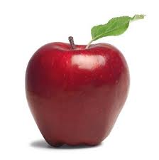
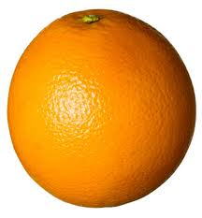
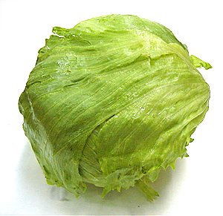
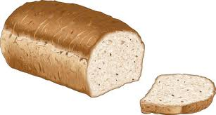
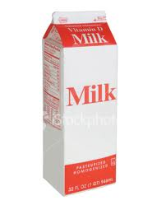
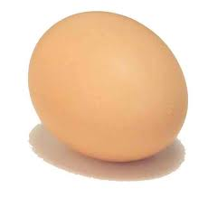
Memory “Tricks”
Organize by How You Walk through the Grocery Store
  PRODUCE: Apples, Oranges, Lettuce,
  BAKED GOODS: Bread
  REFRIGERATED FOODS: Eggs, Milk
Notes:
But here are some things that you can try to help you remember lists of information more easily. Rather than writing your grocery list in order of what you need, write the items in order of how you will walk through the store. Imagine yourself moving through the store, picking up the items. If you do this, you’re rehearsing the information while visualizing -- this is a good way to learn and remember information.

Slide 25
Memory “Tricks”
Group the Items (Chunking):
Notes:
Another trick is to organize information into groups. This is called chunking. So you can think of two groups: a produce group with apples, oranges, and lettuce; and another group with bread and dairy. These groups make sense to me, but maybe you would make different groups, do what seems most intuitive to you. This way, your mind needs to remember two groups of three, rather than six individual items. Remember short-term memory is limited to lists of about 5-7 items — two groups of three is easier to remember than six individual items.

Slide 26

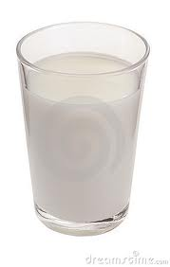
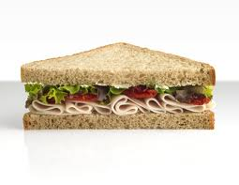
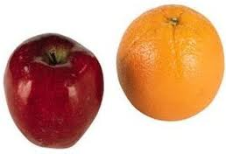
Memory “Tricks”
Association: Create a Story
  The woman made a sandwich for lunch. She used BREAD, EGGS and LETTUCE. She ate the sandwich with APPLES and ORANGES. She drank a big glass of MILK.
Notes:
Another way to study and remember information well is to put the items into a story. You wouldn’t probably do this for a grocery list, but I’ll use it for an example.
Read the story on the slide, emphasizing each of the CAPITALIZED WORDS.
When we make meaningful associations between items, we engage more parts of our brain, and we can remember things easier. The story helps trigger more of the items.
“Each of these strategies is INTENTIONAL. This means your are focusing, concentrating, intending to remember this information. Of all the “tricks” we can use to remember, being intentional is the most important. For instance, when you place your keys on the counter, say to yourself, “I am placing my keys on the counter.” Or “I am filing my tax return in the cabinet in the basement.” By noting the activity, we are much more likely to remember it.
You have to intentionally study information in these ways, and it may take a little extra time at first. With practice this becomes easier.

Slide 27
Is it a serious problem if I can’t . . .
Remember where I left my glasses?
Remember the name of the person I just met?
Remember my doctor’s appointment but can remember my childhood bedroom wallpaper? (Last in, first out)
Notes:
Not usually.
We don’t remember where we left our glasses, because we are not intentional when we put them down. And often other things are occurring at the same time, distracting us from the action. We need to pay attention to the action or the information never even makes it into short-term memory.
For names, repeat their name when you meet them. Say, Hi Donna, glad to meet you. Say it to yourself again. Then say it out loud again as you are leaving. That way your brain has engaged three times in a visual cue as well as a listening cue of the name and face.
Earliest memories are in long-term memory, which is very stable. They are also associated with a variety of senses and emotions, so it’s not surprising that those memories are easier to access than the mundane information of your doctor’s appointment.
It is Alzheimer’s???
THE FOLLOWING IS VERY IMPORTANT TO STATE CLEARLY: Memory decline is normal as we age. Everyone’s memory gets a little slower and less accurate over time. Forgetting a few things does not mean you have Alzheimer’s. Alzheimer’s is a much more profound and serious decline.
There will probably be a lot of questions about:
How is Alzheimer’s disease diagnosed? Currently, a person may be diagnosed with Alzheimer’s but cannot be confirmed until an autopsy is done after death. Even then, the markers we thought were definitive, are not exclusive to the disease. Normal aging can also produce some plaques and tangles in the brain, but without notable cognitive decline. So, we still just don’t know enough yet.
(2) How do I know if I have Alzheimer’s disease? The disease presents as severe forgetfulness. The saying goes, Forgetting where you put your keys is normal. Forgetting what keys are used for is serious. If you feel like you are becoming more forgetful, and it is interfering with your day to day life, then speak to your primary care physician. They can help you determine if there are other symptoms that may point to a different health issue, like cardiovascular disease or depression, or if there may be a lifestyle cause, like diet or sleep.
(3) Is there a cure for Alzheimer’s disease? Currently there is no cure. Researchers are working very hard to understand how the disease is different from normal aging and other forms of dementia. Until then, it’s difficult to know a cause, and so we can’t prevent it. You can try to maintain your current level of cognitive function by taking care of your heart health, good nutrition and physical activity, and staying mentally and socially engaged.
(4) Do games help keep your mind sharp? The marketing for mind games, like Brain Age or luminosity are a little misleading. Playing the games can help you get better at playing the games, but hasn’t yet been proven to improve overall memory. If you enjoy them, though, by all means do them, but they can’t cure Alzheimer’s or guarantee you won’t get it.

Slide 28
How to Increase Memory Function
Practice Makes Perfect
Use and Alter Your Environment
Chunking
Name Game
Pay Attention
Visualization and Association
Exercise
Drink in moderation
Reduce stress, get help for depression
Notes:
Practice paying attention, by reading a news article and then explaining it to someone else. Or watch a favorite TV show with your eyes closed and try to match the voice with the actor.
Put items by the door so you remember to take them in the morning. Put a calendar at the bathroom sink so you see it first thing in the morning. If you need to pick up prescription, leave the empty bottle by front door.
Group things together by category, alphabet, number or any other way that makes sense to you.
Name Game: Use this to remember names by using rhyming or making a unusual connection. Remember “Mary” by thinking of her with a little lamb. Or Mary “Berry” because she was wearing a purple sweater when you first met.
Pay Attention. Make a verbal note, silently or out loud, of what you are trying to remember.
Visualization is seeing the picture of the experience in your head. As with the grocery list, you don’t just remember the words, you actually see the items in the grocery store aisles. Or see yourself walking into your doctor’s office at 10 am on Monday.
Exercise helps blood flow to the brain and is important to all organs in the body. 25% of all the blood pumped per heart beat goes directly to the brain, so keep your heart strong. Aim for 30 minutes three times a week of aerobic exercise where your heart beat is slightly elevated.
Excessive drinking leads to short term memory loss. Confine drinking to light to moderate, which means no more than 2 glasses of wine or bottles of beer a day
Depression contributes to memory loss. It makes new information harder to learn and impedes our ability to access memories. Depression also increases the stress hormone cortisol which has been shown to contribute to Alzheimer’s.

Slide 29
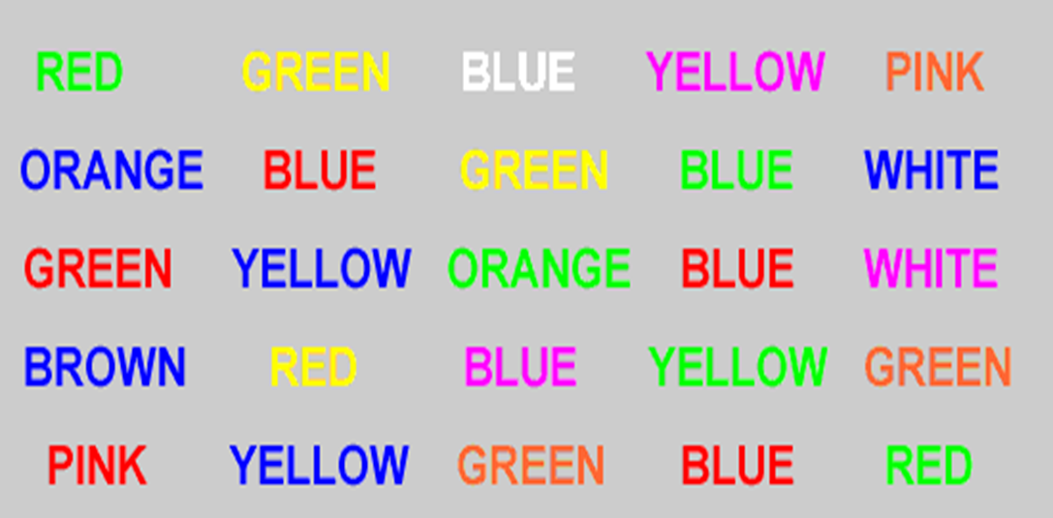
Stroop Test FOCUS
http://faculty.washington.edu/chudler/java/timesc.html
Notes:
Here’s a test of working memory and your ability to suppress primary information. It also measures your ability to focus, concentrate and choose what to pay attention to.
This test was developed by a researcher named Dr. John Stroop. First lets read the words we see in each column: Red, Orange, Green, etc. Go through the whole list.
Next ask the participants to read out the color of the word (not the word itself, only the color). Most people will find this much harder, especially to do quickly. The brain keeps reverting back to the word because we are primarily readers of words. The language center of our brain is strong and usually dominant. To do the Stroop well, we must suppress the urge to read the word and force a different part of our brain to engage and tell us the color instead. This is very difficult but with practice you can get better and help to make your brain a bit more nimble.
Other versions of Stroop are available online at the link at the bottom of the PPT slide.

Slide 30
Remembering Stuff
Write down all the objects on the tray
Notes:
After you reveal the tray, ask everyone how many they got write. Ask the folks who got the most right what strategies they used to remember. This should be a rousing discussion about how memory works. Did people place objects into categories? Did they take a mental picture? Did they concoct a bizarre story? Engage the group in analyzing how well they did and how they could improve in the future.
This works well as a review of the lesson and a double-check of how well they remembered what they learned.

Slide 31
Can You Remember the Items on the Virtual Tray?
Write them down?
How many do you think there were?
Who wants to share?
Notes:
Let participants share and discuss what they remembered. Compare differences and similarities.
Talk about strategies for remembering. These items could easily be grouped or chunked.
Office supplies.
Keys – for the office and for the car.
Two things you can eat.
How did people make the feather fit in? Or is it easy to remember because it doesn’t fit? Some people might remember the pen with the feather as in feather or quill pen.

Slide 32
Memorize These
Notes:
Keys
Bubble gum
Toy car (convertible)
Stapler
Snickers bar
Peacock feather
Pen
Scissors
Paper Clip
Dollar Bill

Slide 33
Take Home Messages
Everyone forgets. Some forgetting is necessary
Use “tricks” to strengthen your memory
Practice these tricks daily
Stay active: At least 30 minutes, 3x/week
Adhere to your prescriptions
If memory issues are affecting your daily life see your physician
Notes:
We talked about some tricks you can do to help you remember more easily, and you should practice the tricks to become better at them. It’s also important to take care of your health: so try to engage in moderate activity a couple of time a week, and then keep up with your prescriptions.
Ask what sorts of changes, if any, the participants are planning to make based on what they learned today.

Slide 34
Resources
Aging in Brain Found to Hurt Sleep Needed for Memory, BENEDICT CAREY, January 27, 2013, New York times
Alzheimer’s Disease Education and Referral (ADEAR) Center, P.O. Box 8250, Silver Spring, MD 20907-8250,www.alzheimers.nia.nih.gov
Citation: Uttl B (2008) Transparent Meta-Analysis of Prospective Memory and Aging. PLoS ONE 3(2): e1568. doi:10.1371/journal.pone.0001568,Academic Editor: Ernest Greene, University of Southern California, United States of America

