Slide 1
^{Institute of Gerontology}

Slide 2
^{Lesson 6: Living Social}
^{Institute of Gerontology}
Notes:
Staying socially connected is important to healthy aging. The support we receive from our friends, family, and colleagues helps maintain our mental health. Studies have shown that those who are engaged with family and community groups take longer to show the symptoms of Alzheimer’s disease than those who are socially isolated. So let’s fight off signs and symptoms of Alzheimer’s by being social. You are lucky here at a senior residence where you have classes, activities, and shared dining rooms, where it is easier to meet others and be social.

Slide 3
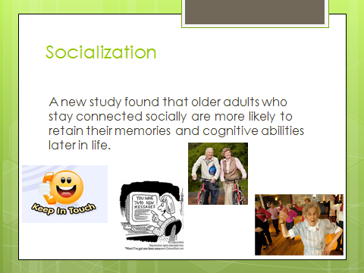
Notes:
Socialization is getting together with people and conversing, being part of a group or activity. Much like what we are doing today.
Why does socialization affect memory and cognitive abilities? Those who suffer from any sort of dementia feel isolated from other people which often leads to anxiety, depression, social withdrawal, and decreased self-confidence. Exercise is more likely to be done when it is social; walking clubs, water aerobics, etc. The same applies to eating. You are lucky to live in a community where there is always someone to eat with, converse while eating, develop friendships. When we are alone, we might not even bother to eat, which can lead to poor nutrition and brain function problems.
Research shows that socialization contributes to our cognitive reserve, which is another way of saying extra brain ability beyond the basics needed to survive. This reserve can help us delay the symptoms of Alzheimer’s and dementia, because we have extra brain power to keep us functioning well even after our brain suffers some damage. Researchers found that a large group of seniors with strong social connections could maintain their memory and thinking skills even though some had actual physical signs of dementia.
Socialization sounds easy, but it isn’t always. As we age our social skills can erode, plus we are likely to experience loss of friends or family, compromised health, mobility issues. All these make it more difficult for us to participate in social situations. The term use it or lose it applies to social engagement as much as it does to exercise. Let’s talk about how we can promote socialization.

Slide 4
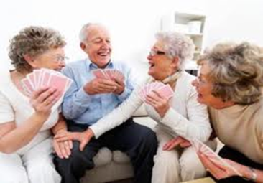
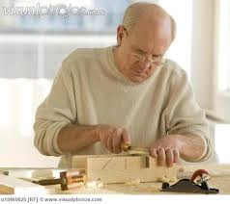
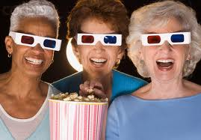
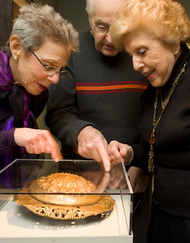
Socialization
Even if you’re not “a joiner” there are
ways to stay socially engaged
Club or activity
Make a list of your skills & talents
Cultural and other public events
Notes:
Talk about different clubs and activities that are available to them. Discuss ways to use our talents and gifts as we get older: local theater, mentoring, tutoring, art classes, choirs, etc.
How to start a new club for your skills, example of woodworking or knitting, etc
Go to the movies or museums as a group, outings to restaurants, etc.

Slide 5
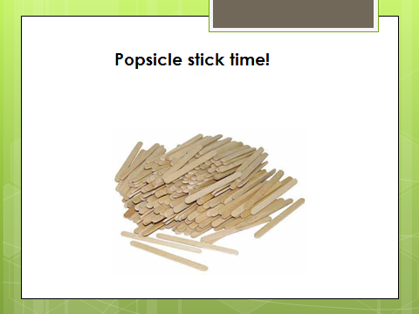
Notes:
FIRST – place a pile of popsicle sticks or straws (any kind of prop you can use as counters) in front of each group of two persons.
Break into groups of two (ask people to not pair with someone they know well) and start talking about what you have in common. Each time you find something significant that you have in common put a stick in a pile in front of you. One stick equals one thing in common. This is your way to add up all the things you have in common. Ask questions out of the ordinary to learn things like how many children or grandchildren you each have, places traveled, foods you love, hobbies, anything you can think of to see how many links you can find. You have 5 minutes.
Afterwards, each pair will count their sticks and talk about the folks who had very high numbers (why) and low numbers (why). Also ask for the most unusual trait that two people had in common. Any other surprises? Keeping our social connections vibrant and learning how to start a friendship is good for our mind and our body. And we often have more in common with the strangers nears us than we imagine.

Slide 6
Emotions and Relationships:
People with many social contacts – a spouse, a close-knit family, a network of friends, church, or other group affiliations – lived longer and had better health.
People who were socially isolated had poorer health and died earlier. In fact, those who had few ties with other people died at rates two to five times higher than those with good social ties.
Notes:
Researchers describe the results of a nine-year study of 7,000 elderly people living in California. Read the slide.
Oscar Ybarra, a psychologist at the U-M Institute for Social Research, found that “socializing was just as effective as more traditional kinds of mental exercise in improving memory and intellectual performance.”
So with all this backing of research and the importance of socialization on our cognitive function, how do we build our social network?
Next Slide

Slide 7
How to Build a Social Life as an Older Adult
Determine what activities you most enjoyed when you were younger
Return to keeping fit
Find a buddy
Be open to new suggestions
Remain positive
Think outside the box
Notes:
Did a recent loss cause you to set aside favorite hobbies or pursuits? Pick up where you left off. Or try new activities with the help of a local club, group, church or even Internet and library research. Use the local newspaper to keep abreast of upcoming events of interest. Visit university lectures on topics you know nothing about to stretch your imagination and improve your knowledge
While you might not be up to making your dreams of climbing Mt. Everest come true, you can continue to be physically active. Try Pickle Ball or Feather Bowling or any other new endeavor. Of course, there’s also group walking, the gym, fitness clubs especially for seniors. Staying fit builds confidence and maintains health and a positive outlook.
Invite a friend or neighbor to attend events with you. Get back into the rhythm of meeting new people. Try not to react negatively to suggestions from others who try to help. You may discover something new and fun that you wish you'd tried earlier.
Try to smile. Smiling induces positive chemical changes in the brain and elevates our mood. Take in a light movie or rent an old classic to watch at home. Listen to comedy on the radio or TV, or read a humorous book and have a good hearty chuckle. Rediscover your sense of humor and your well-being will improve, especially if you have buried yourself under sadness, self-pity and sorrow.
Be inspired by stories of brave new endeavors being accomplished by older adults, like cycling across countries, skiing, writing a first novel, entering the Masters' Olympic Games, etc. Many new accomplishments are possible with the right attitude. Dream big, keep trying, and include others to widen your social circle.

Slide 8
Group Poem Time
You have 10 minutes
All members look at the picture. Take in all the details. Use your senses.
Designate “The Writer” to put it on paper
AS A GROUP, decide on a title for your poem
INDIVIDUALLY, have each member of the group write in a line to the poem, building on the line before it.
Read poems aloud to share among groups
Notes:
Choose pictures in advance, perhaps from magazines or personal photos, or use the options given in the next slides. Try to find photos that represent universal life experiences or unusual or funny events. The photo should show some kind of activity happening.
Give each table a picture. It can be fun to give the same photo to a few different groups and compare how they each approach it to create their poems. This exercise can work with groups as small as 2, but is best with 4 to 5.
Encourage the groups as they write to add some humor, emotion, and to include the senses. After 10 minutes, ask one person from each group to read their poem aloud.

Slide 9

Group Poem
Example
Moon Beam
The moon shines bright above the pond
Clouds part for us to see beyond
Our eyes are droopy and we yawn
I need to sleep before the dawn
Notes:
NOTE: The next slides are photos that can be used to inspire the poems. Print them out in advance to pass out to the groups. Assign a photo to each group or the same photo to a few groups. Then as the poems are read you can display the photo on the screen for all to see.

Slide 10


Slide 11


Slide 12
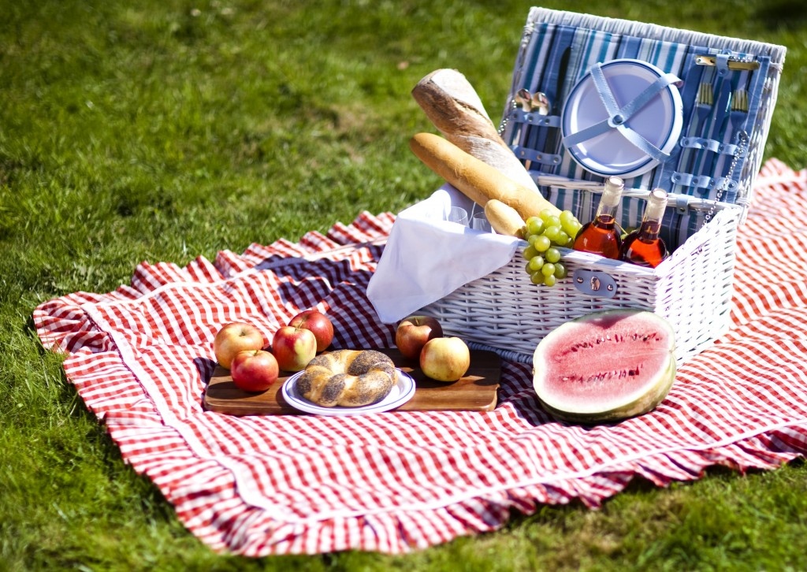

Slide 13
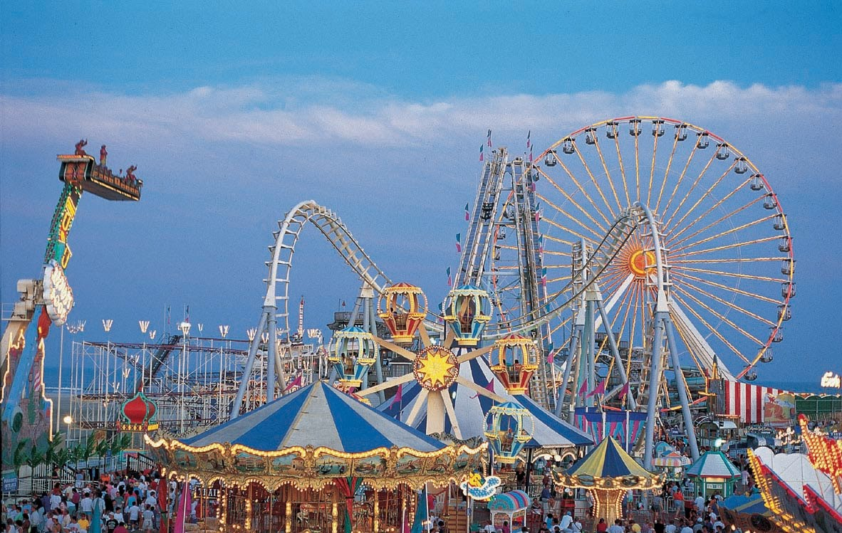

Slide 14
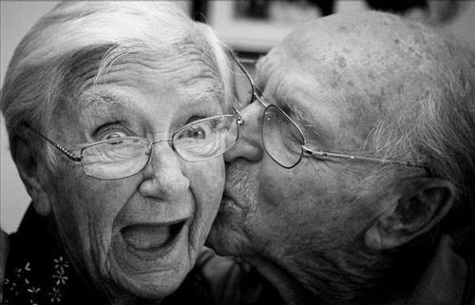

Slide 15


Slide 16
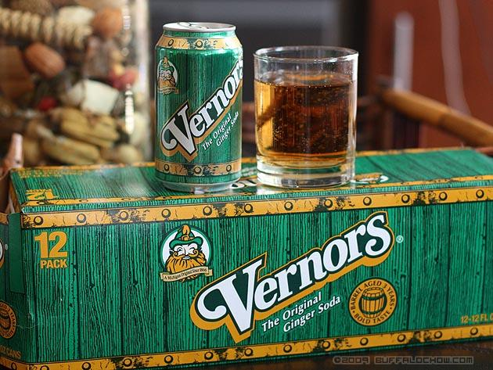

Slide 17
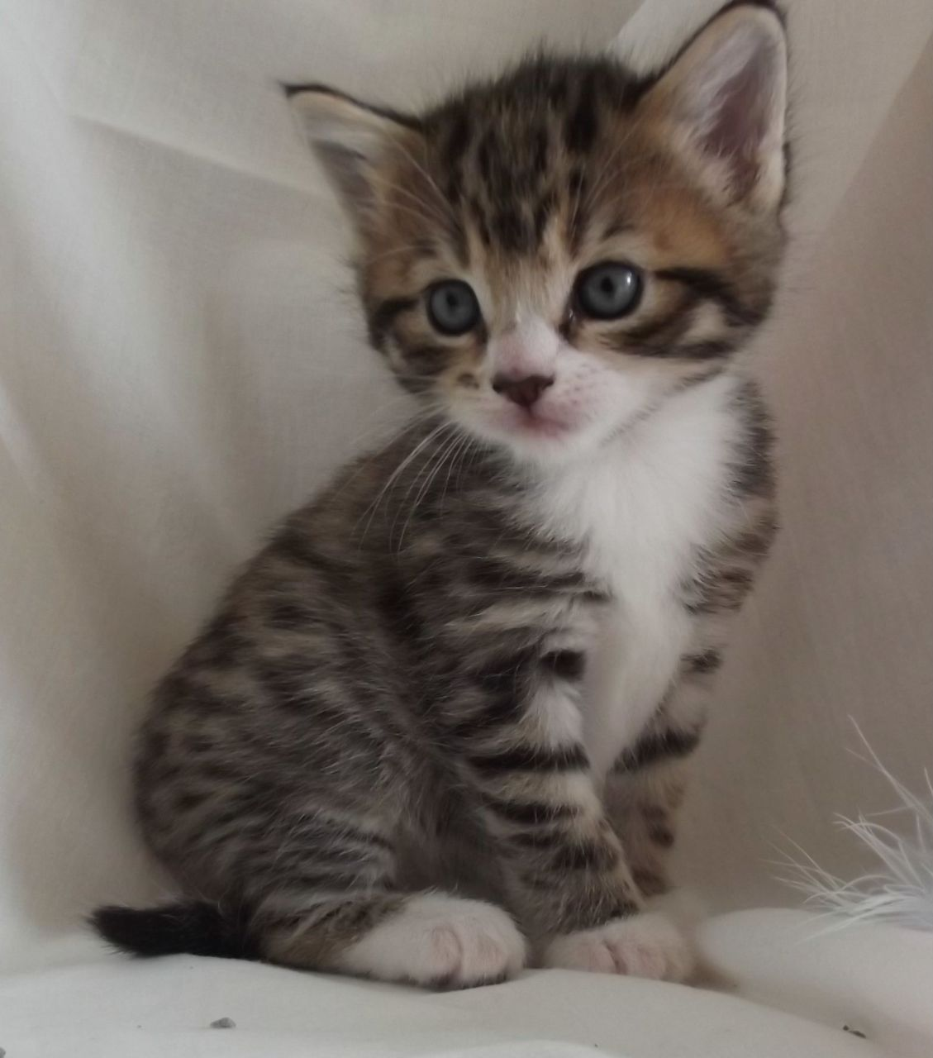

Slide 18


Slide 19
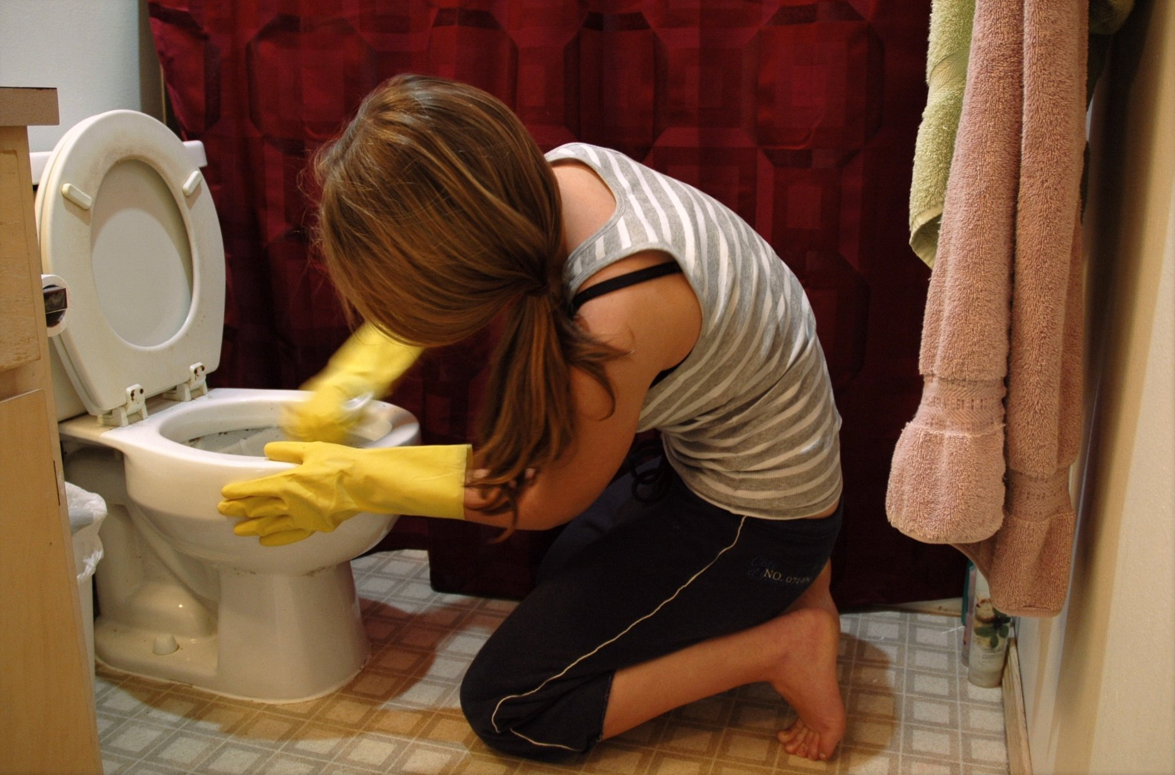

Slide 20


Slide 21


Slide 22
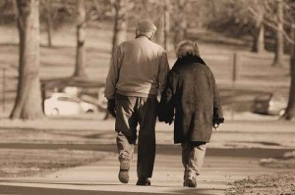

Slide 23
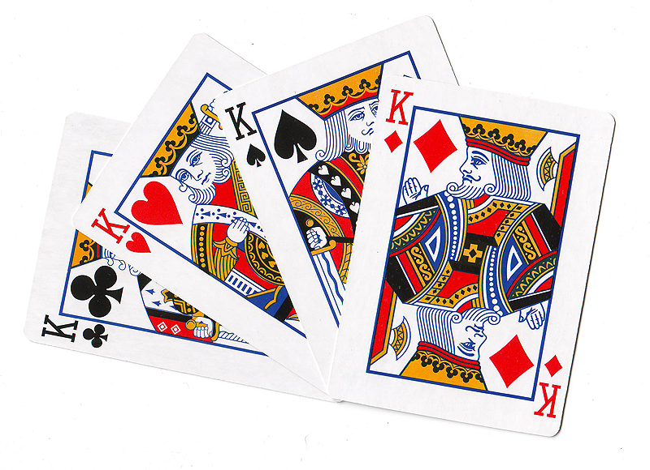
Bridge is King
25 million players in the US
Majority of them are over 50
Large scale trial in Finland showed that combining mentally challenging games with social activity improved memory and thinking in folks at risk for cognitive decline.
Bridge (or Pinochle) offer intellectual and social stimulation.
Notes:
Besides – Warren Buffett and Bill Gates love it. Seems to be doing a good job keeping their brains sharp.
Bridge players have to use memory, visualization and sequencing – all challenging for the brain. There are accommodations of disabilities like blindness. It costs very little to buy a deck of cards. You can play it sitting down. Billions of possibilities when playing. “Every hand is like a snowflake.”
Lily Hansen, 103, of Ludington, Michigan has played bridge for 90 years. She is a Silver Life Master with 1,000 lifetime masterpoints from the American Contract Bridge League. She plays twice a week and is a director of a duplicate bridge club. She’s still driving – “Duplicate bridge is competitive. It keeps your brain working. I honestly believe that.”

Slide 24
Crash Course on Parts of Speech
A NOUN is a person, place or thing, such as:
a cat, a building, Paris, Uncle Bob
A VERB describes action, such as:
run, drive, giggle, jump
An ADJECTIVE describes a noun, such as:
tasty, red, large, beautiful
An ADVERB describes a verb, such as:
quickly, thoughtfully, softly, eagerly
Notes:
Review the parts of speech and answer any questions.

Slide 25
Adjective:
Adjective:
Noun:
Noun:
Animal (Plural):
Game:
Plural Noun:
Verb Ending In "ing":
Verb Ending In "ing":
Food (Plural):
Verb Ending In "ing":
Noun:
Plant:
Part Of The Body:
Place:
Verb Ending In "ing":
Adjective:
Number:
Plural Noun:
Notes:
Write down their answer, call upon a different person each time. Write their answers on your handout.

Slide 26
Vacations
By the BrainStorm Gang
A vacation is when you take a trip to some 1 place with your 2 family. Usually you go to a place that is near a/an 3 or up on a/an 4. A good vacation is one where you can ride 5 or play 6 or go hunting for 7. I like to spend my time 8 or 9. When parents go on vacation, they spend their time eating three 10 a day. Fathers play golf, and mothers sit around 11. Last summer, my little brother fell in a/an 12 and got poison 13 all over his 14. My family is going to go 15, and I will practice 16. Parents need vacations more than kids because parents are always very 17 and, because they have to work 18 hours every day all year making enough 19 to pay for the vacation.
Notes:
Read the silly story they created. See how much fun it was to review those parts of speech? This exercise shows how enjoyable the unexpected can be, since the story doesn’t come out like you think it will.

Slide 27
Resources
Forging Social Connections for Longer Life, March 26, 2012, Jane E. Brody, New York Times
“Successful Aging,” © 1998, John Rowe, M.D.,
and Robert Kahn Ph.D. and Robert Kahn, Ph.D.
Glass, T.A., Mendes de Leon, C.F., Marottolie, R.A. & Berkman, L.F. (1999). Population based study of social and productive activities as predictors of survival among elderly Americans. British Medical Journal, 319(21), 478-483.
Generations-Journal of American Society on Aging People, Do need People: Social Interactions Boosts Brain Health in Older Age, summer 2011

